Slide 1
Transmission of unknown inherited diseases in assisted reproduction technology – what to do.
Safety and Traceability for the Patients
Dea Svaneby, MD, Clinical Geneticist

Slide 2
The World’s
Largest Sperm
& Egg Bank

Slide 3
Agenda
How we handle (genetic) conditions
Child with disease, what to do
Quarantine, Block, Release
Information: to whom and how
Different perspectives: donor, Customer, Clinics, other
Questions

Slide 4



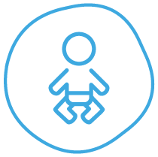


How we handle genetic conditions
RELEASE:
Donor cannot be the cause and the report can be rejected
EVALUATION:
Donor might be the cause – investigation continues
RELEASE:
Donor cannot be the cause – the donor is released again
BLOCK:
The condition is registered on the donor’s files and Summary of Records. Consent must be signed before use.
REPORT:
Donor or donor child disease discovered and reported to Cryos
Assessment of report
QUARANTINE: Donor might be the cause
Analysis and evaluation
RELEASE:
Donor cannot be the cause
– the donor is released again

Slide 5
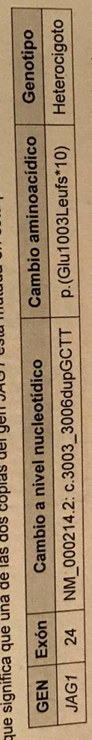
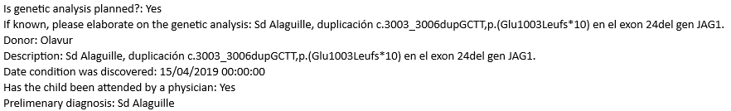
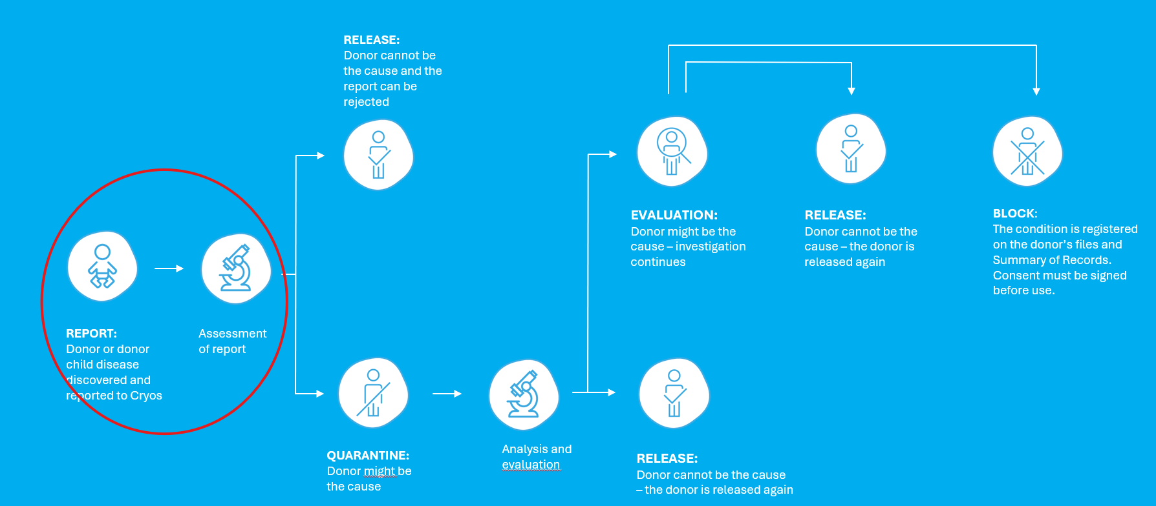
Case: Child with Condition
Alagille reported in donor concieved child

Slide 6
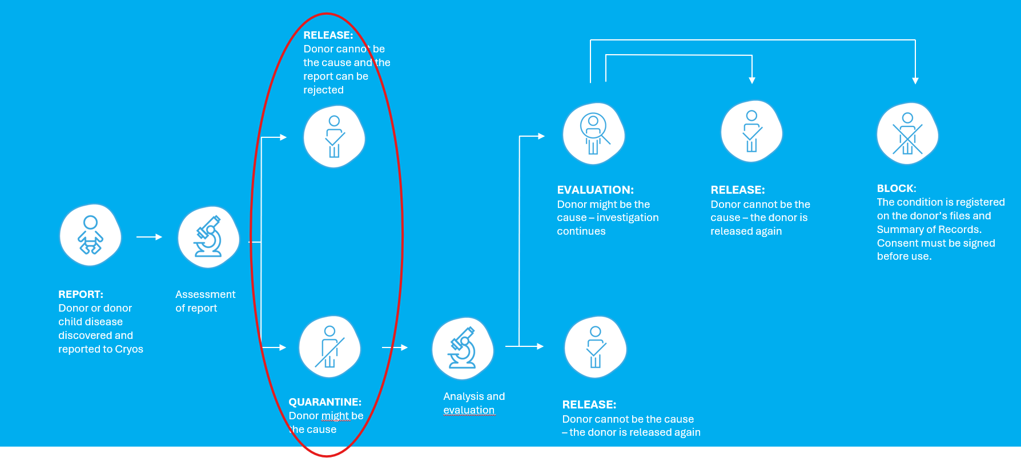
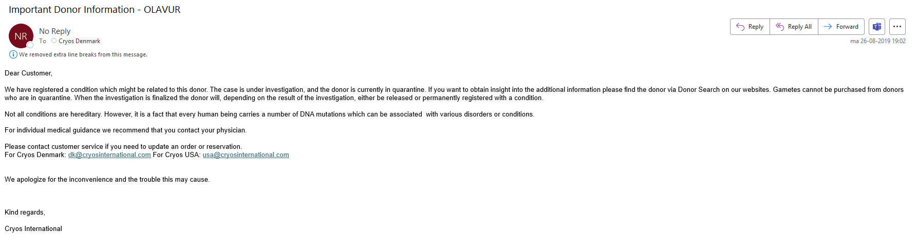
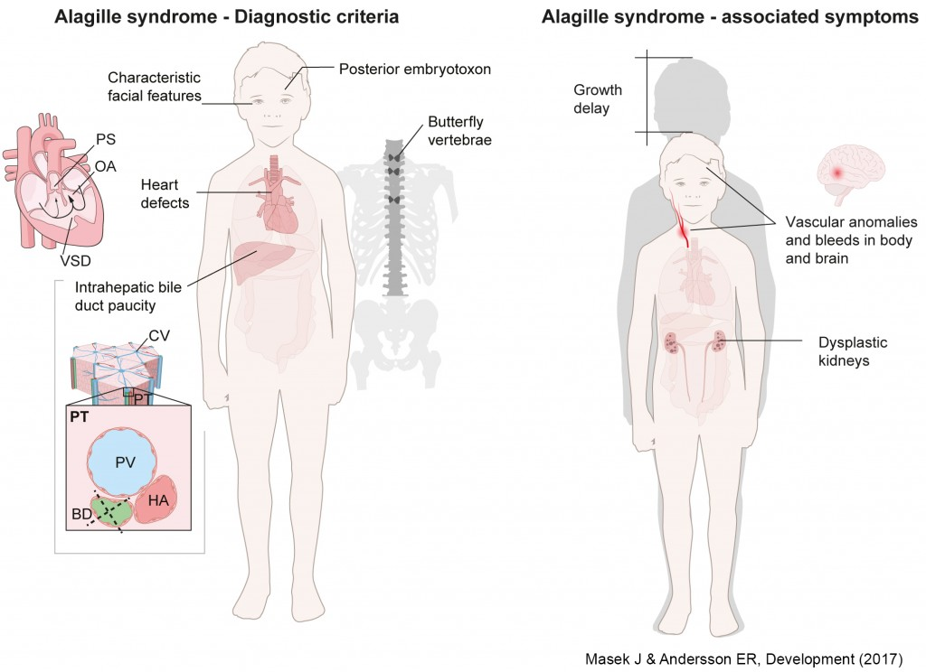
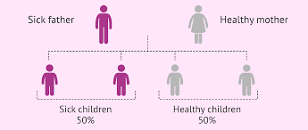
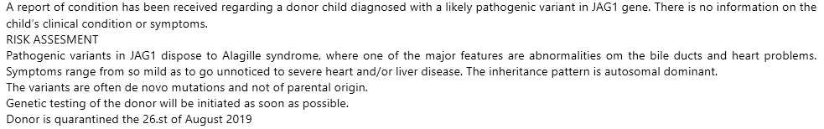
Evaluation and Information
Manual process:
Disease assesment
Heritability assesment
Recurrence risk above 1%?
General description
Donor is Quarantined
Automated process:
Information sent to Clinics who have bought or
reserved the donor
Clinics are informed by mail
Donors in quarantine can not be sold or send
General description visible on our website

Slide 7
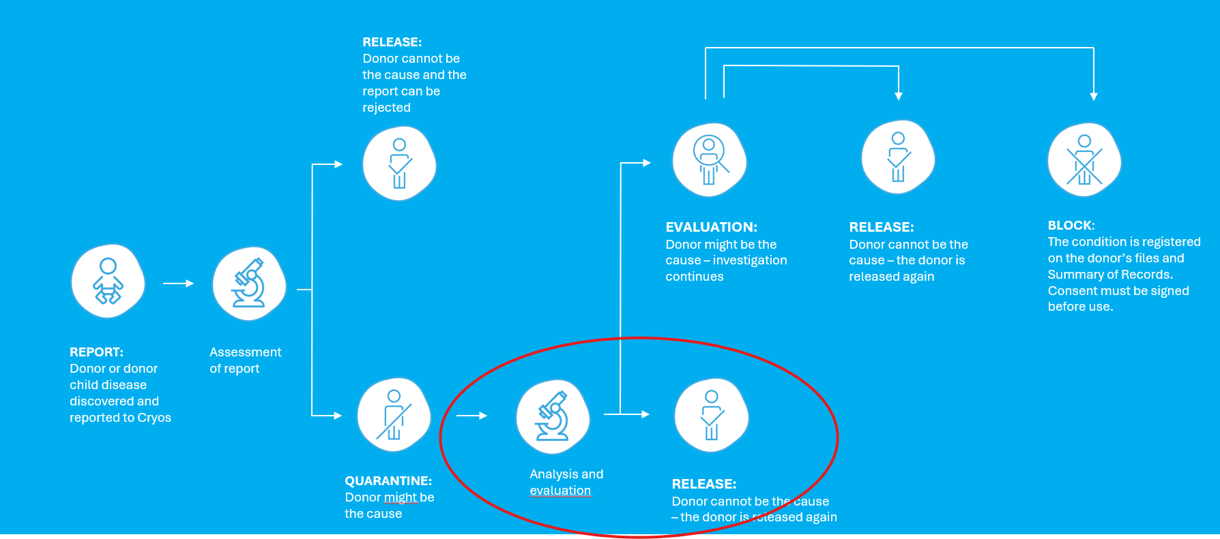
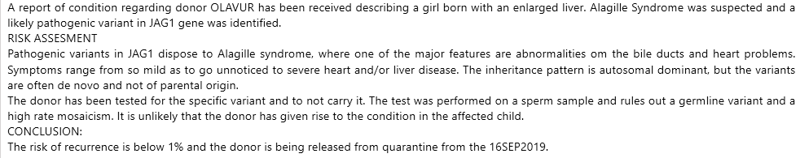
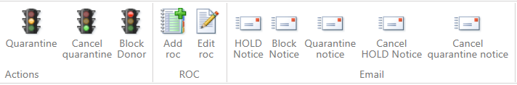
Test of Donor and Evaluation
Manual process:
To test or not to test
Always external testing
Recurrence risk above or below 1%?
General description
Donor is Released
Automated process:
Information sent to Clinics who have bought or made reservation
Clinics are informed by e-mail

Slide 8
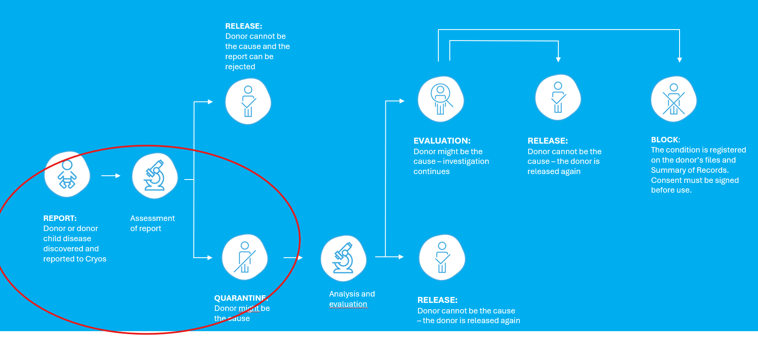
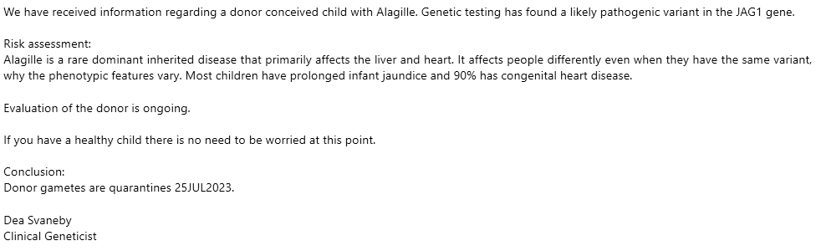
A second child with same disease years later
Two children with same genetic variant
Several pregnancies are reported world wide (>10)
Healthy donor

Slide 9
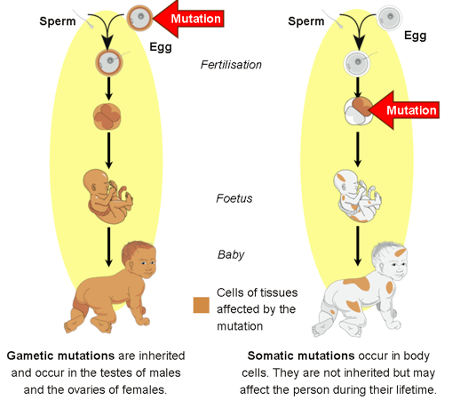

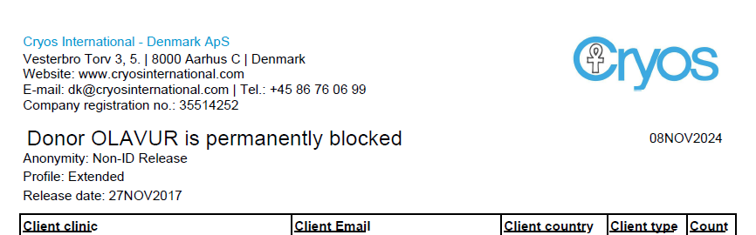
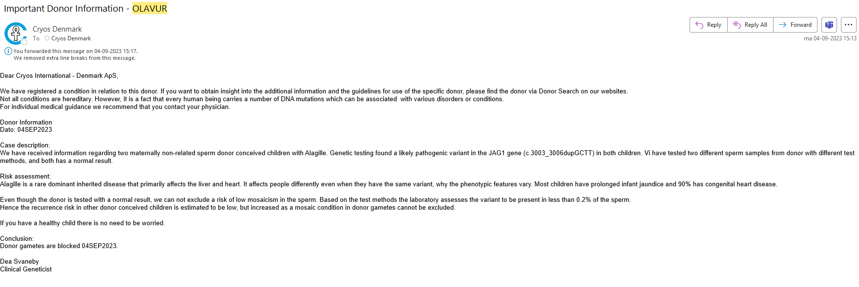
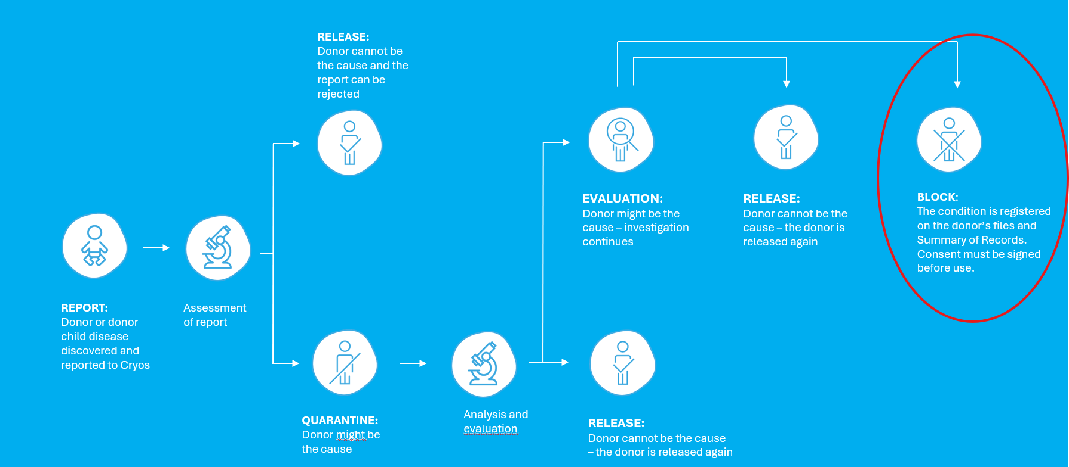
Donor evaluation
New genetic test and evaluation
Sperm mosaicism could be low grade
Donor is Blocked
Automated process:
Information to Clinics & Patients
Information on website
Informed by e-mail

Slide 10
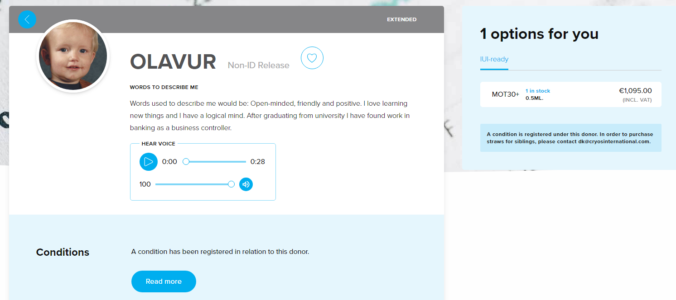
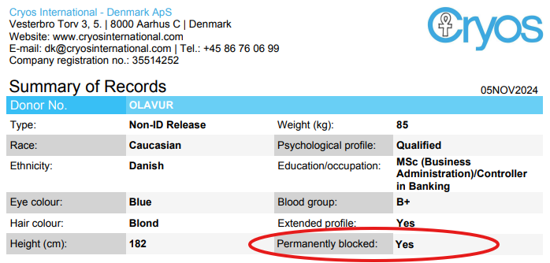
Use of a Blocked donor
Only for siblings
Signed consent from Customer
Information on Website
Information on Donor Summary

Slide 11

What about the donor?
He/she is informed
He/she must consent to genetic test
He/she receive a genetic report if positive
He/she receive genetic counseling
Donor reply
Concerned about own children
Concerned about family members

Slide 12
What about the other families out there?
We do our best to ensure Traceability
We do our best to ensure Safety
We follow the legislation
For the donor children and their families

Slide 13
Any questions?
Dea Svaneby
MD, Clinical Geneticist
Mobile: +45 92822497
E-mail: gen@cryosinternational.com

Slide 14
CRYOS Quota System
Why?
What?
Cryos System is set up to limit the donations according to max per country of treatment
How ?
A robust tool offering clinics a guarantee towards the Authorities but also towards patients !
Example: 6 families per donor with treatment in Belgium
100 % secure handling of pregnancy slots per donor
The Quota Reservation is a preregistered pregnancy which means that a Clinic (patient) holding a Quota Reservation is ensured a pregnancy slot within the national limit.
A Quota is automatically added when placing an order
If a fertility clinic does not report a pregnancy, the Quota remains blocked on the clinic’s account.

