Slide 1
Handling and processing errors impacting on MPHO safety and quality:
what does the NOTIFY LIBRARY show us?
Evangelia Petrisli
on behalf of the Notify Team
Forum30 – The MPHO Safety and Traceability Summit
14-15 November 2024
Rome, Italy

Slide 2



Background
Resolution 63.22 of the World Health Assembly was adopted in 2010 and gave WHO a mandate to facilitate Member State access to appropriate information on donation, processing and transplantation of tissues, cells and organs, including data about serious adverse events and reactions.
NOTIFY Project: optimising global vigilance and surveillance for MPHO

Slide 3

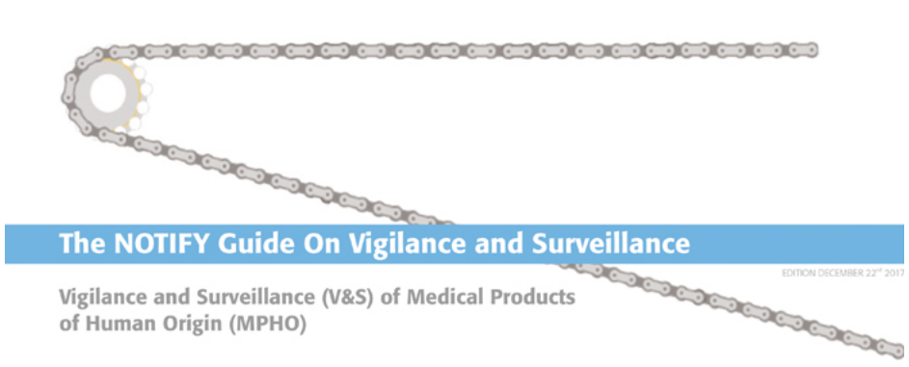
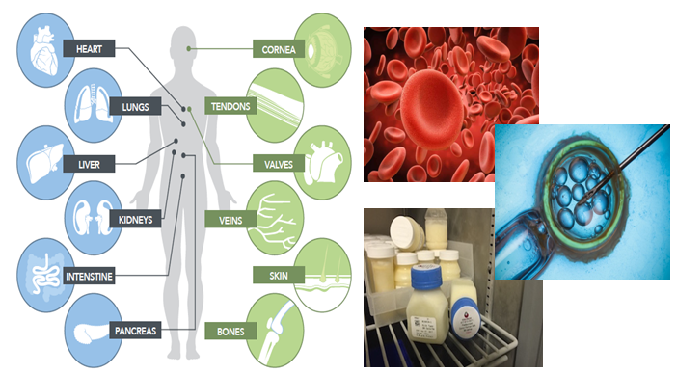

NOTIFY website:http://www.notifylibrary.org

Slide 4
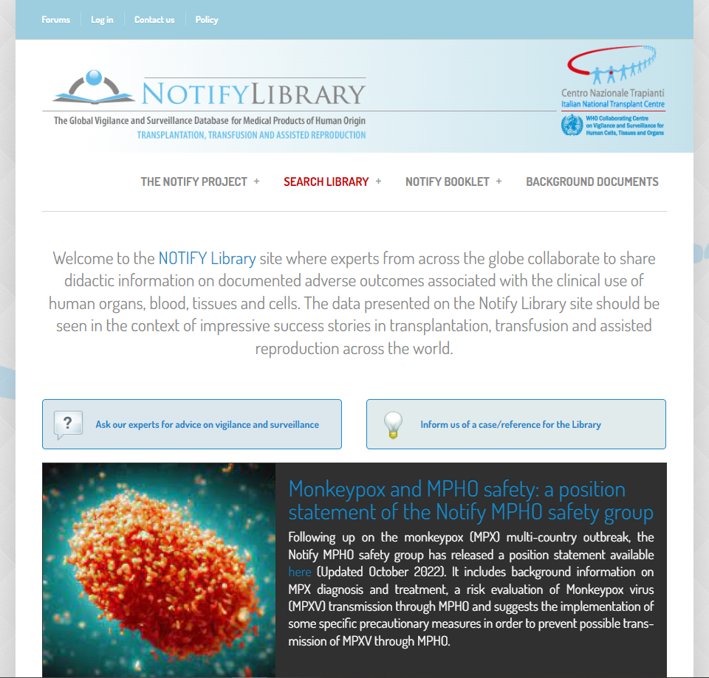
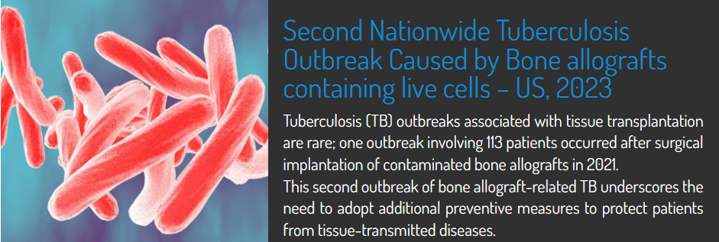

The NOTIFY Library
publically accessible online database of didactic cases of severe adverse reactions and events
from procurement and processing to clinical application of blood, organs, tissues and cells used in transfusion, transplantation and medically assisted reproduction
cases collected and analyzed by 5 dedicated editorial groups of international experts, regulators and clinicians and linked to their source reference

Slide 5
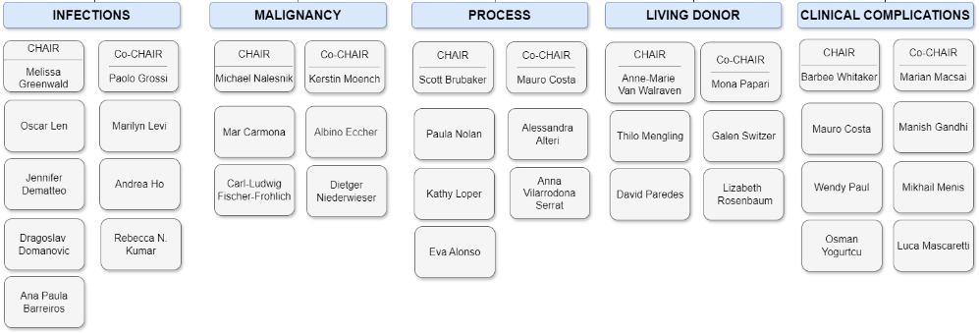
Editorial groups
Available at: https://www.notifylibrary.org/content/who-we-are

Slide 6
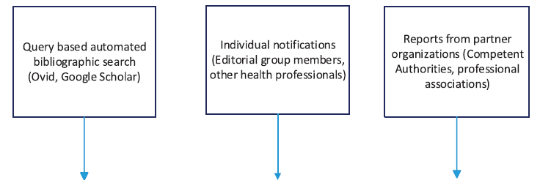
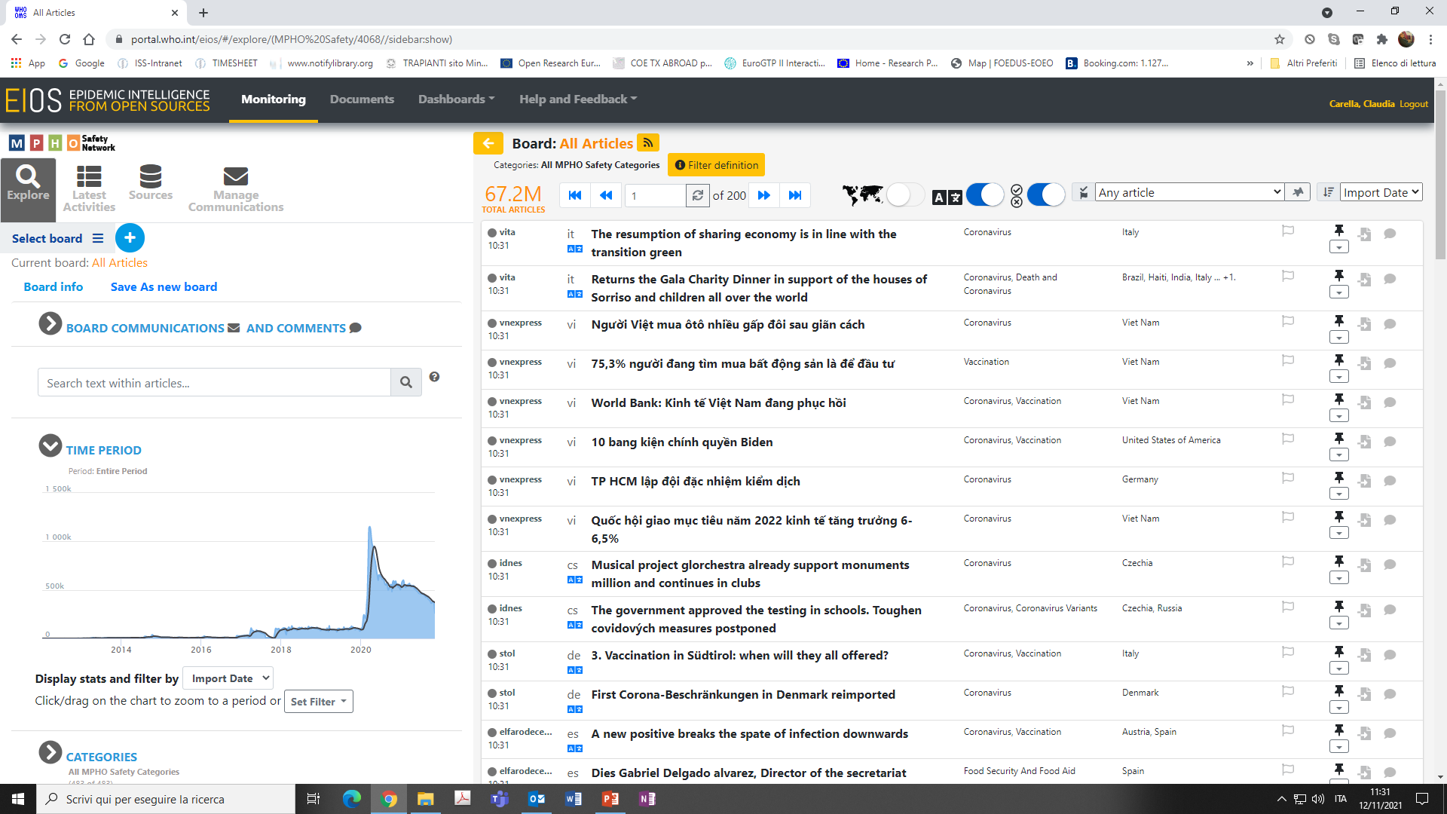
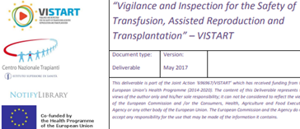
Reference sources
Literature review
Grey literature
Estimation of risk for MPHO donation or clinical application
Implementation of changes in routine procedures to avoid recurrence

Slide 7
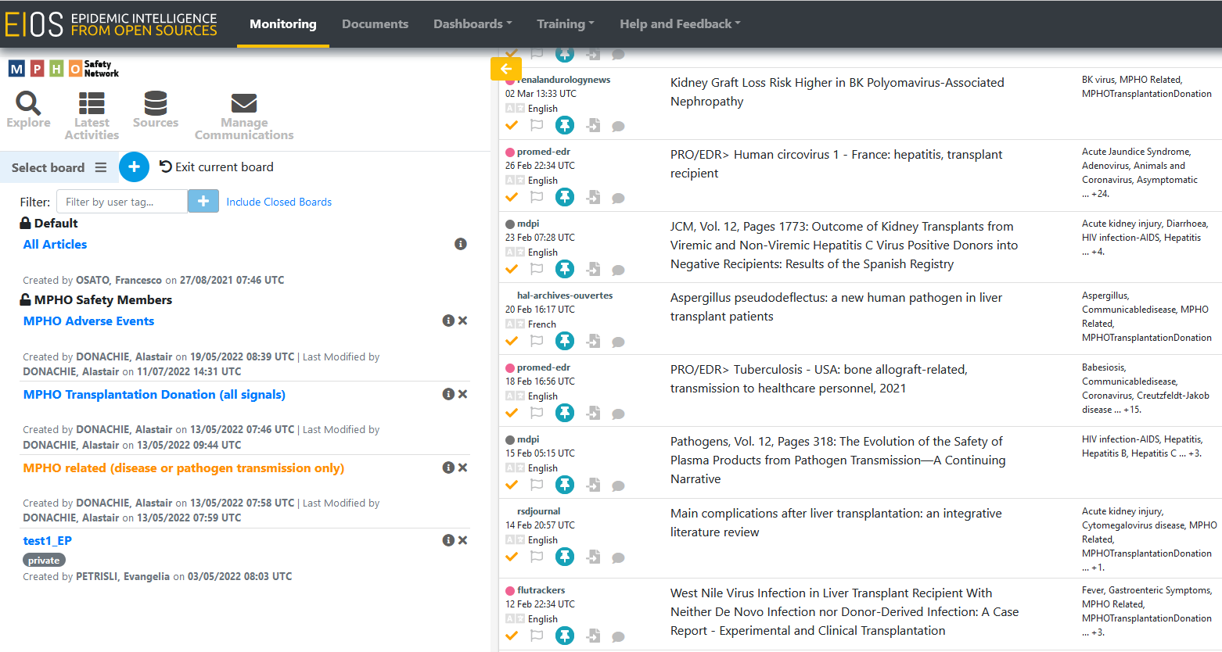
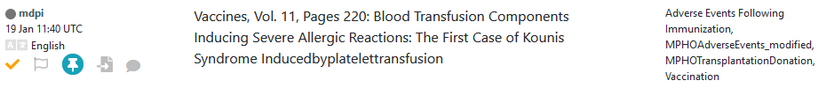
WHO - Epidemic Intelligence from Open Sources (EIOS)
New papers for inclusion in the Notify Library

Slide 8
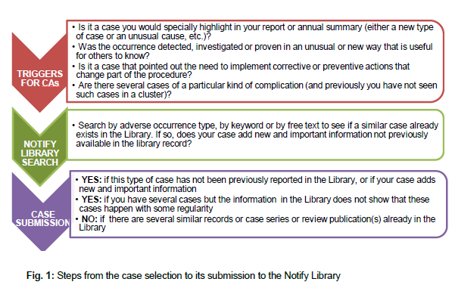
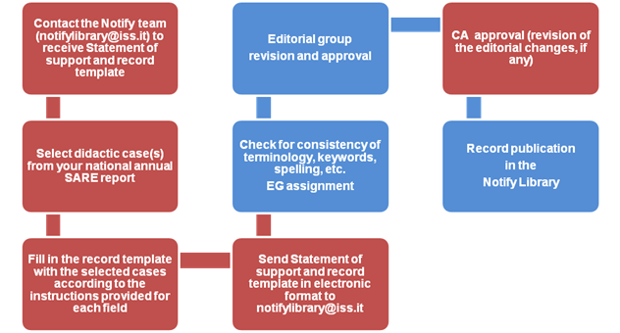
Vigilance and Inspection for the Safety of Transfusion, Assisted Reproduction and Transplantation (VISTART)
In the framework of VISTART Joint Action a specific guidance document was developed in order to provide instructions to facilitate EU CAs in the selection and analysis of case types with didactic value from their annual biovigilance reports to the European Commission for insertion in the Notify Library.
Steps from the case selection to its submission to the NOTIFY Library
Workflow and editorial process
Document available at the link: https://www.notifylibrary.org/sites/default/files/VISTART_WP5A_A%20User%20Guide%20for%20CA.pdf

Slide 9
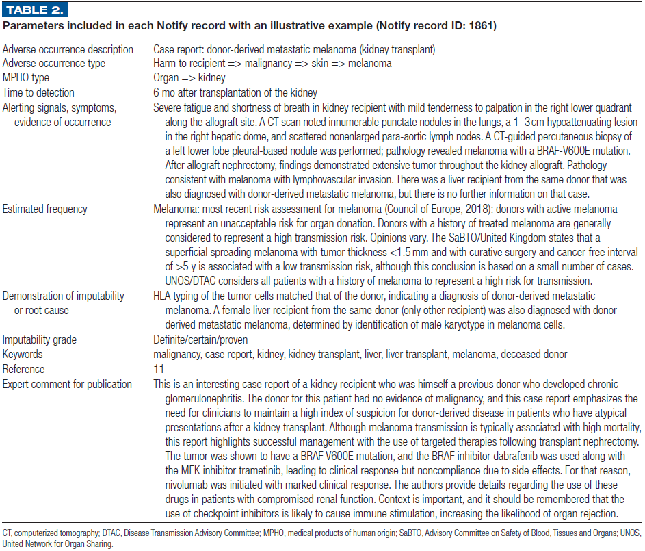
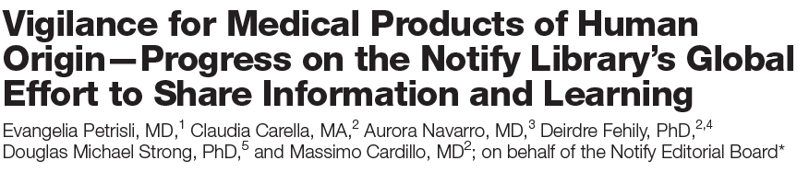
NOTIFY records
Minimum data set
Free text title (AO description)
MPHO type involved
Time to detection
Alerting signals, symptoms, evidence of occurrence (clinical presentation)
Demonstration of imputability or root cause (all relevant information for imputability setting)
Reference(s)
Petrisli, E et al. Transplantation. 2021 Sep 1;105(9):1921-1929

Slide 10
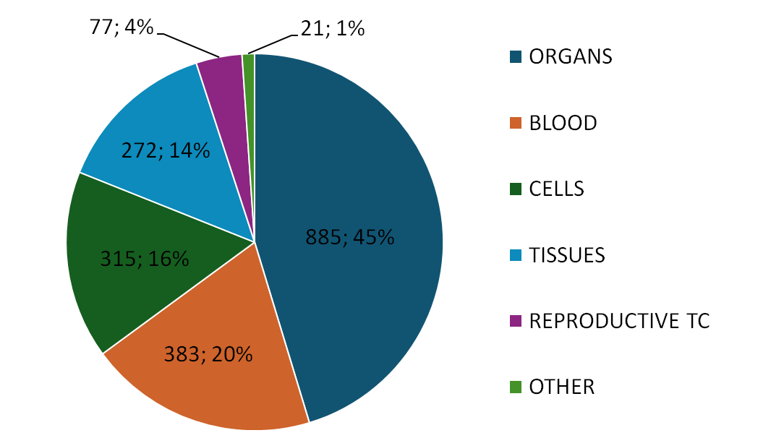
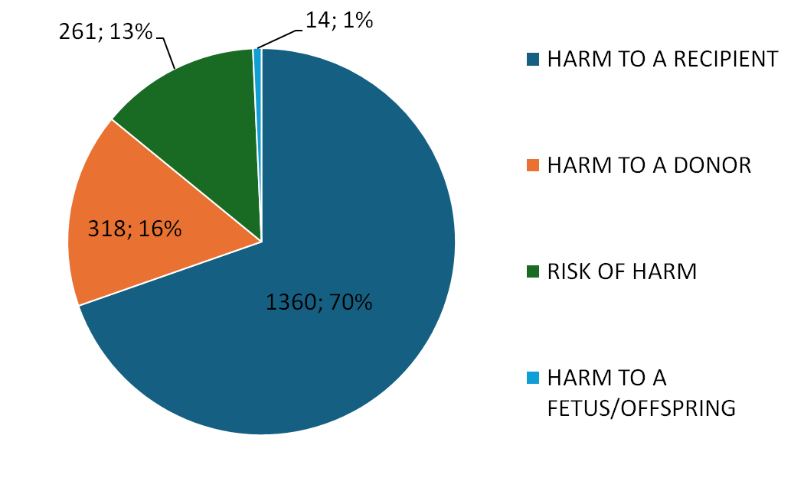
NOTIFY Library’s content
1,953 Notify records; 2,860 references indexed
NOTIFY Library’s content by MPHO type
NOTIFY Library’s content by adverse occurrence type
Last update: October 30, 2024

Slide 11
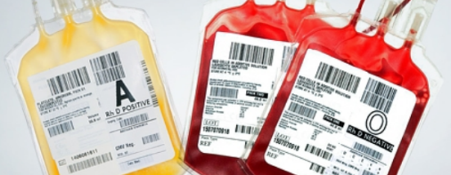



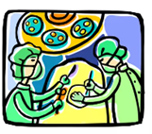

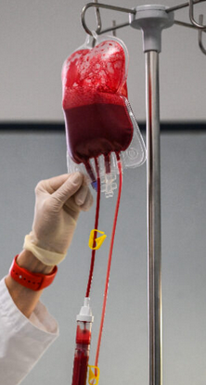

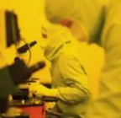

Activity steps from donation to clinical application
TRACEABILITY
ability to locate and identify the MPHO involved during any activity step
ability to identify the donor and the blood or tissue establishment or the manufacturing facility
ability to identify the recipient(s) at the medical facility/facilities
ability to locate and identify all relevant data relating to products and materials coming into contact with those MPHO.
Donor selection/evaluation
Procurement
Transport
Processing
Testing
Clinical appilication
Source: Notify Booklet available at: https://www.notifylibrary.org/sites/default/files/Booklet_2018_1.pdf

Slide 12
Transmission of yellow fever vaccine virus through
blood transfusion and organ transplantation
Four patients who had received solid organ transplants from a common organ donor developed encephalitis beginning 2–6 weeks after transplantation.
Metagenomic NGS identified one read from yellow fever virus in CSF from the recipient of a kidney. Recent infection with yellow fever virus was confirmed in all four organ recipients by identification of yellow fever virus RNA consistent with the 17D vaccine strain in brain tissue from one recipient and seroconversion after transplantation in three recipients. Two patients recovered and two patients had no neurological recovery and died.
Three days before organ procurement, the organ donor received a blood transfusion from a donor who had received a yellow fever vaccine 6 days before blood donation.
The standard pre-donation screening questionnaire—which included a question about recent vaccinations—was administered but failed to elicit vaccination history to prevent blood donation, showing the limitations of obtaining accurate information through the administration of donor history questionnaires.
Gould CV, et al. Lancet Microbe. 2023 Sep;4(9):e711-e721

Slide 13
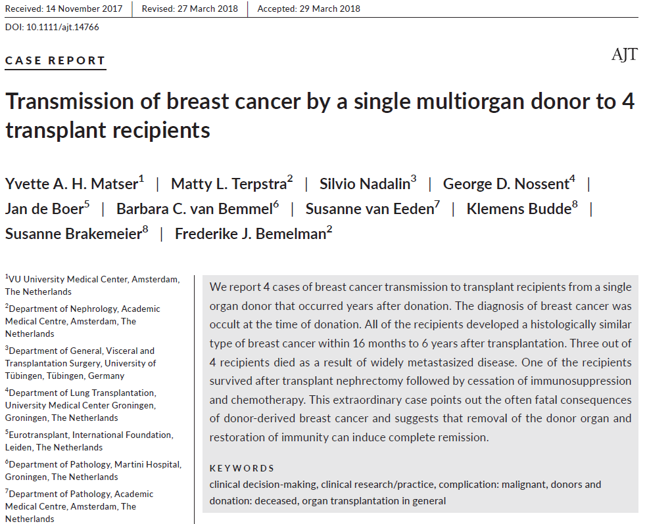
Breast carcinoma transmission to 4 recipients
Disease manifesting at different times between 16 months and 6 years after transplantation. The donor cancer was unknown at time of transplant.
This report shows that it is prudent to consider donor origin tumor in any unusual late-arising tumor in a transplant recipient and, if possible, take steps to confirm the suspicion (e.g. DNA microsatellite analysis that can be performed on routine surgical pathology specimens) in order to provide warning for other potential recipients from that donor.
The authors note that a breast examination should be part of the routine donor physical examination.

Slide 14
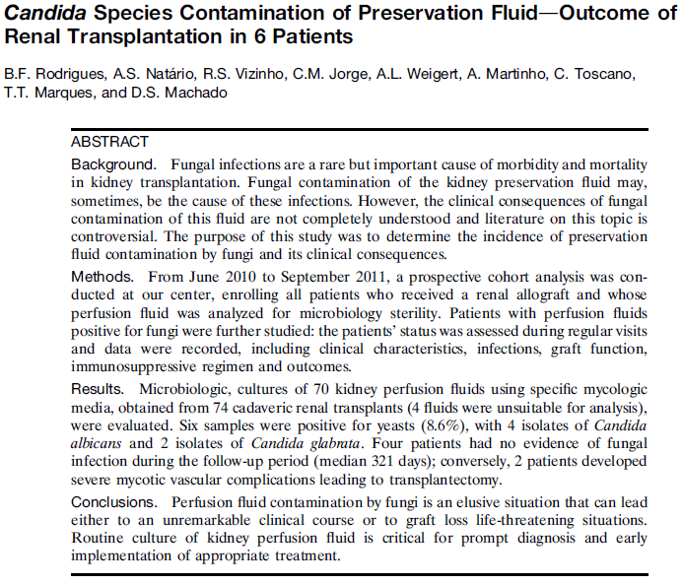
Candida species contamination of preservation fluid
Peritoneal contamination with donor strain during multi-abdominal organ recovery is not a frequent event but when transmission occurs and there is no intervention, the risk of significant complication is high. Rate of Candida spp isolation from organ preservation fluid varies widely; in this small, single centre study it was 8.6%, with 33% rate of complication (2 out of 6).
There is no consensus on the use and duration of anti-fungal prophylaxis in renal transplanttaion where preservation fluid culture is positive and management is largely based on local experience. Culture of preservation fluid is not universally applied and great variation in microbiological methodology makes cross site comparison very difficult.
Rodrigues BF, et al. Transplant Proc 2013; 45 (6) :2215 - 9

Slide 15
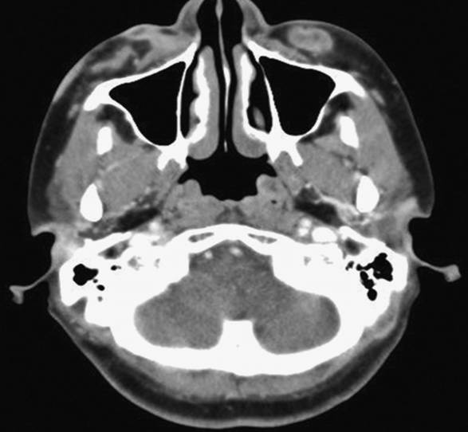
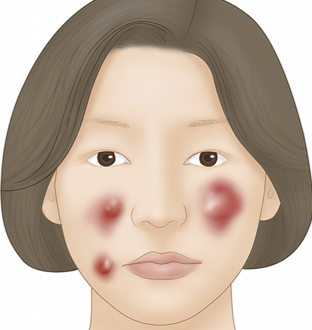
M. fortuitum and A. fumigatus infection following fat graft
Painful swelling and erythema at implantation sites on face 4 weeks after replantation. CT of neck showed multiple peripheral enhancing nodular lesions to forehead, both cheeks, and right nasolabial area compatible with abscesses.
This is specifically related to infection from a "cryopreserved autologous fat graft". Contamination of the graft likely occurred during handling either at the harvest procedure (unlikely since some fat from the same lipectomy was used for reconstruction during the same surgical procedure and resulted in no harm), during cryopreservation steps, while it was stored for 2 months, during the thawing procedure, or during implantation. The root cause was not identified but it's not likely to be donor derived since the autologous donor was not reported to have abscesses or infections at time of harvest (lipectomy) or at implantation. Body site where harvest took place was also not reported.
Kim SK, et al. J Craniofac Surg.
2013 Sep;24(5):1676-8

Slide 16
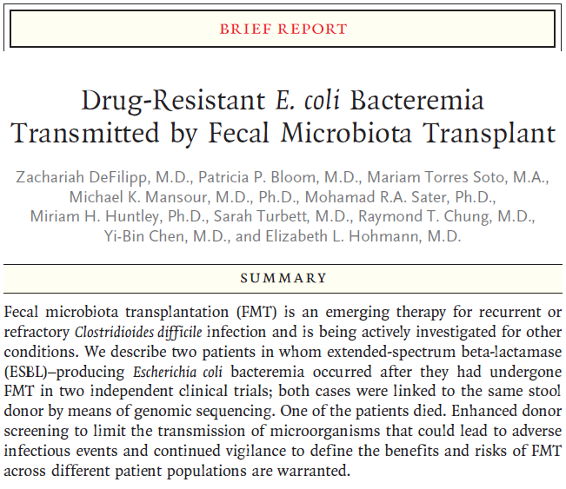
Drug-Resistant E. coli bacteremia transmitted by FMT
Both cases of infection were linked to the same stool donor by means of genomic sequencing. Each of three lots of capsules from that donor was later found to contain ESBL-producing E. coli with a resistance pattern similar, but not identical, to the blood isolates from the patients, as determined by means of culture. Frozen fecal samples that were obtained from patients before FMT were cultured and found to be negative for ESBL-producing organisms. The stool donor was screened and tested appropriately according to protocols and regulations, and had no risk factors of MDR organism carriage. Subsequently, after these serious adverse events were reported, donor-stool screening was expanded to include tests for ESBL-producing organisms.
DeFilipp Z, et al. N Engl J Med. 2019 Nov 21;381(21):2043-2050

Slide 17
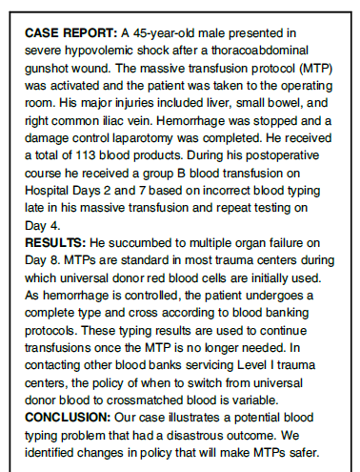
ABO hemolytic transfusion reaction
Double- and triple-checking blood typing is paramount, especially in urgent situations. Blood typing should occur as early as possible in a patient's care, with universal donor blood (O-negative) used in emergencies where the blood type is unknown.
Clinicians must remain vigilant for early signs of transfusion reactions and recognize that these reactions might present atypically. Patients with recent transfusions require close monitoring.
This case underscores the need for systemic improvements, including enhanced protocols and technology to minimize blood typing errors. Openly discussing communication failures and training clinicians to recognize atypical transfusion reactions are important.
Davis CS, et al. Transfusion. 2019 Aug;59(8):2532-2535

Slide 18

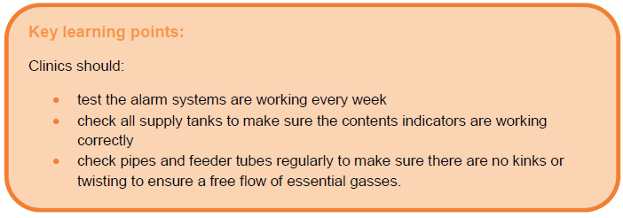
Loss of donor sperm belonging to 250 patients
The liquid nitrogen in the tank run out earlier than expected, leading to loss of 250 donor sperm samples.
The investigation revealed that a valve supplying liquid nitrogen to the storage tank containing the samples had been left closed, preventing liquid nitrogen from entering the system. There was also a damaged connection hose, resulting in the liquid nitrogen evaporating in the hose and emptying the entire supply tank while not filling the storage tank.
This incident highlighted the need to make sure that laboratory staff understand how to use the supply tanks and have further training in the use of liquid nitrogen, especially in relation to identifying potential problems.
HFEA. Adverse incidents in fertility clinics: lessons to learn, January–December 2013

Slide 19
Conclusions
NOTIFY Library as a compendium of instructive information to raise clinicians’ awareness of adverse occurrences related to their practices and of how they have been detected, investigated, and managed elsewhere
Easy access to reliable, empiric evidence, and real-life experience that can be used for guideline development by professionals and health authorities when managing a specific adverse occurrence raised in the transfusion, transplantation, or MAR or when estimating risk
Sharing of vigilance information across international borders and between professional sectors working in all MPHO fields can provide invaluable input to improving the safety and effectiveness in very different geographical and clinical realities

Slide 20
Thank you for your attention
Interested parties can contact us
e.petrisli@yahoo.com
notifylibrary@iss.it

