Slide 1
Stem Cells & How They are Different
15, November 2024

Slide 2
Disclosures
Conflicts of Interest: None
Reimbursement: Will accept Caprese Salads…

Slide 3
Stem Cells & How They are Different
Stem Cells as MPHO – MNC(A) used as donor lymphocyte infusion or starting material for further manufacturing
  Primary donation type in U.S. (most common):
    Voluntary Donation by living donors
    1:1 to recipient
    As part of hematopoietic cell transplant for a variety of diseases including hematologic malignancies
    Use of ISBT 128
    Reporting may be based on multiple regulating bodies depending on the country
Notes:
Voluntary donation by living donors –Vs- other’s may be compensated donors / Tissue: mostly cadaveric donor
1:1 to recipient –Vs.- Tissue: Many recipients to one donor

Slide 4
Stem Cells & How They are Different
Stem Cells as MPHO – Broad Overview
*For useful transplant, stem cells must reproducibly:
    In HCT -> Replace the immune system
    Differentiate into desired cell type(s)
    Survive in recipient after transplant
    Integrate into surrounding tissue after transplant
    Avoid rejection by recipient’s immune system
    Function appropriately for duration of recipient’s life
*U.S. Department of Health and Human Services. (n.d.). Stem cell basics. National Institutes of Health. https://stemcells.nih.gov/info/basics/stc-basics

Slide 5
Stem Cells & How They are Different
Stem Cells as MPHO – Broad Overview
*Pluripotent stem cells
    Undifferentiated
    No tissue-specific characteristics
    Can become all differentiated cell types in the body
Adult stem cells
    Differentiated to the specialized cell types of the tissue or organ they reside in
    e.g. Hematopoietic progenitor cells
*U.S. Department of Health and Human Services. (n.d.). Stem cell basics. National Institutes of Health. https://stemcells.nih.gov/info/basics/stc-basics

Slide 6
Stem Cells & How They are Different
Stem Cells as MPHO – Broad Overview
*Hematopoietic Progenitor Cells – (Blood forming stem cells)
  Bone marrow (HPC, Marrow or HPC(M)) – Approx 20% of transplants
  Peripheral blood stem cells (HPC, Aphaeresis or HPC(A)) – Approx 80% of transplants
  Umbilical cord blood (UCB)
*Centro Nazionale Trapianti, Italian National Transplant Centre. (Edition December 22nd 2017). Notify Library The Global Vigilance and Surveillance Database for Medical Products of Human Origin. Transplantation, Transfusion and Assisted Reproduction, 35. https://www.notifylibrary.org/content/booklet-2018

Slide 7
Stem Cells & How They are Different
Uniqueness of Stem Cells & Difference in Possible Adverse Events (AE)
*HPC(M) products are most often collected in surgical suites with donors receiving general or regional (epidural or spinal) anesthesia. Standard of care for these donors in some countries is hospitalization for 1-2 days, in many other countries “day surgery” without overnight hospitalization is most common
    Common donor reactions (acute or delayed) may be different: Bone and back pain, anemia, fever, headache and hypotension.
    More severe donor reactions (including death, very rare): Stroke, air embolism, chest pain, endocarditis, fat embolism, iliac fracture
*Centro Nazionale Trapianti, Italian National Transplant Centre. (Edition December 22nd 2017). Notify Library The Global Vigilance and Surveillance Database for Medical Products of Human Origin. Transplantation, Transfusion and Assisted Reproduction, 35. Retrieved from https://www.notifylibrary.org/content/booklet-2018

Slide 8
Stem Cells & How They are Different
Uniqueness of Stem Cells & Difference in Possible Adverse Events (AE)
*HPC(A) donation commonly involves mobilization of HPC from the bone marrow into the peripheral blood stream via a mobilization agent administered to the donor subcutaneously, one or twice daily for 4 to 5 days prior to aphaeresis (19).
    Common donor reactions: headache, bone pain, splenomegaly and thrombocytopenia
    More severe reactions: Arrhythmias, splenic rupture and vascular problems
*Apheresis collection alone can have its own donor complications:
    Acute, immediate or chronic or delayed: Central line thrombosis, citrate toxicity, hypotension, infection, mild leucopenia and thrombocytopenia (unassociated with clinical complaints)
    More severe reactions: Pulmonary embolism, subdural hematoma, sepsis
*Centro Nazionale Trapianti, Italian National Transplant Centre. (Edition December 22nd 2017). Notify Library The Global Vigilance and Surveillance Database for Medical Products of Human Origin. Transplantation, Transfusion and Assisted Reproduction, 35. Retrieved from https://www.notifylibrary.org/content/booklet-2018

Slide 9
Stem Cells & How They are Different
Differences in Reporting & Follow-Up Recommendations for Donors
    Adverse occurrences between initiation of donation procedure and 30 days post completion should be reported. (Longer timeframe than tissue)
    Reporting of hospitalization-related occurrences that result from common donation-associated incidents, e.g., nausea, vomiting, pain, headache, may be excessive because the distinction between adverse occurrences and hospital-related incidents is highly dependent on many factors. (Not an issue with tissue or medically assisted reproduction)
    Long-term follow-up of donors annually or biannually for at least 10 years. (Shorter than organ donation (lifespan))
*Centro Nazionale Trapianti, Italian National Transplant Centre. (Edition December 22nd 2017). Notify Library The Global Vigilance and Surveillance Database for Medical Products of Human Origin. Transplantation, Transfusion and Assisted Reproduction, 36-56. Retrieved from https://www.notifylibrary.org/content/booklet-2018

Slide 10
Stem Cells & How They are Different
Unique Safety & Traceability attributes
Stem cells – Potential Impacts on recipients
  Infections
  Relevant Communicable Disease Agents or Diseases (RCDAD)
  Graft Failure
  Graft-versus-Host-Disease (GvHD)
  Genetic transmission of mutations known to cause disease

Slide 11
Stem Cells & How They are Different
Unique Safety & Traceability attributes
Donor-eligibility determination based on screening & testing
  Testing of donor for relative communicable disease agents e.g.:
      Human immunodeficiency virus, type 1;
      Human immunodeficiency virus, type 2;
      Hepatitis B virus;
      Hepatitis C Virus; and
      Treponema pallidum
  Additional testing for donors of leukocyte-rich cells or tissue
*FDA 21 CFR Part 1271., (7-38) Human Cells_Tissues_and Cellular and Tissue-Based-Products. Retrieved 11.13.2024 https://www.ecfr.gov/current/title-21/chapter-I/subchapter-L/part-1271?toc=1

Slide 12
Stem Cells & How They are Different
Unique Safety & Traceability attributes
Current donor medical history interview
    (1) Laboratory test results (other than results of testing for relevant communicable disease agents required under this subpart);
    (2) Medical records;
    (3) Coroner and autopsy reports; and
    (4) Records or other information received from any source pertaining to risk factors for relevant communicable disease (e.g., social behavior, clinical signs and symptoms of relevant communicable disease, and treatments related to medical conditions suggestive of risk for relevant communicable disease).
*FDA 21 CFR Part 1271., (7-38) Human Cells_Tissues_and Cellular and Tissue-Based-Products. Retrieved 11.13.2024 https://www.ecfr.gov/current/title-21/chapter-I/subchapter-L/part-1271?toc=1

Slide 13
Stem Cells & How They are Different
Unique Safety & Traceability attributes
*Donor Privacy – Records must not contain:
  Donor’s Name
  Other personal information that might identify them
Safety = timely notification + traceability to support hemovigilance & biovigilance
*FDA 21 CFR Part 1271., (7-38) Human Cells_Tissues_and Cellular and Tissue-Based-Products. Retrieved 11.13.2024 https://www.ecfr.gov/current/title-21/chapter-I/subchapter-L/part-1271?toc=1

Slide 14
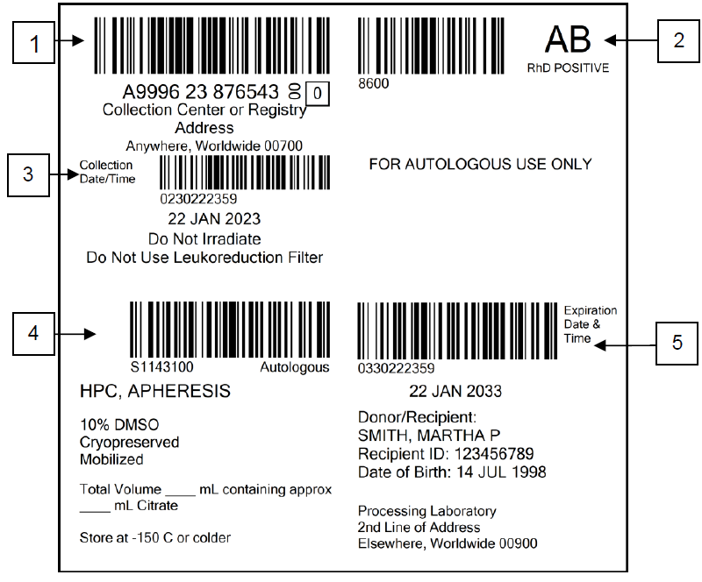
Stem Cells & How They are Different
Unique Safety & Traceability attributes
*ISBT128 - International agreement on product descriptions & unique identification of each donation = Effective traceability on a global scale
*ICCBBA., ISBT128 For Cellular Therapy, An Introduction 15th Edition. , (1 – 26) Retrieved 11.13.2024
https://www.isbt128.org/_files/ugd/2965e4_bfcad3bda21846f09cf00f93351d72ba.pdf

