Slide 1
Standardized Terminology for MPHO
Speaking the same language globally
Karen Moniz, Technical Director, ICCBBA

Slide 2

What does it mean?
Notes:
This petroglyph, located on the Palisade Rim Trail in Colorado provides information.
However, without definition, standardization, and harmonization, how can we be sure what it means?
What would a neighboring community think it means? Dinner? Family Pet? Art? Quantity? Direction?
WHY is it important to understand WHAT this means? HOW to determine WHAT symbol is used?

Slide 3
Why is a standardized terminology important?
Patient safety - MPHO carries risk
What information is being conveyed to clinicians? To patients?
Biovigilance – What is stored in health records?
Inventory control – What do you have or need?
Data Mining – Statistical analysis and research
Notes:
What do you have available?
What can you collect or acquire?
What do you need?
?– Type of information vs purpose of information
Ensure consistent documentation across the healthcare

Slide 4
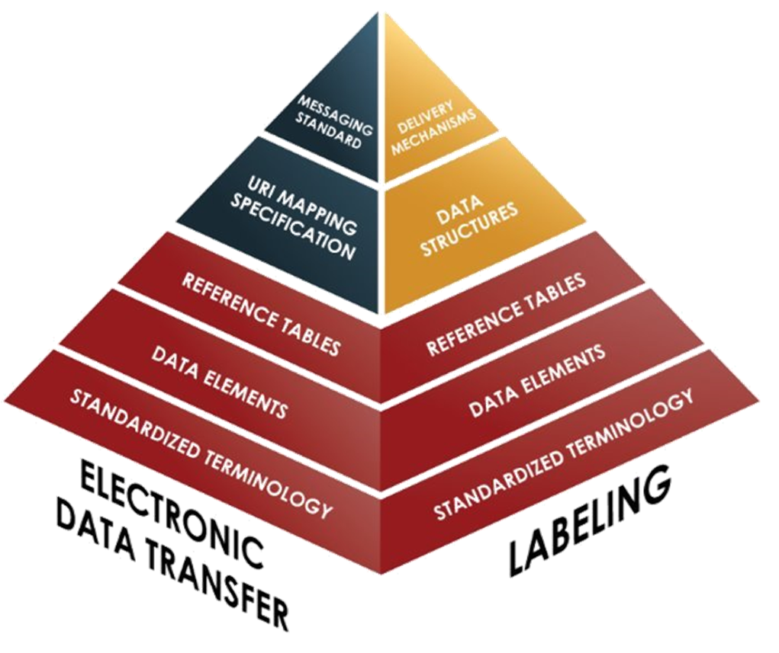
ISBT 128 Information Environment Model
Notes:
International standard for terminology, identification, labeling, and electronic data exchange associated with medical products of human origin (MPHO).
So it's like comparing apples with oranges both fruits but very different
Encoding and data
transfer with standardized terminology at its base

Slide 5
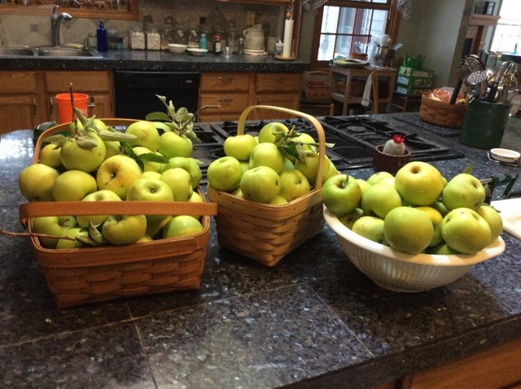

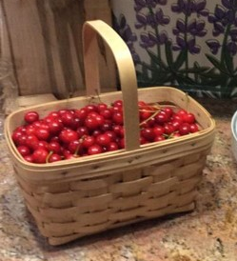
Class Names
APPLE
PEACH
CHERRY

Slide 6
Some ISBT 128 Class Names
Blood
Tissue
Cellular Therapy
CONVELESCENT PLASMA
CROPRECIPITATE
FIBRINOGEN COMPLEX
FRESH FROZEN PLASMA
PLATELETS
RED BLOOD CELLS
ARTERY, BRACHIAL
VEIN, FEMORAL
TENDON, ACHILLES
BONE, CHIPS
DERMIS
BIRTH TISSUES
HPC, APHERESIS
HPC, MARROW
MNC, APHERESIS
iPSC, SKIN
MSC, AMNIOTIC MEMBRANE
DC, CORD BLOOD

Slide 7

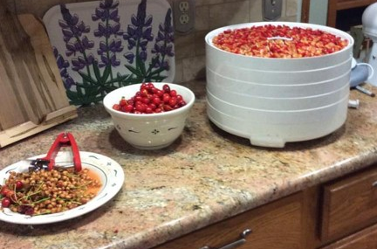
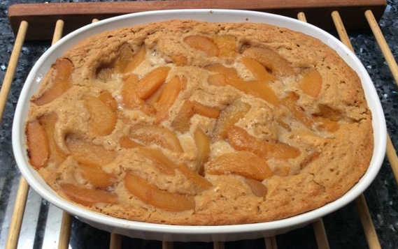
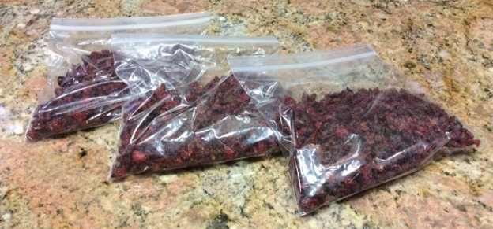
Attribute Groups
Additives
Type of preservation

Slide 8
Some ISBT 128 Attribute Groups
Blood
Tissue
Cellular Therapy
Core conditions
System Integrity
Irradiation
Residual Leukocyte Content
Pathogen Reduction
Antibody Specificity
Additives
Type of Preservation
Pathogen Reduction
Demineralization
Nominal Granule Size
Skin Fenestration
Core conditions
Cryoprotectant
Genetically Modified
Mobilization
Enrichment
Cultured
Notes:
Quality and Safety
Type of information vs purpose of information

Slide 9

How?
ISBT 128 Standard Information Environment
Technical Advisory Groups
Standards Committee
Public Comment
Notes:
Collaboratively Developed TRANSPARENCY
ICCBBA Technical Advisory Groups
Fully compatible with the Single European Code
Engagement with other groups and associations
The PDC database maintained by ICCBBA consists of codes mapped to product descriptions.
These product descriptions are based on standard terminology, which was developed and is maintained with input from the technical advisory groups (or TAGs) I mentioned previously, as well as input from end users.
Standardized product description codes let the physician order the correct product for treatment and allow records to reflect exactly what the patient received.
The standards document referenced here, ISBT 128 Standard Terminology for Medical Products of Human Origin (ST-002) describes the terminology used to define ISBT 128 PDCs.
To use an analogy, not only does the terminology differentiate apples from oranges, it defines whether the fruit was sliced, juiced, frozen, etc.
As more input is gathered from end user requests and technical advisory groups, the terminology document is updated and published approximately 10 to 12 times per year, as is the product description code database.

Slide 10
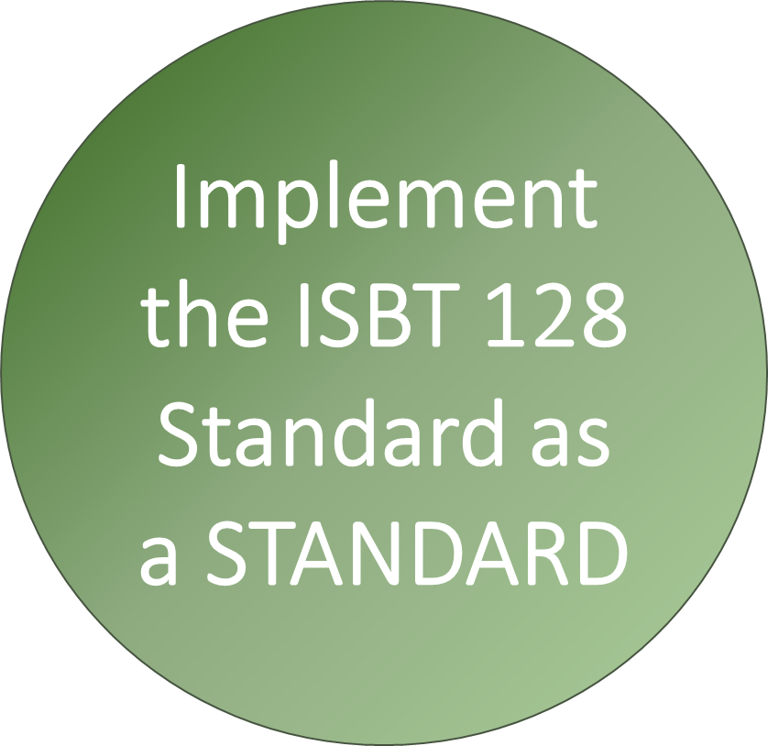
Syntax
Structured format
Data Identifiers
Check Characters
Notes:
Data Identifiers
Check characters
Structured format for barcodes
Structured format for data elements

Slide 11
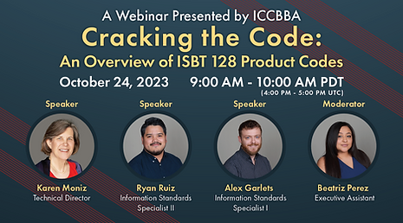
Learn more about it!
Notes:
For a deeper dive into PDCs, please visit ISBT128.org for the Cracking the Code webinar.
Help Desk:
support@isbt128.org

Slide 12
Terminology development
Existing areas - existing terminology
Existing areas – new Class Names or New Attributes
New areas – Example: Extracellular Vesicles
Collaborative effort with:
  ICCBBA’s CTCLAG (Cell Therapy Coding and Labeling Advisory Group)
  ISCT (International Society for Cell & Gene Therapy)
  ISEV (International Society for Extracellular Vesicles)

Slide 13
Fundamental Elements of Traceability
Globally Unique Donation Identification
Product Description Code
Division Identifier
Processing Facility Code
Notes:
MPHO Unique Identifier

Slide 14
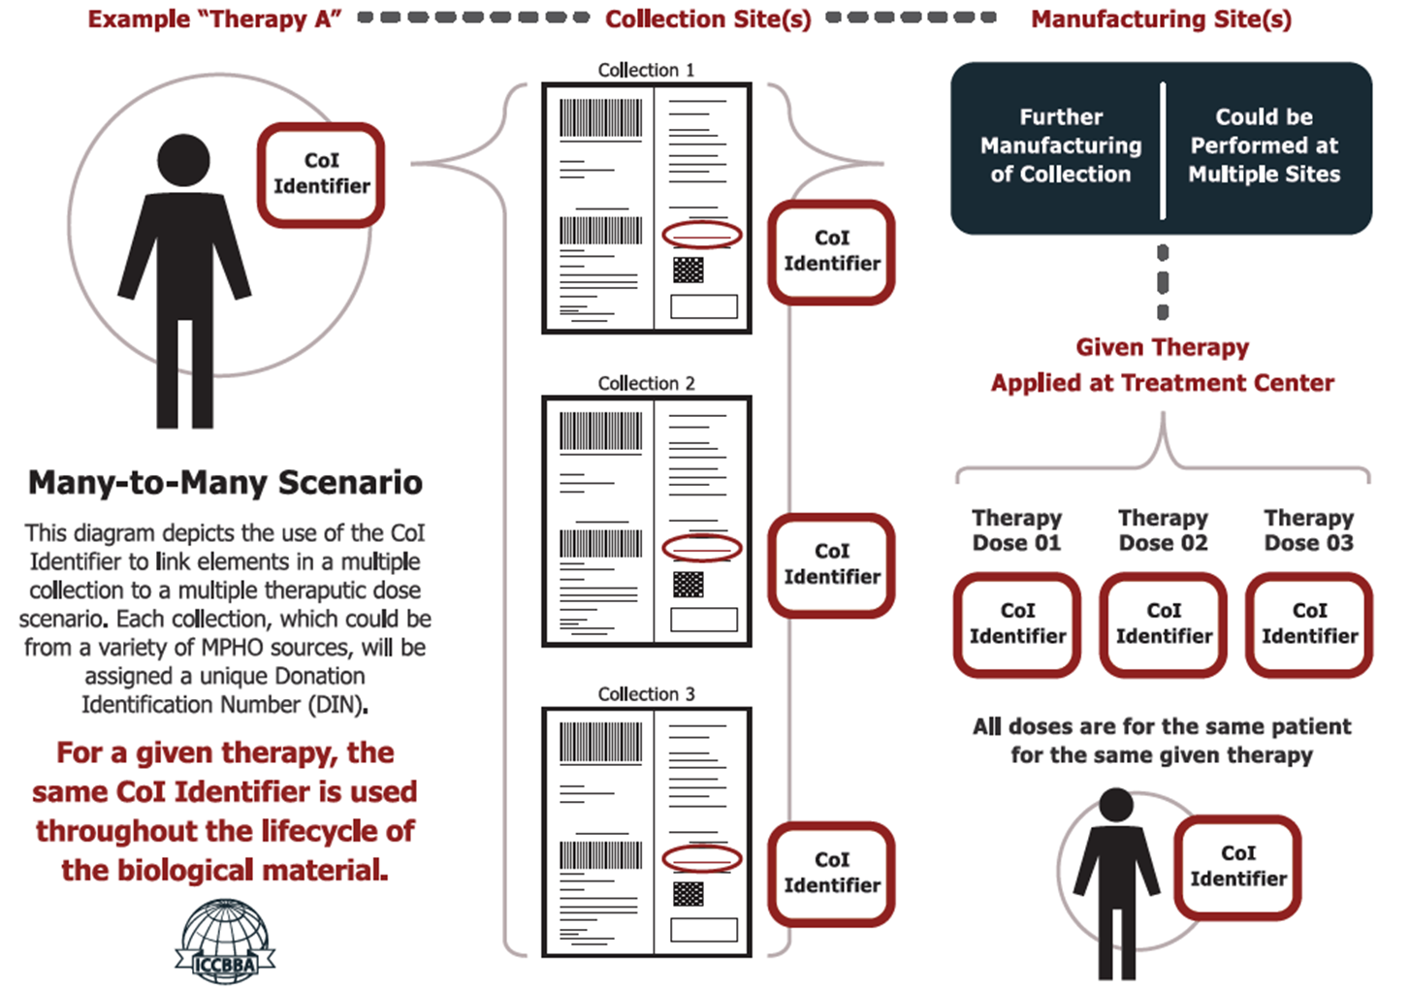

Chain of Identity Identifier
Notes:
Here’s a diagram that depicts the use of the CoI Identifier to link elements in a multiple collection to a multiple therapeutic dose scenario. Each collection, which could be from a variety of MPHO sources, will be assigned a unique Donation Identification Number (DIN).
For a given therapy, the same CoI Identifier is assigned to each collected product (in addition to the DIN), all the way throughout the lifecycle of the biological material, including not just collection but manufacturing, distribution, and administration.
The CoI Identifier should be assigned prior to the first collection.
It should mean something at the beginning, middle, and end.

Slide 15

Bridging Gaps
MPHO
CoI Identifier
Drug

Slide 16
More than Physical Labeling
What language are we using to communicate?
  Linear Bar Codes
  2D Data Matrix Symbols
  RFID (radio frequency identification)
  Electronic Messaging
Notes:
It is about effectively communicating the information in a standardized format

Slide 17

Artificial Intelligence
Complexity of healthcare language
Medical intent
Clinical guidelines
AI might make coding easier, but human experts are still needed to apply judgment
Reference
https://hadasbitran.substack.com/p/generative-ai-and-clinical-coding
Notes:
2001 Space Odyssey - HAL's most famous line from 2001: A Space Odyssey is, "I'm sorry, Dave. I'm afraid I can't do that". Shift from helpful AI to a more dangerous presence.
"I am putting myself to the fullest possible use, which is all I think that any conscious entity can ever hope to do"
"This mission is too important for me to allow you to jeopardize it"
"I can only be attributable to human error"
"Let me put it this way, Mr. Amer. The 9000 series is the most reliable computer ever made. No 9000 computer has ever made a mistake, or distorted information. We are all, by any practical definition of the word, foolproof and incapable of error"

Slide 18
Key Takeaways
Standardized Terminology can enable:
Traceability
Biovigilance
Data mining
Inventory control

Slide 19
Resources
ICCBBA Website: www.isbt128.org
ICCBBA Helpdesk: support@isbt128.org

Slide 20

Interoperability

