Slide 1
FORUM30: Product Traceability in the Pharmaceutical sector (Serialisation)
November 2024

Slide 2
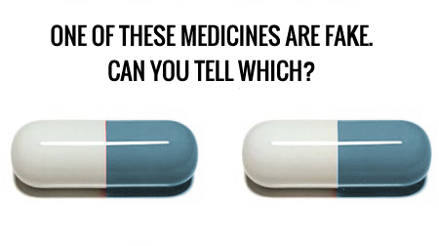
Why Serialization – Counterfeiting
One is a fake – but how can you tell which one?
AUTHENTIC
FAKE!
Fake medicine will not help patients and could cause harm/death

Slide 3
Falsified And Substandard Drugs
  Can cause harm to patients and fail to treat the diseases for which they were intended – may lead to death
  Affect every region of the world – found in illegal street markets, unregulated websites, pharmacies, clinics and hospitals
  An estimated 1 in 10 medical products in low- and middle-income countries is substandard or falsified
  Counterfeits mimic branded or generic drugs - may include products with
  Correct ingredients
  Wrong ingredients
  No active ingredients
  Insufficient or too much active ingredient
  Fake packaging

Slide 4
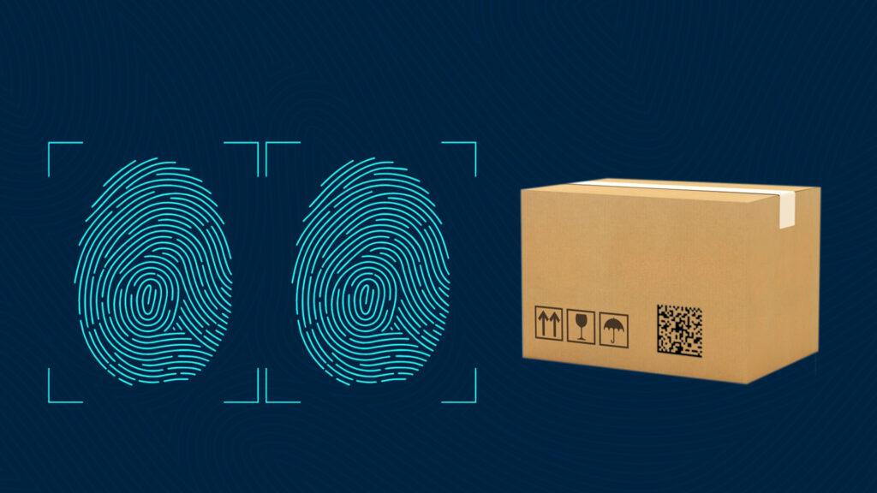
Serialisation – What is it ?
What is the General Meaning of Serialisation?
In simple terms, serialization means giving a unique identifier to an item. For example, a natural form of serialization is our fingerprint. No two individuals have the same fingerprint, even twins.
Asides from pharmaceuticals, other sectors like the logistics & aviation sector also use the concept of serialization for tracking packages and luggage respectively.

Slide 5
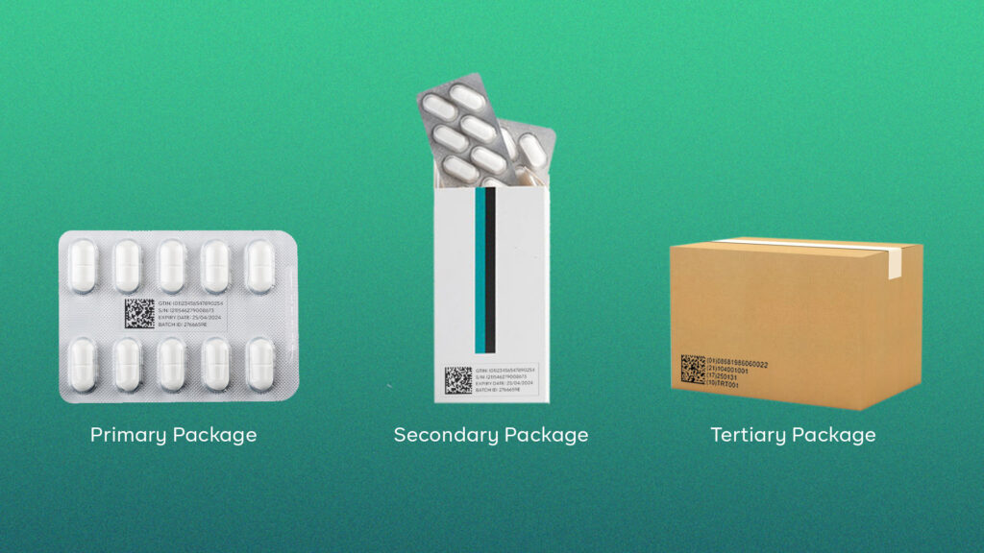
Serialisation in Pharma:
Pharma serialisation:
Pharma serialisation is the process of assigning unique serial numbers to every drug packaging that is saleable; primary, secondary, and tertiary. So from blisters, to bottles, cartons, and pallets, they all carry a unique identifier. This unique identifier can either be QR Codes or Data Matrix Codes (depending on the country/region) and carry information about the product’s origin and validity.
These codes are then printed visibly on the respective packaging and are linked to each other. That is, the code of a bottle of drug is linked to the code of the carton it came in, which is also linked to the pallet. This is all stored in a cloud database that transported it from the factory/warehouse.
.

Slide 6
How does serialisation stop counterfeiting ?
Traceability
Traceability guidelines from GS1 help to create a closed distribution system that monitors the movement of every drug produced in or imported into a region.
As a drug moves from manufacturer to distributor to retailer and to the final patient, the product is authenticated and logged on National or WHO databases
Any suspicious activity will be flagged through these automatic verification steps and reported to relevant bodies.
A set of standards is available from GS1 to communicate with the databases
End to end flows will show the application of barcodes by manufacturer, upload to the cloud and authentication by the patient
Once a product has left the supply chain, it should be decommissioned meaning it’s serial is no longer in use.

Slide 7
Benefits of implementing Serialisation
  PRO’s:
    Gives complete security across the end to end supply chain (If implemented well)
    Ensures packs are not re-used (Cannot be re-scanned)
    Prevents falsified medicine from entering the market
    Governed by strict regulations – enforcement is key
    Cannot distribute non-serialised product into markets where serialisation governance exists
    Suspicious activity will be flagged & reported through automatic verification steps
    Serialisation alerts received from governing bodies must be investigated.
  Cannot distribute non-serialised product into markets where serialisation governance exists ( E.G: EU/US )
  Serialisation alerts received from governing bodies must be investigated.
  X

Slide 8
Negatives of Serialisation
  CON’s:
    Supply Chain needs to support the whole end to end process with dedicated Teams or assigned personnel
    Enforcement must be in place to ensure regulations are followed
    Pharma companies can only enforce so far – once into pharmacies/hospitals, it can be difficult to track – E.G. Pharmacy to pharmacy transfers or parallel imports
    Data accuracy is essential – any keystroke error entry can slow down release of product when verification steps are implemented.
    Third world markets may not have distributors or pharmacies that are regulated

Slide 9
Regulation/Enforcement:
Where is Pharma Serialisation a Regulation for Drug Distribution?
Serialisation has long been a regulation in Europe, the United States of America, Brazil, Russia, the United Kingdom, China, Saudi Arabia, and many developed countries. Over the years, others have followed suit including many developing nations like Nigeria, India, and many more across Africa, South America & Asia.
In total, pharma serialisation is a requirement in over 70 countries globally (75% of global volume)

Slide 10
Serialisation support structure required for Mid Size Pharma brand owner
Serialization Responsibility – Supply Chain:
Assigned Business System Owner / System Administrator (BSO).
This role involves coordinating serialization interactions with CMO’s (Contract manufacturers) & 3PL’s (Distribution centres), EMVS ( European medicines verification system) and management of TraceLink system activities
Serialization Responsibility – IT:
Assigned IT System Owner (ITSO).
This role involves supporting the functioning of the TraceLink system and supporting Serialization set up activities.
Serialization Support Team:
The Serialization Support Team typically consists of the Business System Owner (BSO), IT System Owner (ITSO) and Serialization support SMEs
Quality:
Provide Quality support for both, Business in use of system and for IT in maintaining the system.
System Architecture:
TraceLink: Connections with all CMOs & 3PL for active serialized supplies established
Serialized Products: Products are serialized for markets.
GS1 Status: GS1 Registration for Labeler code established; Irish pharma companies would hold a GS1 License from GS1 Ireland as well as from GS1 USA. GLNs available for Ireland

Slide 11



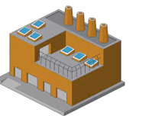
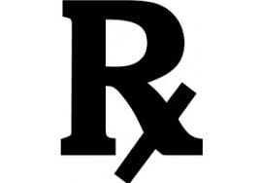
Cloud Database
Upload serial numbers
to Cloud Database
Authenticate and consume
serial numbers in Cloud Database
Packaging
Systems
Print Barcode
Wholesalers
in each Market
Dispensers, pharmacies,
hospitals, vaccine
centres in each Market
Regulator to monitor the enforcement of the whole process

