Slide 1



CONSIDERATION OF RISK-BENEFIT OF MPHO
THE VIEW OF A NATIONAL COMPETENT AUTHORITY
Dolores Hernández-Maraver MD, PhD

Slide 2


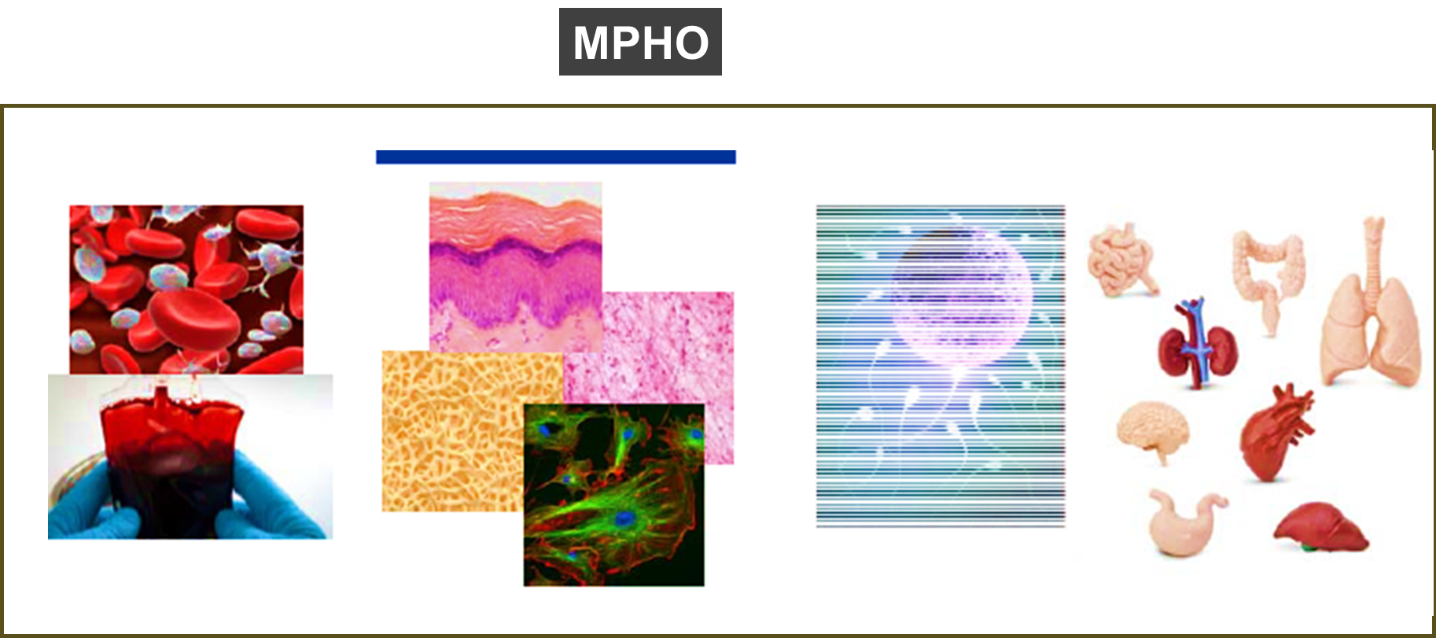
Advances in science and healthcare technology have resulted in human organs, tissues and cells being used in various new ways
These MPHO encompass a wide range of therapies: transfusion, transplants, tissue implants and medical products, developed from cells and tissues, blood and organs or any substance retrieved from the bodies of living persons or from those of the dead
The SoHO donated by a human with the goal to benefit others turn into, these MPHO that save and improve human life through their clinical application
The term MPHO may result confusing: medicines?
Regulation No 1394/2007 (advanced therapy medicinal products)

Slide 3
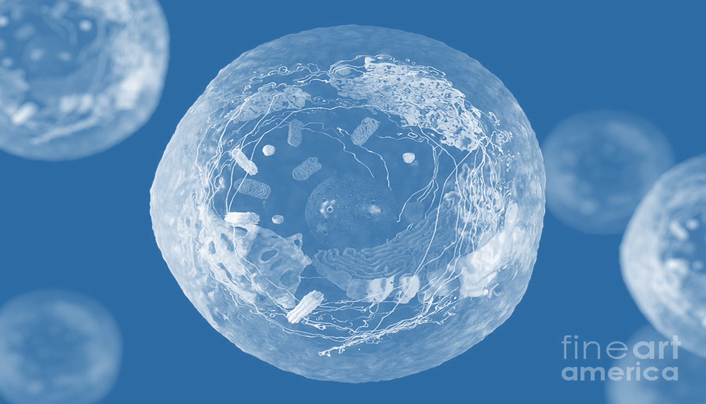

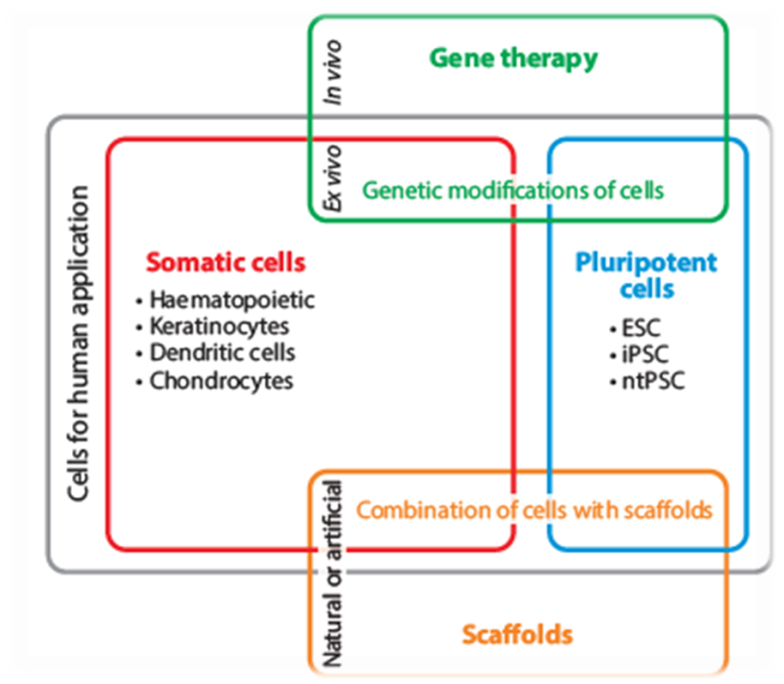
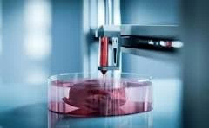

Notes:
Examples

Slide 4


SoHO-BASED THERAPIES
Antecedentes
SoHO Human application
Medical Devices
Medicines
(ATMPS, SoHO derived MP*…..)
Non-marketable products
Offered as a Service, not for profit
Marketable products
Commercialized for profit
Directive 2002/98/EC (human blood and blood components); Directive 2010/45/EU (Organs); Directive 2004/23/EC (human tissues and cells); Regulation No 1394/2007 (advanced therapy medicinal products); Regulation 2017/745 (medical devices). Regulation 2024/1938 (SoHO ).
* Under discussion (Pharma Regulation): Medicines derived from SoHO other than Tissues and Cells

Slide 5
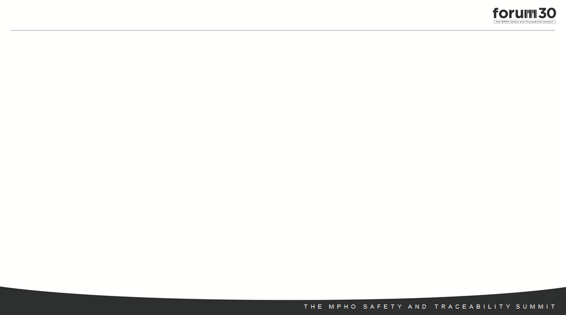



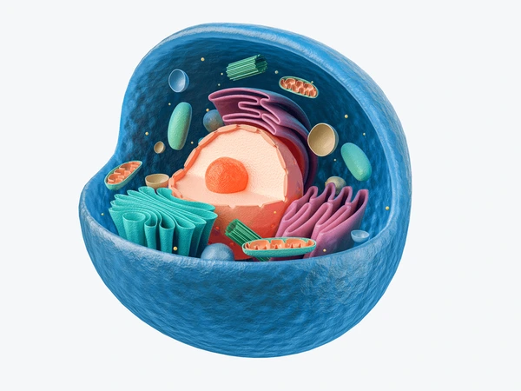
«You are about to leave the SoHO sector»
HUMAN CELL
MEDICINE PRODUCT/MEDICAL DEVICE

Slide 6
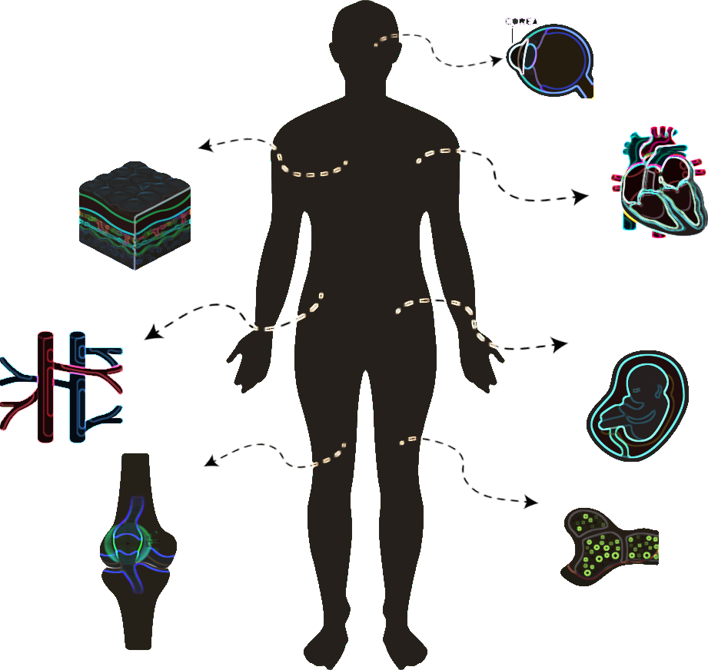

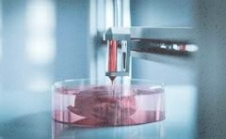
HUMAN ORIGIN
Notes:
Examples

Slide 7
FROM SoHO TO MEDICINES/MEDICAL DEVICES
Carry a range of unique RESPONSIBILITIES to ensure ethical and safe procurement, distribution, and societal acceptance of the public as source of the necessary human components. TRUST
Have a shared exposure to RISKS-breaches of ethical, legal and safety standards or the risk of disease transmission with a potential undesirable outcome

Slide 8
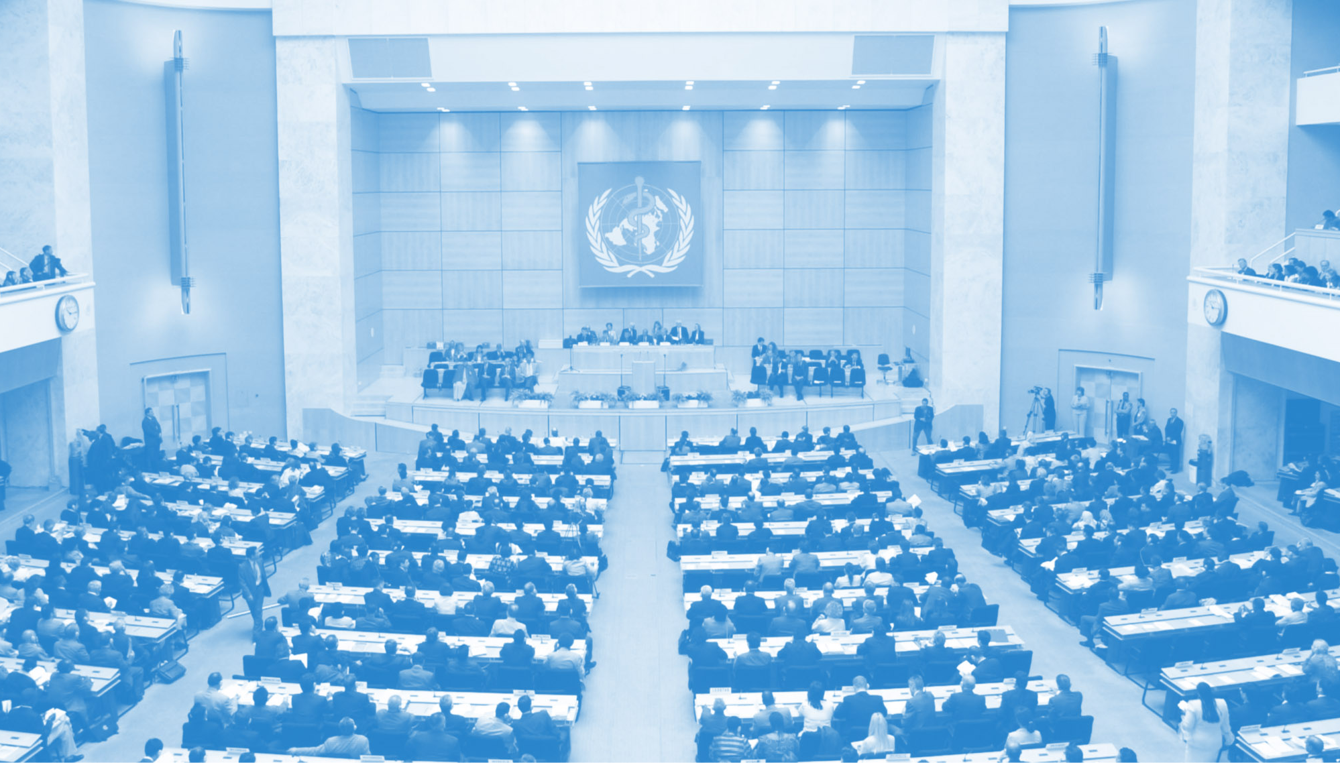
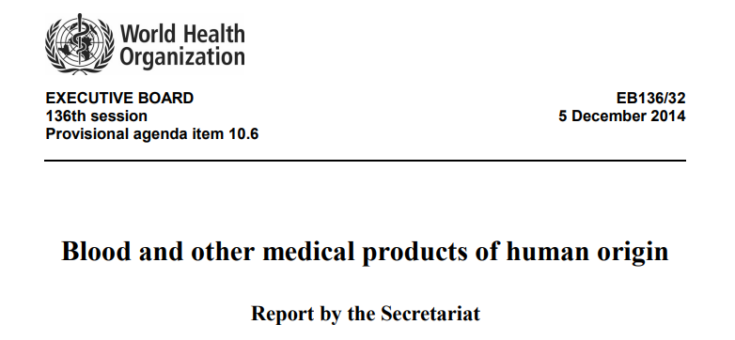
WHA 70: PRINCIPLES ON THE DONATION AND MANAGEMENT OF BLOOD, BLOOD COMPONENTS AND OTHER MEDICAL PRODUCTS OF HUMAN ORIGIN
Medical products of human origin encompass all biological materials that are derived wholly or in part from the human body and are intended for clinical application
https://apps.who.int/iris/handle/10665/274794
10 PRINCIPLES
DONOR PROTECTION
(dignity/health)
CONTROL OF BIOLOGICAL RISKS
EQUITY IN ACCESS

Slide 9


EU REGULATORY PATHWAY SoHO vs MEDICINAL PRODUCTS
SoHO
Regulation 2024/1938
MEDICINES/MEDICAL DEVICES
Directive 2001/83
Regulation 2007/1394
Regulation 2017/745
Donation/Procurement/Testing/Relase of SoHO: same norm
Transplant Competent Authority
Processing:
SoHO Establishments
+ SoHO Standards (EDQM, ECDC)
Manufacturing:
GMP Laboratories
+ Pharmaceutical standards
Clinical Use: Authorization
for human application
SoHO Competent Authority
Clinical Use: Commercialization
(Hospital Exemption)
EMA or Pharma Competent Authority
Directive 2002/98/EC (human blood and blood components); Directive 2004/23/EC (human tissues and cells); Regulation No 1394/2007 (advanced therapy medicinal products); Regulation 2017/745 (medical devices). Regulation 2024/1938 (SoHO).

Slide 10

SOHO-BASED THERAPIES
SoHO Transplants/ Human application
Medicinal product
Medical
Device
PATIENT ACCESS
PATIENT ACCESS
Not commercialized
Incorporated into healthcare practice as a therapeutic procedure in centers authorized by competent authorities after their quality and safety (and efficacy) have been appropriately assessed
Medicinal product: authorization of commercialization (possible hospital exemption)
Medical device: commercialization that requires European Certificate of Conformity (CE)

Slide 11
Innovation: before the SoHO Regulation……
At the EU level, where could developers request advice for SoHO products regulatory status?
DEVELOPERS
MEDICINAL PRODUCT?
BORDERLINE PRODUCT?
SoHO?
CAT*
RISK FOR OVERCLASSIFICATION AS MEDICINAL PRODUCT
* Under discussion. Pharma Regulation
Cuende N, et al. Stem Cell (submitted for publication)

Slide 12
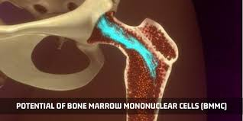
AN EXAMPLE: BONE MARROW MONONUCLEAR CELL FRACTION
Fraction of the bone marrow rich in hematopoietic stem cells and stem cells of different types, including endothelial stem cells that are involved in neovasculogenesis in the adult. It is obtained through a procedure of cellular separation using closed automatized equipment, that is considered a non-substantial manipulation.
CLINICAL USE
Treatment of hemato-oncological diseases that require an allogenic HSC when there is an ABO incompatibility between donor and recipient
Treatment of non hematological diseases (e.g. ischemic diseases as a critical ischemia of the lower limbs to avoid amputation)
Allogenic treatment
Immunocompromised patient
Administered by a central route
Autologous treatment
Immunocompetent patient
Administered by a peripheral route or locally
HIGHER RISK PATIENT (immunocompromised)
HIGHER RISK PRODUCT (ALLOGENIC)
HIGHER RISK ADMINISTRATION ROUTE
LOWER RISK PATIENT (immunocompetent)
LOWER RISK PRODUCT (AUTOLOGOUS)
LOWER RISK ADMINISTRATION ROUTE
Cuende N, et al. Haematologica 2013; 98(3): 323-324

Slide 13
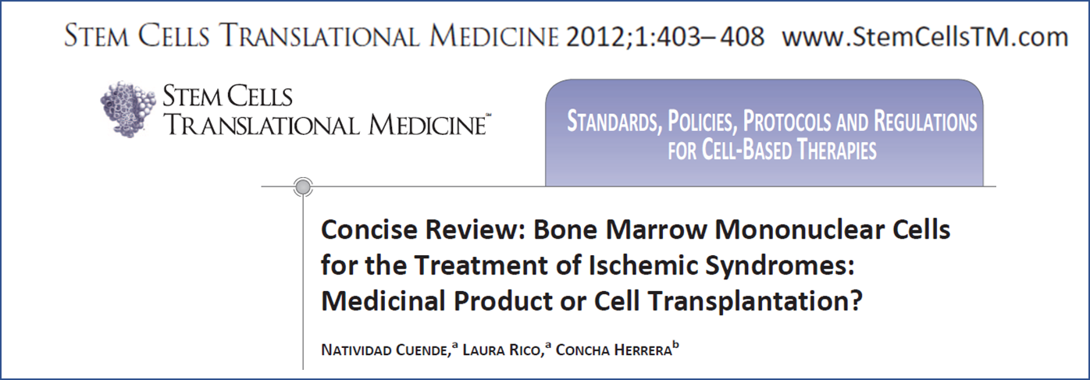
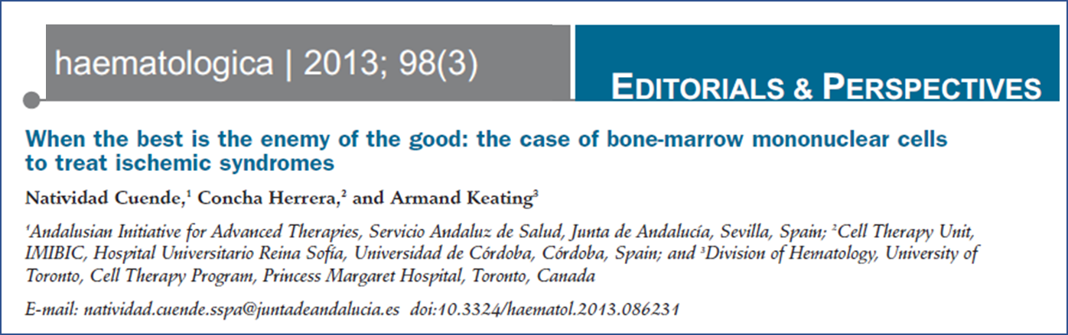
AN EXAMPLE: BONE MARROW MONONUCLEAR CELL FRACTION
REGULATORY FRAMEWORK
Treatment of hemato-oncological diseases
HIGHER RISK TREATMENT
Treatment of non-hematological diseases
LOWER RISK TREATMENT
TRANSPLANT
ATMP
According to CAT advice, because it is considered that cells are used for a non-essential function.
Highly questionable from a scientific point of view, and with relevant consequences from an economical, organizational and ethical perspective
Cuende N, et al. Haematologica 2013; 98(3): 323-324

Slide 14

BENEFITS? YES! BUT……..
Risk of violation of fundamental ethical principles
Risk of increasing costs
Risks for the sustainability of health-care systems
Risks for the accessibility of patients to SoHO based treatments

Slide 15




RISKS DERIVED FROM THE COMMERCIALIZATION OF SOHO
RISK OF VIOLATION OF FUNDAMENTAL ETHICAL PRINCIPLES
Principle of voluntary and unpaid donation of SOHO
  Article 21 Oviedo Convention: “the human body and its parts, as such, shall not give rise to financial gain”
Principle of equity in access to SOHO-based treatments
  Article 3 Additional Protocol Oviedo Convention: “Parties shall guarantee that a system exists to provide equitable access to transplantation services for patients.”
Principle of prohibition of financial gain of the human body
  Article 21 Oviedo Convention: “the human body and its parts, as such, shall not give rise to financial gain”
Principle of informed consent, if donors do not receive explicit information on the destination of the donated biological material and of the possibility of subsequent profit for a third party (sometimes disproportionate).
Article 19 Oviedo Convention: “the necessary consent (…) has been given expressly, specifically and is documented. Such consent may be freely withdrawn at any time”.
RISK OF JEOPARDISING THE TRUST OF THE POPULATION AND ALTRUISTIC DONATION

Slide 16
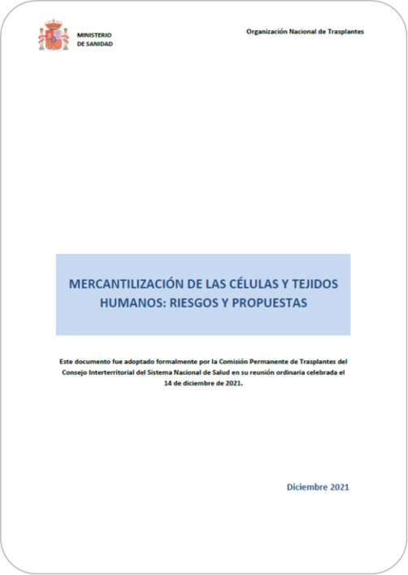
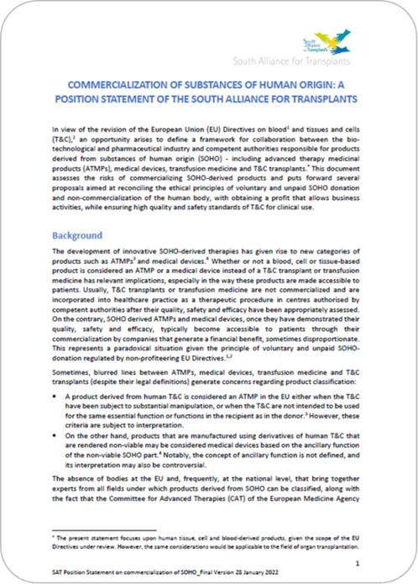
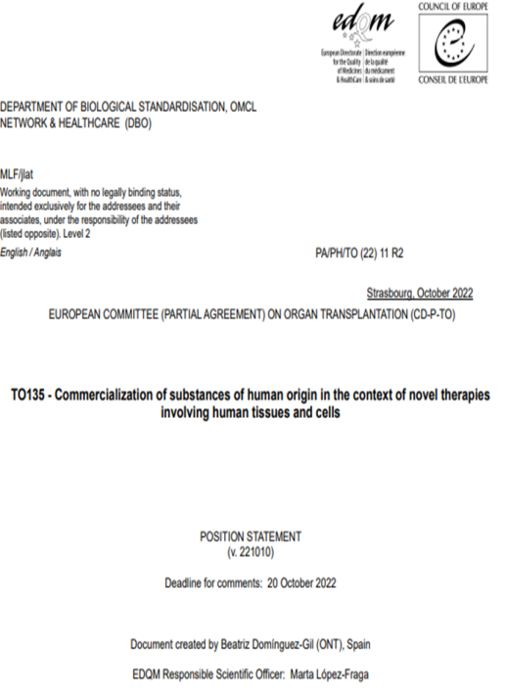
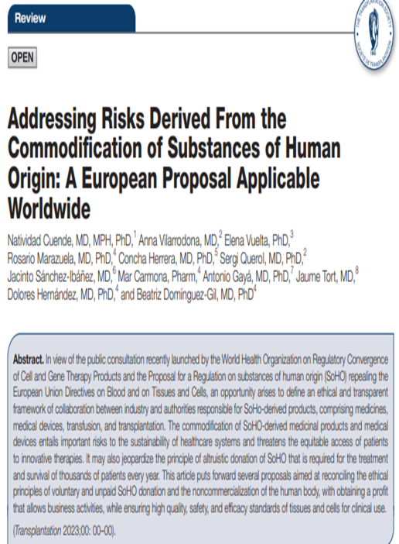
IDENTIFYING RISKS AND PROPOSING SOLUTIONS
Spain Ministry of Health
SAT
CD-P-TO
Transplantation
And beyond!

Slide 17
ONT: IDENTIFYING RISKS AND PROPOSING SOLUTIONS
TO PRESERVE AND REAFFIRM THE PRINCIPLE OF NON-COMMERCIALISATION OF SOHO, prohibiting any remuneration of subjects who donate SOHO, whatever their final destination and future application are, including the preparation of ATMPs or medical devices, and establishing mechanisms to regulate profits
TO FURTHER GUARANTEE DONOR PROTECTION, by establishing mechanisms to ensure informed consent on the final use of these substances, explicitly specifying the destination of the donated biological material, whether for research or treatment purposes, and the possibility of subsequent profit for a third party.
TO IMPROVE COORDINATION BETWEEN THE VARIOUS BODIES AND COMPETENT AUTHORITIES IN THE FIELD OF ATMPS, MEDICAL DEVICES, TRANSFUSION MEDICINE AND T&C TRANSPLANTATION BY ESTABLISHING
At the EU level, a body composed, in a balanced manner, of experts from the four afore mentioned fields. This expert body should transparently provide advice on the classification of any SOHO-derived product.
At a MS level, a balanced composition body that classifies SOHO-based products as ATMPs, medical devices, transplants or transfusion medicine in a binding manner, taking into account certain criteria that are open to interpretation, the consequences derived from the commercialization of SOHO and the impact that such classification may have from a strategic perspective.

Slide 18
ONT: IDENTIFYING RISKS AND PROPOSING SOLUTIONS
TO ESTABLISH TRANSPARENT AND PARTICIPATORY MECHANISMS FOR THE DEFINITION OF QUALITY AND SAFETY STANDARDS FOR DONATION, PROCUREMENT AND CLINICAL USE OF SOHO. We urge using as standards the technical guides published by the EDQM - Council of Europe.
TO REGULATE CLINICAL RESEARCH WITH HUMAN T&C IN A DIFFERENT WAY TO CLINICAL TRIALS APPLIED TO MEDICINES, allowing research methodologies designed in accordance with the level of complexity of the innovation and its potential risk for patients, such as those proposed by the GAPP Joint Action.
TO PROMOTE MECHANISMS TO FOSTER DEVELOPMENT AND INNOVATION WITHIN TISSUE ESTABLISHMENTS, which ensure citizens have access to SOHO-based therapies of greater added value, while safeguarding the sustainability of the system.
TO ESTABLISH CRITERIA AND TRANSPARENT MECHANISMS TO ASSESS AND ENSURE THE QUALITY, SAFETY AND EFFECTIVENESS OF NEW T&C-BASED PRODUCTS prior to their incorporation into clinical practice as transplants.

Slide 19

SoHO Regulation
Santander Summit

Slide 20

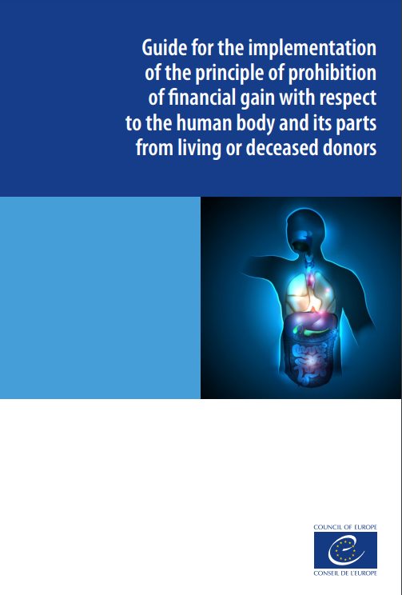



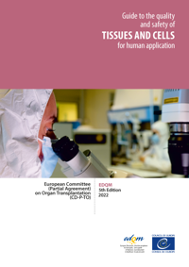
SoHO REGULATION
PRESERVE AND REAFFIRM THE PRINCIPLE OF NON-COMMERCIALISATION OF SOHO prohibiting any remuneration of subjects who donate SOHO
Consolidation of the principle of voluntary and unpaid donation
IMPROVE COORDINATION BETWEEN THE VARIOUS BODIES AND COMPETENT AUTHORITIES IN THE FIELD OF ATMPS, MEDICAL DEVICES, TRANSFUSION MEDICINE AND T&C TRANSPLANTATION
Creation of the SoHO Coordination Board which, among other functions, will advise the Member States on the regulatory status of substances, activities and products
Common procedure for the authorisation of innovative SoHO preparations, with development of risk-based monitoring plans and clinical studies
PROMOTE MECHANISMS TO FOSTER DEVELOPMENT AND INNOVATION WITHIN TISSUE ESTABLISHMENTS
High quality and safety standards, implemented through technical guidelines developed by specialized external bodies and based on scientific evidence
ESTABLISH TRANSPARENT AND PARTICIPATORY MECHANISMS FOR THE DEFINITION OF QUALITY AND SAFETY STANDARDS FOR DONATION, PROCUREMENT AND CLINICAL USE OF SOHO

Slide 21
SoHO REGULATION
At the EU level, NOW developers will be able to request advice for SoHO derived products´ regulatory status to the SCB
DEVELOPERS
MEDICINAL PRODUCT?
BORDERLINE PRODUCT?
SoHO?
CAT*
Fostering cooperation between sectors
SoHO Coordination Board
* Under discussion. Pharma Regulation

Slide 22
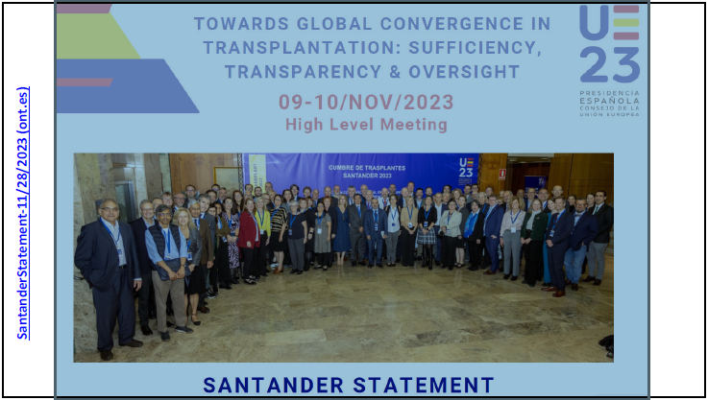
SANTANDER GLOBAL SUMMIT
The ONT under the Spanish Presidency of the Council of the European Union, convened in Santander a Global Summit entitled “Towards Global Convergence in Transplantation: Sufficiency, Transparency and Oversight”.
Co-organised by the EDQM of the Council of Europe, the ESOT, and the Transplantation Society (TTS). Co-sponsored by the World Health Organization (WHO) and supported by the International Society of Nephrology (ISN).
Objectives:
Pave the way for global action in transplantation for the next decade.
  Critically review the current state of donation and transplantation of organs, tissues, and cells,
  Identify key challenges, and shape the future direction of transplant activities worldwide to ensure that advances in this field benefit citizens across the globe.

Slide 23
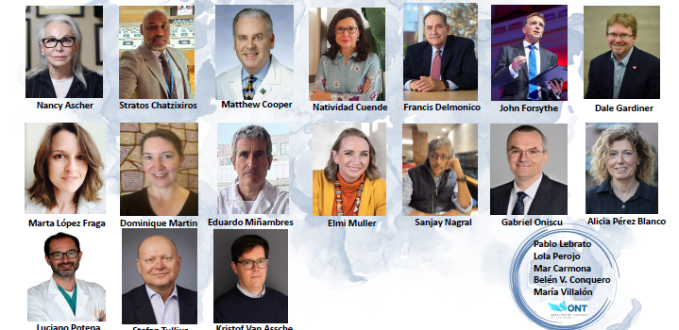

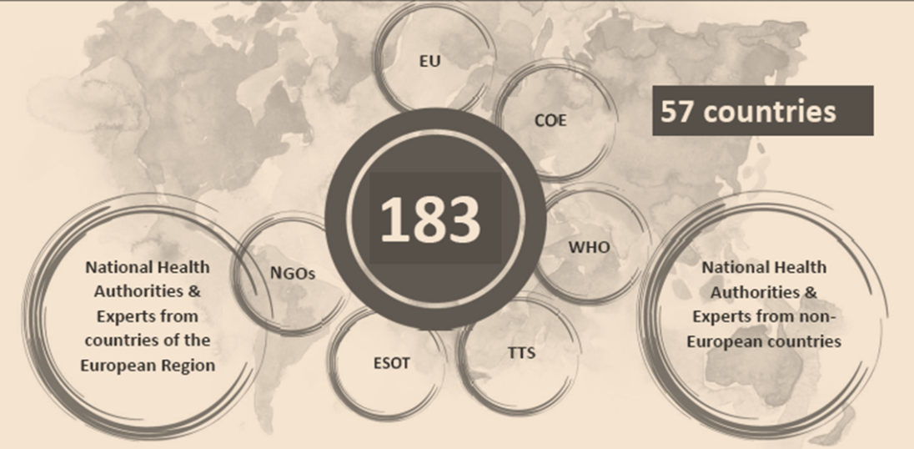
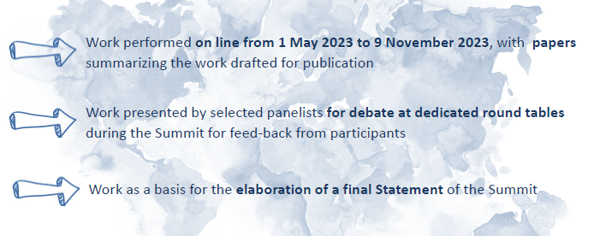
INNOVATION IN DONATION AND CLINICAL APLICATION OF SoHO
Describe and document preselected challenges
Analyse models, programs, initiatives of success
Identify priority actions for Gov. International Organizations and NGOs
ETHICAL CHALLENGES
TRANSPLANTATION AS A HEALTH CARE PRIORITY
DONATION AND TRANSPLANTATION
Notes:
E,loxperts conveyed and assigned four diffetent WORKING GROUPS
Describe and document preselected challenges
Analyse models programs initiatives of success addressing those challenges
Identify priority actions for governments, international organizations and NGOs

Slide 24
INNOVATION IN DONATION AND CLINICAL APLICATION OF SoHO
Describe and document preselected challenges
Analyse models, programs, initiatives of success
Identify priority actions for Gov. International Organizations and NGOs
ETHICAL CHALLENGES
TRANSPLANTATION AS A HEALTH CARE PRIORITY
DONATION AND TRANSPLANTATION
Notes:
E,loxperts conveyed and assigned four diffetent WORKING GROUPS
Describe and document preselected challenges
Analyse models programs initiatives of success addressing those challenges
Identify priority actions for governments, international organizations and NGOs

Slide 25
SANTANDER GLOBAL SUMMIT
ETHICS GROUP CHALLENGES
Limited knowledge of inequities in access to SoHO based therapies (SBT)
Multifactorial nature of inequities in access to SBT
Setting ethically justifiable boundaries on access to SBT
INNOVATION GROUP CHALLENGES to promote innovation in a collaborative, sustainable and transparent manner:
Understand the implications of how SBT are regulated
Ensure clinical benefit and safety before innovation reaches the bedside
Making innovation sustainable for health care systems
Make innovation accessible for patients
RECOMMENDATIONS
Martin DE, Van Assche K, Cervantes L, et al. Toward Equity in Global Access to SoHO-based Therapies: Recommendations for Action. Transplantation. 2024 Oct 22. doi: 10.1097/TP.0000000000005106
Cuende N, Tullius SG, Izeta A, et al. Promoting Equitable and Affordable Patient Access to Safe and Effective Innovations in Donation and Transplantation of Substances of Human Origin and Derived Therapies. Transplantation. 2024 Oct 22. doi: 10.1097/TP.0000000000005169.

Slide 26
SANTANDER GLOBAL SUMMIT
KEY CONSIDERATIONS FOR COMPETENT AUTHORIITIES
Establish and maintain registries in accordance with minimum data sets (CoE or WHO observatory)
Governance on data collection under the responsibility of National Health Authorities
Resources for data collection
Warrant data protection, traceability and dissemination nationally and internationally
Differences in donation and transplantation governance for SoHO intended for manufacturing of Medicines
Accurate activity data to assess risks (SARE) with SBT
Substantial manipulation obscure human origin and awareness on ethical significance
Fewer data available for SBT
Limited Knowledge on inequities in access to SBT
SBT regulation within various frameworks : variable levels of supervision
Martin DE, Van Assche K, Cervantes L, et al. Toward Equity in Global Access to SoHO-based Therapies: Recommendations for Action. Transplantation. 2024 Oct 22. doi: 10.1097/TP.0000000000005106

Slide 27
SANTANDER GLOBAL SUMMIT
Lack of investment in infrastructure for donation and development of SBT
Clinician bias
Regulation and legal considerations
Lack of diversity donor pool
Multifactorial nature of inequities in access to SBT
Lack of public health insurance for relevant clinical care
SETTING ETHICAL BOUNDARIES ON ACCESS TO SBT
Procedural justice: transparency-impartiality-consistency-accountability for exceptions
Optimize therapeutic benefit
Strive for self sufficiency
Cross-border collaboration: agreements, responses to regional crises, Governance of international travel for transplant, criteria for import/export of SBT
Martin DE, Van Assche K, Cervantes L, et al. Toward Equity in Global Access to SoHO-based Therapies: Recommendations for Action. Transplantation. 2024 Oct 22. doi: 10.1097/TP.0000000000005106

Slide 28
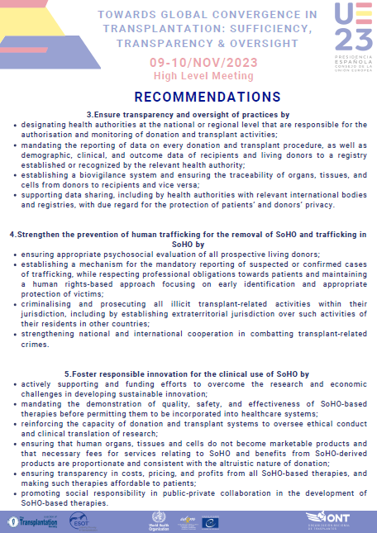
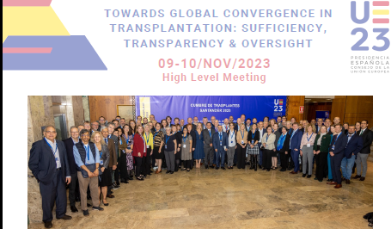
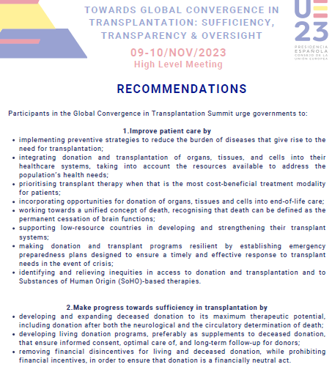
SANTANDER STATEMENT
Improve patient care
Make progress towards sufficiency in transplantation
Ensure transparency and oversight of practices
Strengthen the prevention of human trafficking for the removal of SoHO and trafficking in SoHO
Foster responsible innovation for the clinical use of SoHO

Slide 29
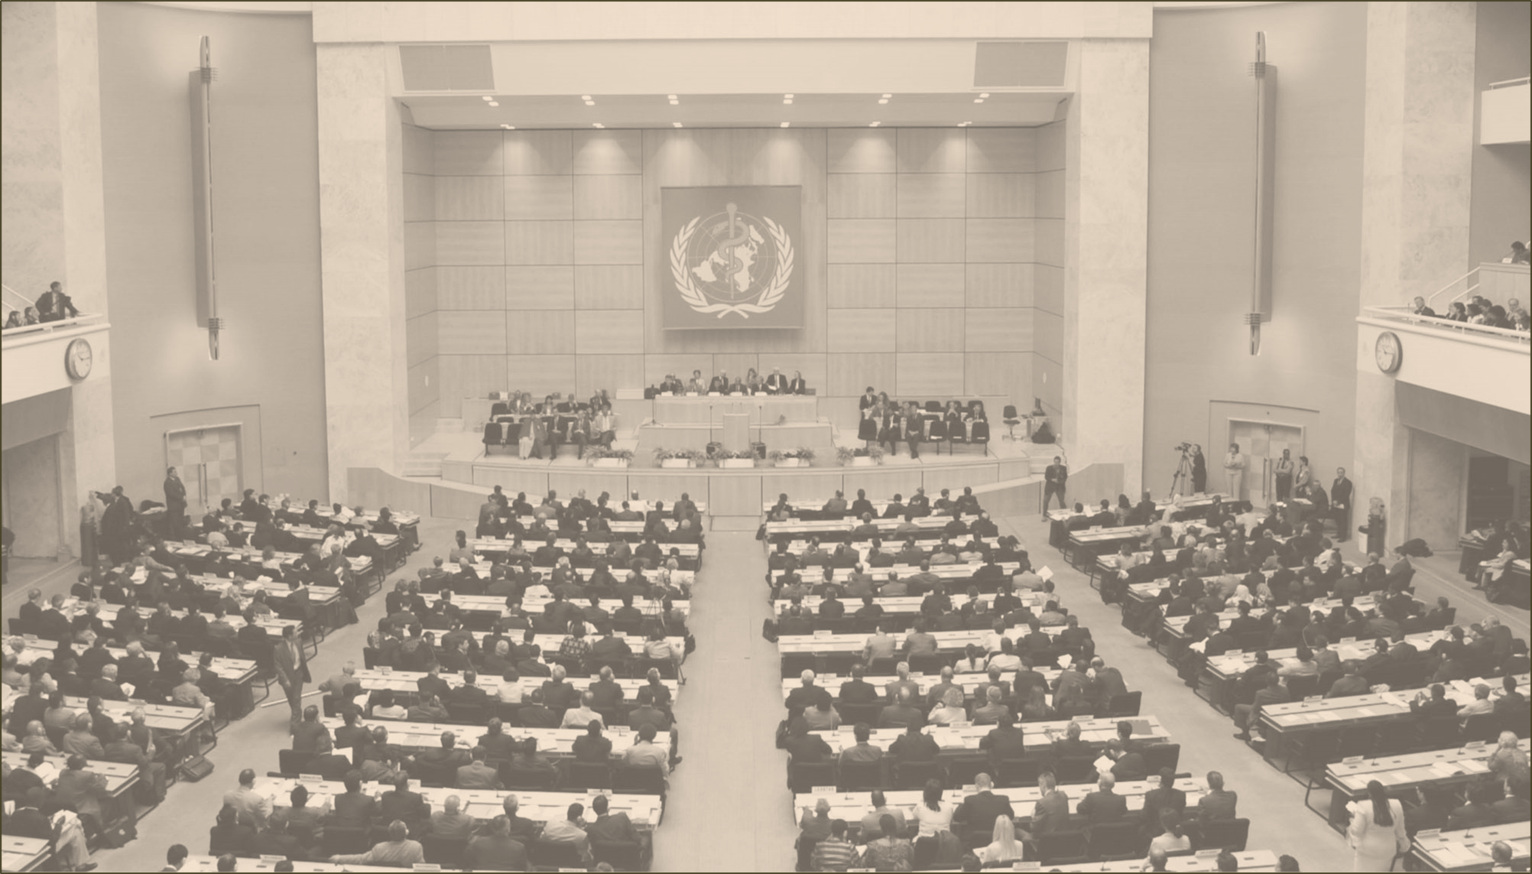
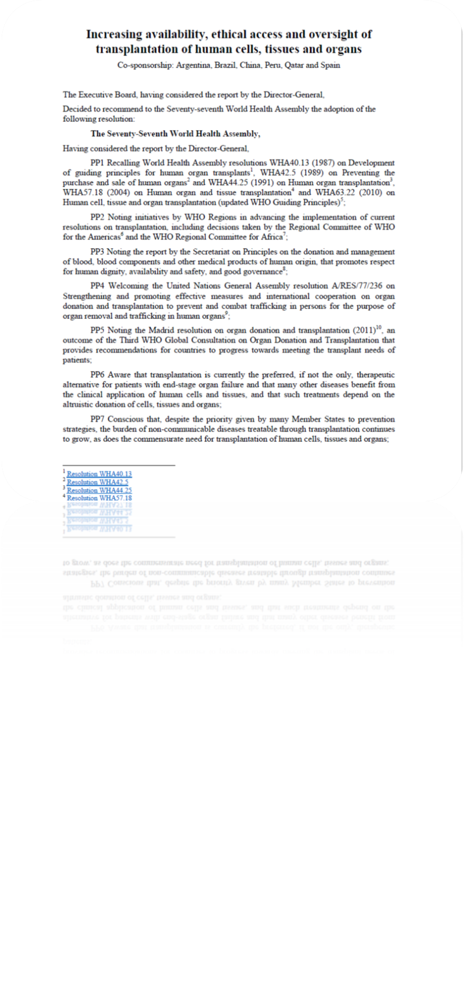
THE 77 th WORLD HEALTH ASSEMBLY
Protect Living donors
Implement regulatory frameworks encouraging VUD and promoting equitable access to transplant
Promote research and innovation
Implement regulatory frameworks applicable to innovative therapies developed from substantially manipulated cells, tissues and organs that ensure protection of donors and recipients and that pursue equity in access to these novel therapies and sustainable health care systems

Slide 30
CONCLUSIONSES
START WORKING ON A GLOBAL STRATEGY
Achieving consensus on terminology: SoHO / MPHO….
Fostering innovation and cooperation with pharma sector
Working on classification of SoHO based therapies considering the risks of overclassification as Medicines
Building trust in population about the need of SoHO beyond transfusion and transplantation

Slide 31
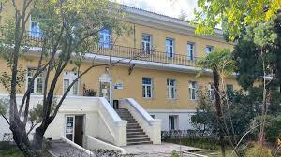
ON BEHALF OF THE ONT´S SoHO TEAM….
Notes:
Charo

Slide 32








THANK YOU FOR YOUR ATTENTION
Marina Alvarez
Projects Unit
Rebeca Sanchez
Investigation Unit
Mar Carmona
Projects Unit
Bibiana Ramos
Administration
Lucía Peña:
Investigation Unit
Dolores Hernández-Maraver
MD PhD
IT
Félix Sánchez-Vicario
Nuria García-Moriche
Nurses Transplant Coordination
dhernandezma@sanidad.gob.es
ont_donaciónytrasplante
@ONT_esp
Communication
Notes:
Charo

