Slide 1

From Forum 25 to Forum 30: how far have we come since 2019?
Future: what will the next 5 years hold for MPHO?
Efstratios (Stratos) CHATZIXIROS
Advisor, Transplantation Human Organs-Tissues-Cells
Blood and Other Products of Human Origin team
Health Products Policies and Standards department
WHO Headquarters - Geneva

Slide 2
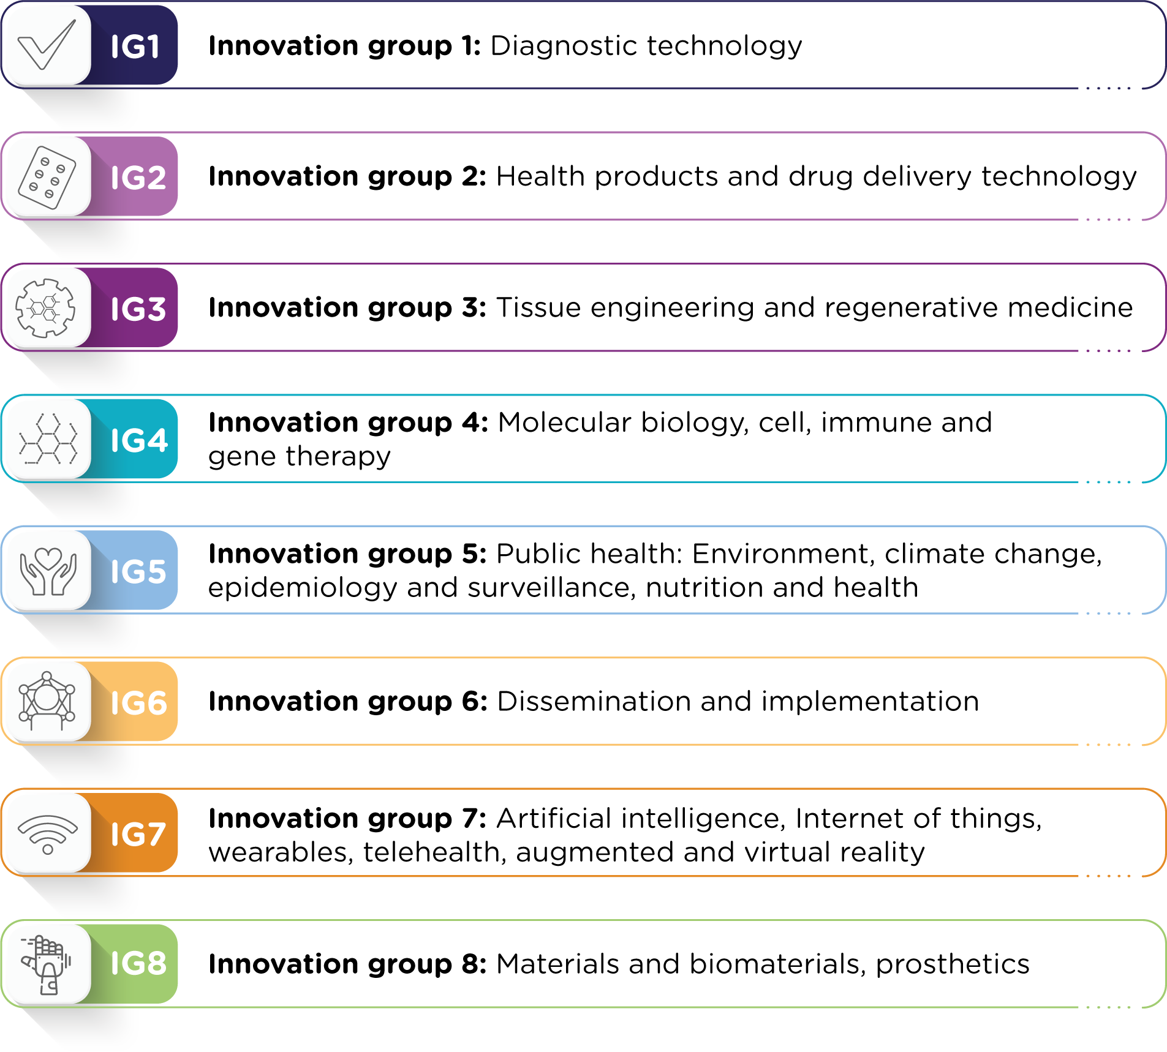
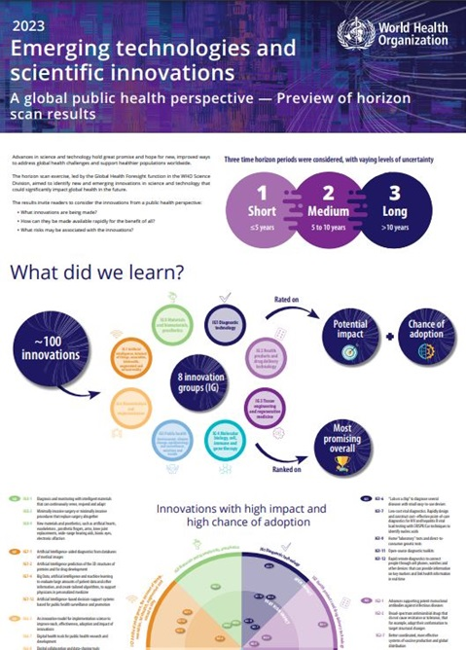
Monitoring trends in Emerging Technologies & Science
~100 innovations

Slide 3
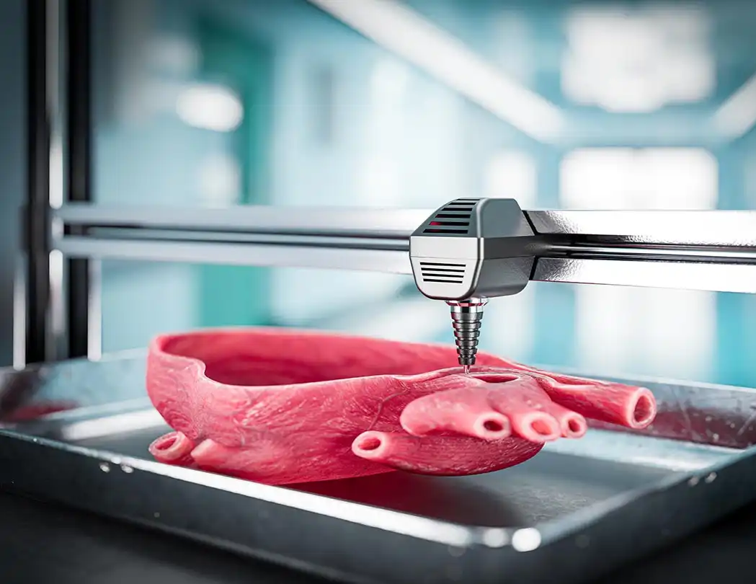

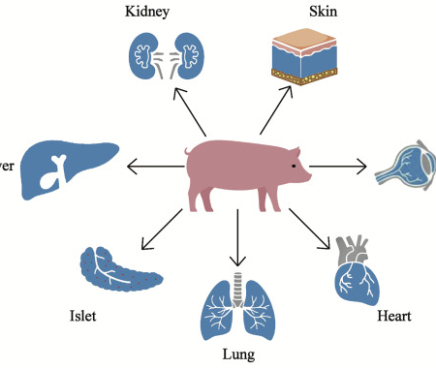
Key advancements in science and technology
(opportunities/challenges)
Cell and Gene Therapies
Regenerative Medicine
Immunogenetics
Organ Preservation
Donor Alternatives
  Xenotransplantation
  Bioprinting
  Artificial organs

Slide 4
WHO 14th General Programme of Work (GPW14)
Advancing health equity and health systems resilience in a turbulent world: a global health agenda for 2025–2028
Promoting, providing and protecting health and well-being for all
Strategic Objectives
1. Respond to climate change, an escalating health threat in the 21st century.
2. Address health determinants and the root causes of ill health in key policies across sectors.
3. Advance the primary health care approach and essential health system capacities for universal health coverage.
4. Improve health service coverage and financial protection to address inequity and gender inequalities.
5. Prevent, mitigate and prepare for risks to health from all hazards.
6. Rapidly detect and sustain an effective response to all health emergencies.

Slide 5
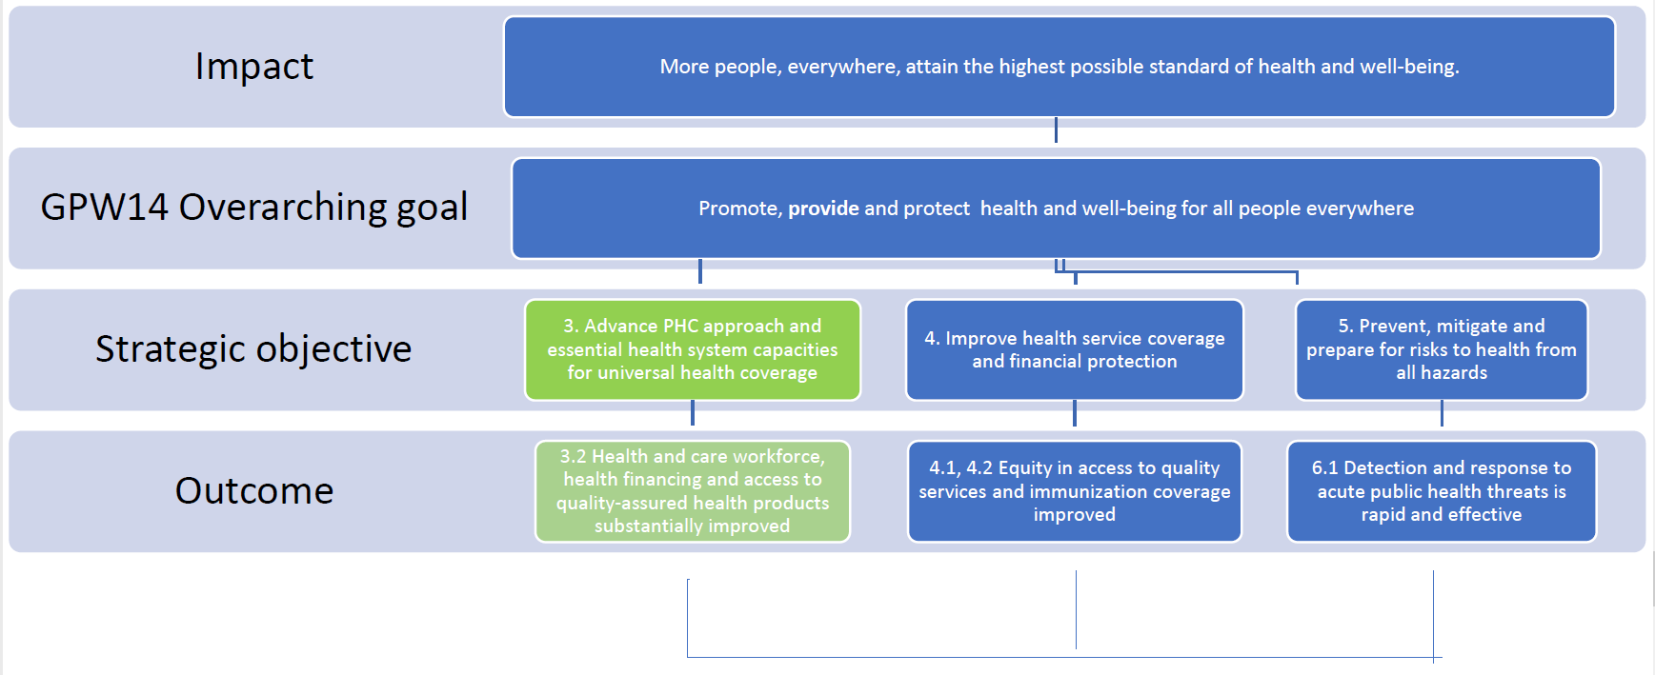
Access to health products within the GPW14

Slide 6
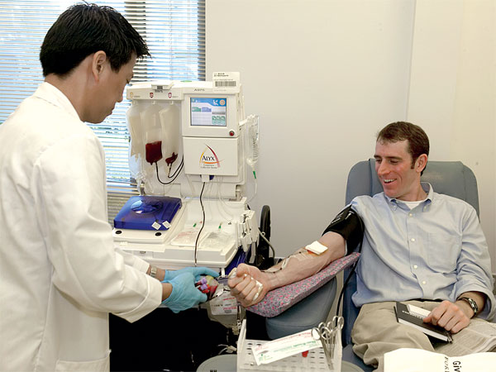
GLOBAL CHALLENGES IN BLOOD SYSTEMS
GDBS 2021 reported on data by 92 countries:
33 high-income
29 upper-middle-income
21 lower-middle income
9 low-income
Hospital transfusion committees in 48% of hospitals performing transfusion.
Systems for reporting adverse transfusion events were present in 55% of hospitals
GDBS 2018 indicates that 49% (84 of 171) countries reported having a national haemovigilance system.
Europe: 81% (34 of 42)
Western Pacific: 52% (13 of 25)
Eastern Mediterranean: 50% (9 of 18)
South-East Asia: 40% (4 of 10)
Africa: 40% (17 of 43)
Americas: 21% (7 of 33)
WHO Global Database on Blood Safety (GDBS) https://apps.who.int/iris/handle/10665/356165
Inadequacy in policy, regulations, governance & financing
Insufficient supply of blood products
Deficiencies in safety, effectiveness and quality
Lack of availability of PDMPs
Sub-optimal clinical practices
Poor access to blood during emergency

Slide 7
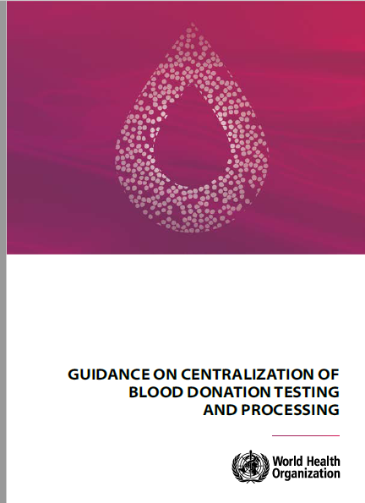
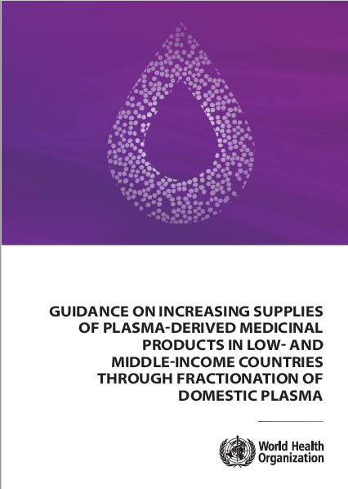
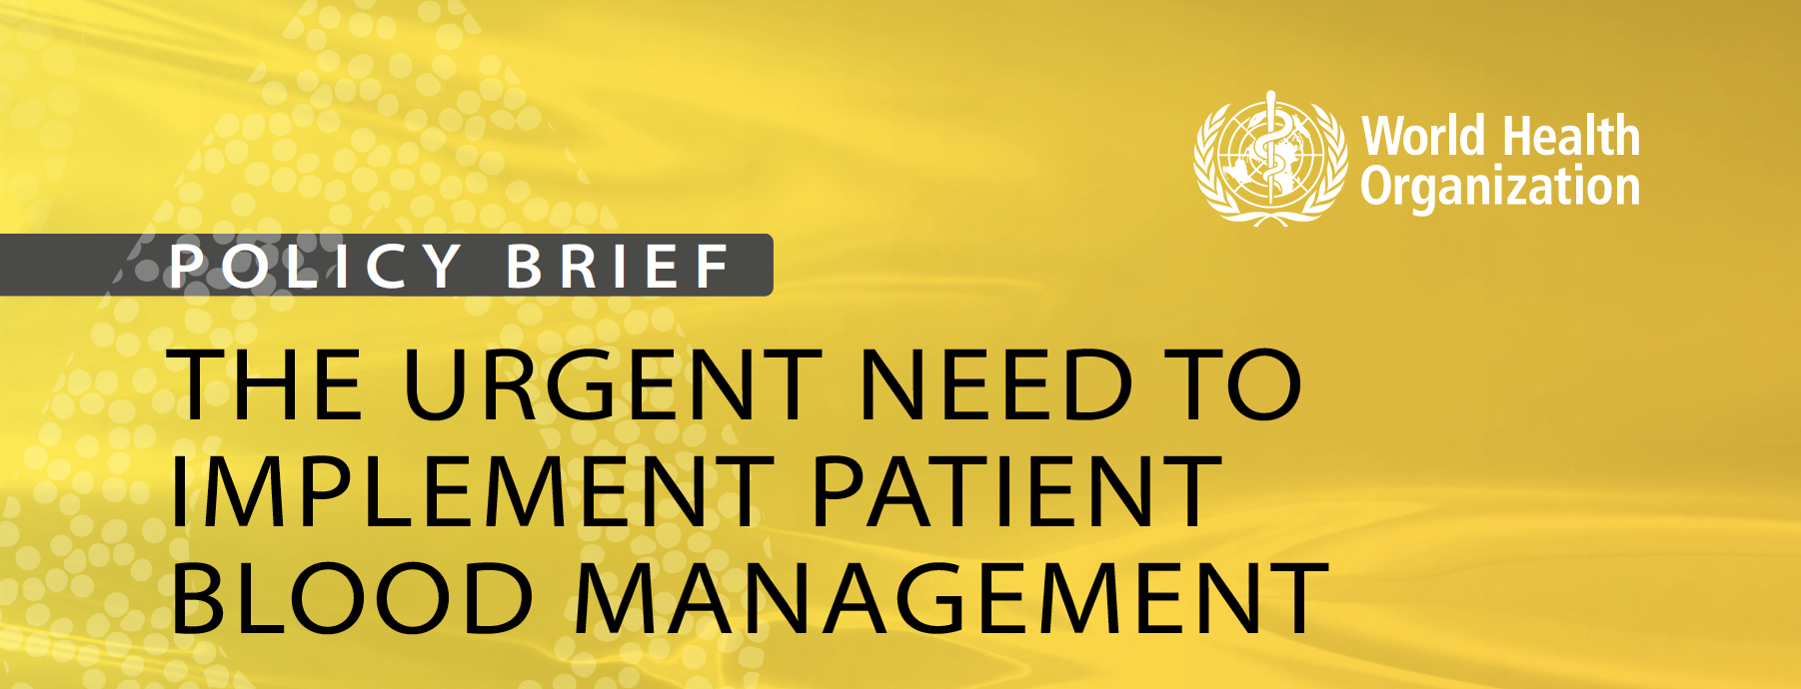
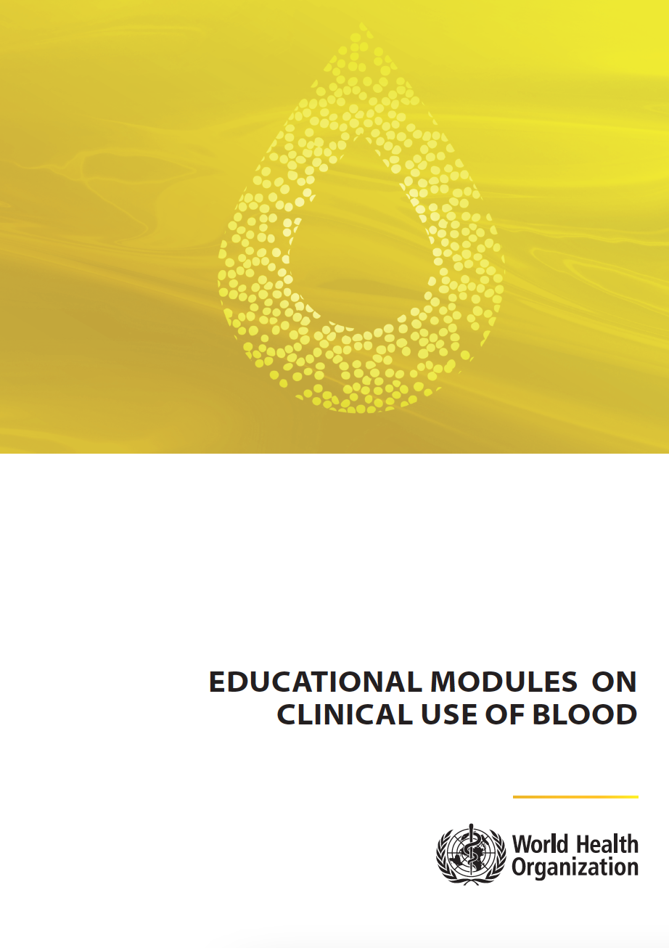
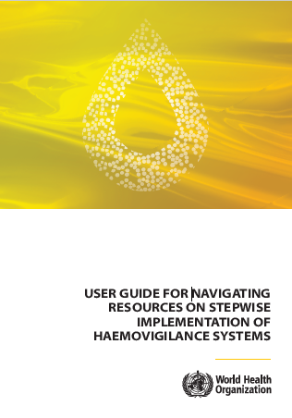
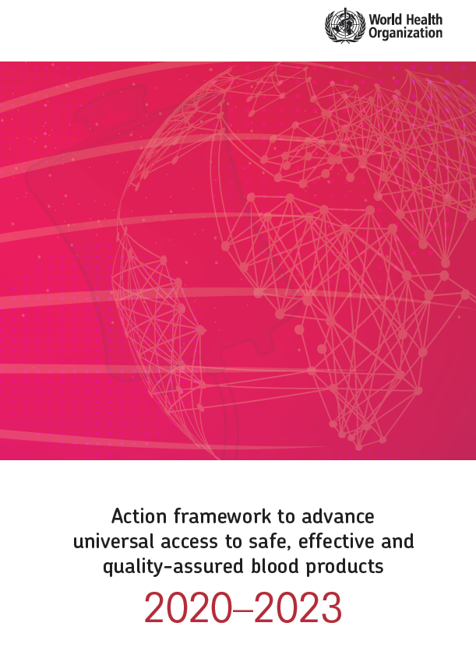
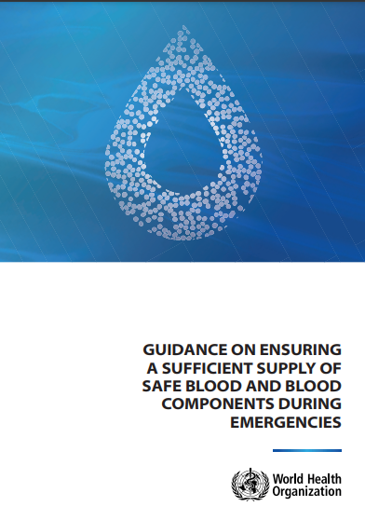
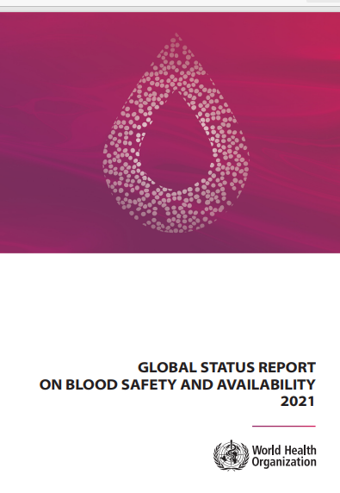
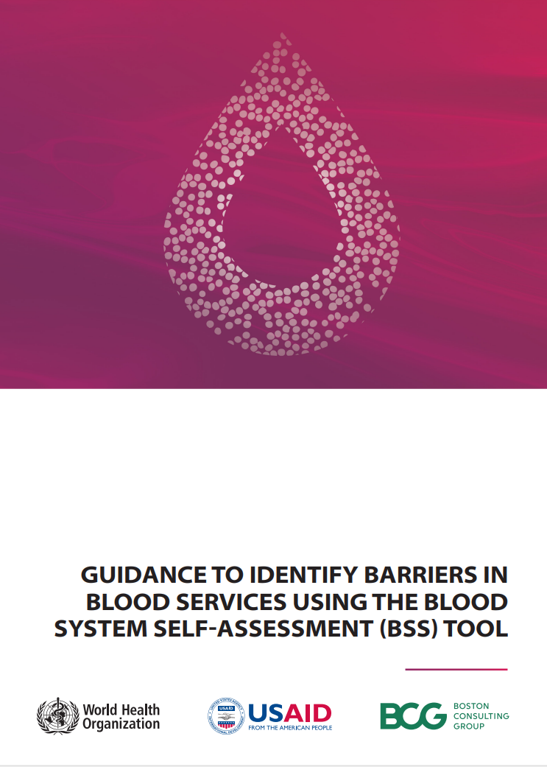
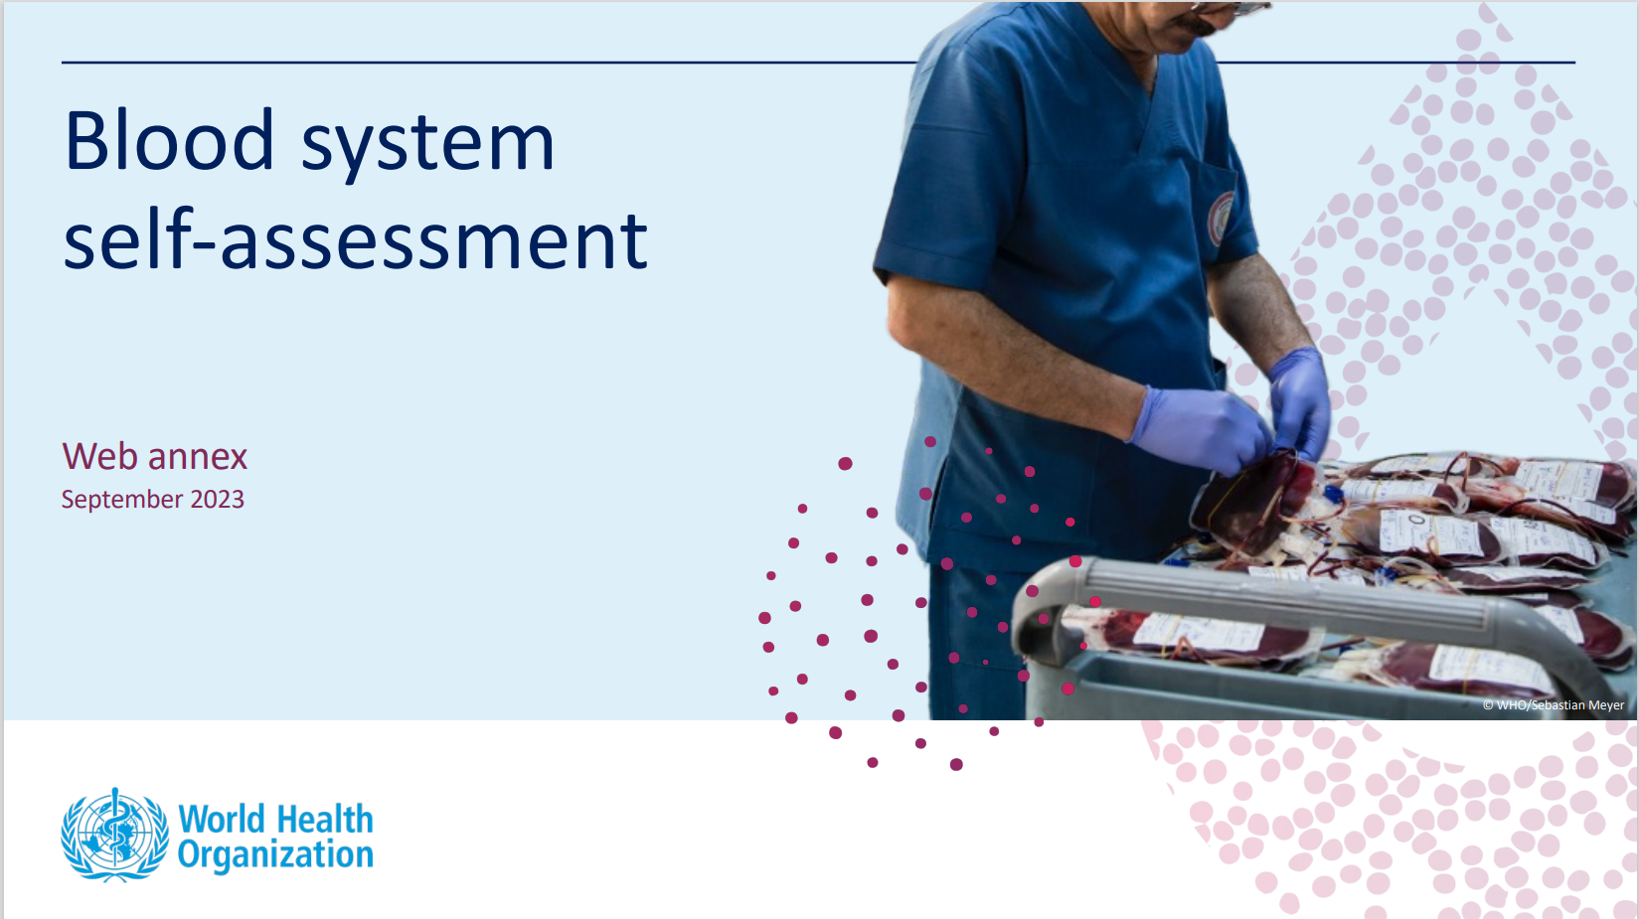
Global Guidance on Blood Products
(Developed in 2020-2023)
WHO Response (February 2020)
Aims: Strategic direction to global efforts
to address present barriers to safe blood
https://apps.who.int/iris/bitstream/handle/10665/340182/9789240020825-eng.pdf
https://apps.who.int/iris/bitstream/handle/10665/340171/9789240021815-eng.pdf
https://apps.who.int/iris/bitstream/handle/10665/346655/9789240035744-eng.pdf
https://apps.who.int/iris/bitstream/handle/10665/350246/9789240033733-eng.pdf
https://apps.who.int/iris/bitstream/handle/10665/360060/9789240047860-eng.pdf
https://apps.who.int/iris/handle/10665/331002
https://apps.who.int/iris/bitstream/handle/10665/366870/9789240068636-eng.pdf
https://www.who.int/publications/i/item/9789240051683
https://iris.who.int/bitstream/handle/10665/374355/9789240082243-eng.pdf
https://iris.who.int/bitstream/handle/10665/374183/9789240082267-eng.pdf

Slide 8
WHO Activities in other MPHOs
Global Guidance on Transplantation (OTC):
Policy Brief on Tissue Donation-Transplantation
  Tissue Compendium
Policy Brief on Role of National Competent Authority
Assessment of country capacity in transplantation
  Global Benchmarking Tool
MPHO related activities by other WHO units:
Standards on Human Milk Donation-Banking (Nutrition & Child Development)
Regulatory Convergence on Cell and Gene Therapies (Biological Standardization)
Framework for Gamete Donation-Banking (Sexual and Reproductive Health)

Slide 9
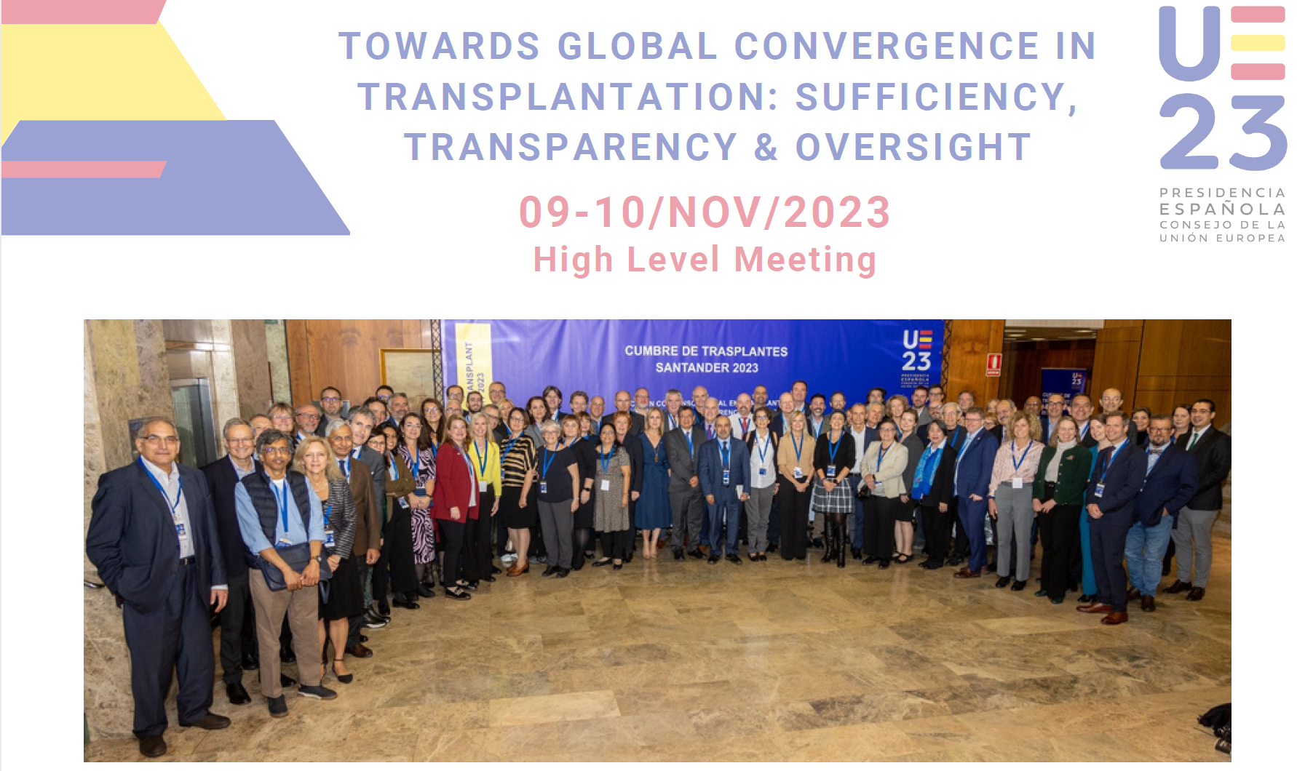
Santander Summit (Nov. 2023)
Recommendations
Improve patient care
Make progress towards sufficiency in transplantation
Ensure transparency and oversight of practices
Strengthen the prevention of human trafficking for the removal of SoHO and trafficking in SoHO
Foster responsible innovation for the clinical use of SoHO by
mandating the demonstration of quality, safety, and effectiveness of SoHO-based therapies before permitting them to be incorporated into healthcare systems;
reinforcing the capacity of donation and transplant systems to oversee ethical conduct and clinical translation of research;
ensuring that human organs, tissues and cells do not become marketable products and that necessary fees for services relating to SoHO and benefits from SoHO-derived products are proportionate and consistent with the altruistic nature of donation;
ensuring transparency in costs, pricing, and profits from all SoHO-based therapies, and making such therapies affordable to patients;
promoting social responsibility in public-private collaboration in the development of SoHO-based therapies.

Slide 10
New Resolution WHA 77.4 (2024)
Increasing availability, ethical access and oversight of transplantation of human cells, tissues and organs
Urges Member States to:
(7) to designate authorities and improve capacities to provide governance and implementation of donation and transplantation activities in their jurisdictions;
(8) to ensure that donation and transplantation activities take place in centres specifically authorized, accredited or registered, and establish control measures, such as periodic or risk-based inspections and the collection and timely reporting of data on every donation and transplant procedure, including transplants carried out on residents in other jurisdictions;
(9) to promote the safety and efficacy of transplantation by collecting data on the outcomes of recipients and living donors, conducting biovigilance and relevant surveillance, ensuring capacity to trace cells, tissues and organs from donor to recipient, and vice versa, and encouraging the use of globally consistent coding systems for human cells, tissues and organs;
(10) to consider including donation and transplantation in national and regional preparedness plans designed to increase the resilience of health care systems and to facilitate an effective response to transplant needs in the event of crisis;
(13) to implement regulatory frameworks applicable to innovative therapies developed from substantially manipulated cells, tissues and organs that ensure the protection of donors and recipients, and that pursue equity in access to these novel therapies and sustainable health care systems;

Slide 11
WHO Activities Under the New Resolution
Technical assistance to MS
Capacity building & Guidance
WHO Guiding Principles on Human Cell, Tissue and Organ Transplantation
Global Strategy
Establish an expert committee to assist in developing and implementing the global strategy
Developing national legislation & regulations
Assessing transplantation needs
Establishing or strengthening national authorities
Improving capacities to increase the availability of CTO
Strengthen regulatory capacity to effectively oversee donation and transplantation practices
Monitoring and evaluating transplantation program performance and donor and recipient outcomes
Novel products and treatments that are developed from human cells, tissues and organs
For consideration by the 79th WHA, through EB158 (2026)
Implementing ethical, effective and safe transplant programs
Provide reference guidance to MS on the diagnosis of death by neurological and by circulatory criteria
Analyse and make available global data on legislation, regulations, practices, safety, quality, effectiveness, epidemiology and ethics
Data collection:

Slide 12
Global Strategy Draft Outline
Vision and Objectives
The vision of the Global Strategy is that by 2035, every Member State will be able to address its patients' needs for life-saving transplantation treatments.
The objectives are to increase availability and accessibility, as well as to enhance safety and quality of transplantation of human cells, tissues and organs.

Slide 13
Key Elements of a Global Strategy
Strategic Actions:
Areas of interventions
Implementation:
Actors, Partnerships, Funding
Evaluation/Monitoring:
Measurable indicators
Legal framework
Regulation, quality and framework
Financial resources
Waiting list management
Allocation system
Registries
National authority
Mission and vision
Specialization
Clinical procedures (SOPs, guidelines, etc.)
Research & Education
Scientific societies
Hospitals
& healthcare professionals
Awareness
Religious and cultural leaders
Mass media & Information management
Patients
Population

Slide 14
Areas of Strategic Action (Proposed)
National Donation Programs for Cells, Tissues and Organs
National Transplantation Programs for Cells, Tissues and Organs
Establishment of International Collaboration
Organization of National Systems
Alternative Sources
Legislation
Regulation
Financing
Oversight
Infrastructure
Professional Capacity
Public Awareness
Infrastructure
Professional Capacity
Health Coverage
National insufficiency
Emergency situations
Biotechnology
Xenotransplantation
V & S

Slide 15
Global Strategy process/timeline
Information Session
Establish Expert Committee
Draft strategy development
Global Web Consultation
MS Consultation (6 Regional)
Finalization of drafting process
EB158
WHA79
2 Sep 2024
Jan-Feb 2025
Oct-Nov 2024
Mar-Jul 2025
Jan. 2026
May 2026
Sep-Dec 2024
Sep. 2025

Slide 16

Thank you for your attention
Email: chatzixirose@who.int

