Slide 1
Interoperability
Safely
Freeing critical MPHO data from IT silos
in the interest of better patient care and vigilance

Slide 2
Disclosures
…& Biases
Employed as Managing Director,
STEMSOFT Software
Subspecialty software vendor
28 years in cell therapy informatics
Worked with facilities on six continents
Developed first CIBMTR registry interface and first commercial Cell Therapy ISBT 128 Label
Product Manager for HL7v2 and FHIR
Notes:
What that means is that my experience is in cell therapy only, that it isn’t limited to a specific jurisdiction, and that my principal focus has been on hospitals, cord blood banks, and small scale manufacturing.

Slide 3
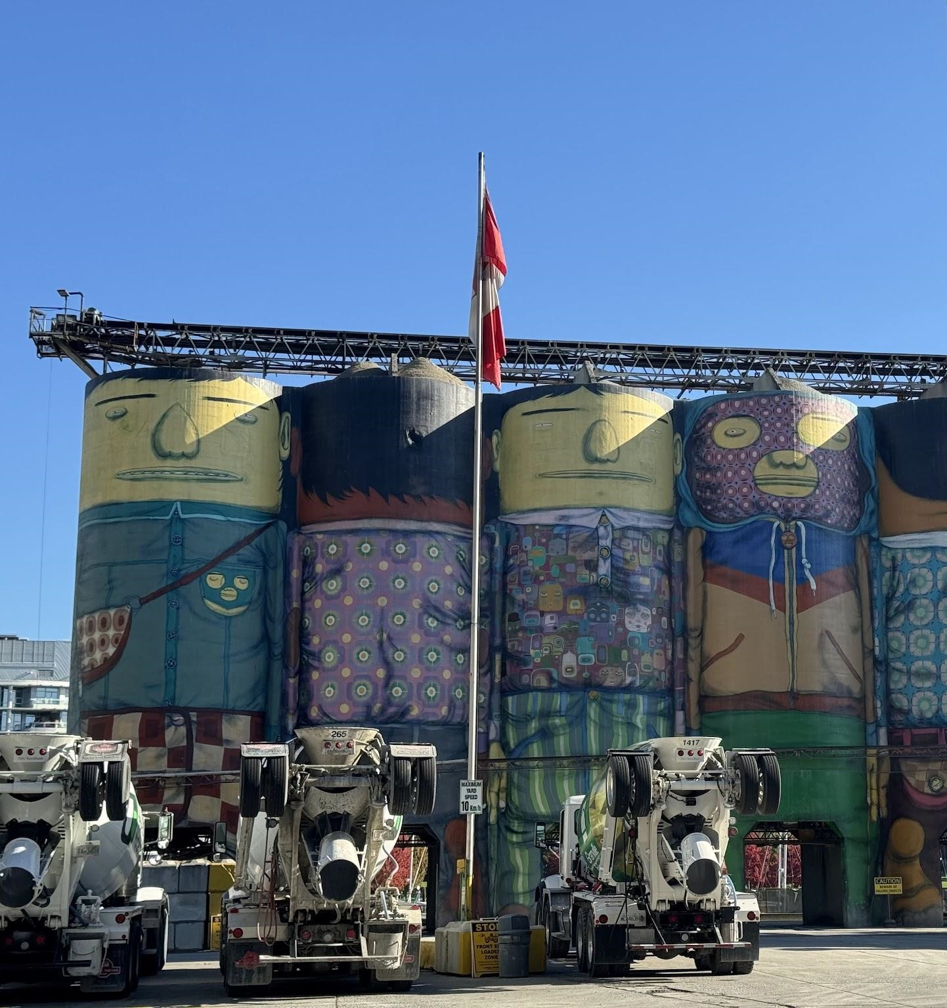
Silos
Ensure that bulk material is:
Consistent
Uncontaminated
Accessible
Photo by author, 2024
Notes:
When I started to plan this presentation, I was inspired by these Silos, which are on Granville Island in Vancouver, Canada, about a ten minute walk from my home. Painted by Brazilian Twins Gustavo and Otavio Pandolfo, OSGEMEOS, these are the Ocean Concrete Silos.
We tend to use Silo negatively when we talk about information, data, and IT, but Silos serve an incredibly useful and ancient purposes. The term is the same in Italian, French, English, because as humans we have need to keep bulk materials like concrete Accessible (So that Ocean can fill their trucks), Consistent (so that they deliver the correct grade), and Uncontaminated by water, animals, or other materials.

Slide 4
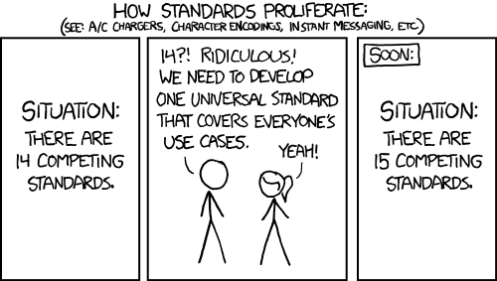
Consistent
Standardized terminology for the current context
Cell Processing Facility (CPF) Batch Process Records
Aphaeresis, Birth, and other Collection Records
Administration and Outcomes in
Hospital Electronic Medical Records (EMR)
Outcome Registry Reporting
https://xkcd.com/927/
Notes:
Sometimes we silo our data because we are solving different problems… we are describing different parts of the continuum of care or we have different national or regional requirements.

Slide 5
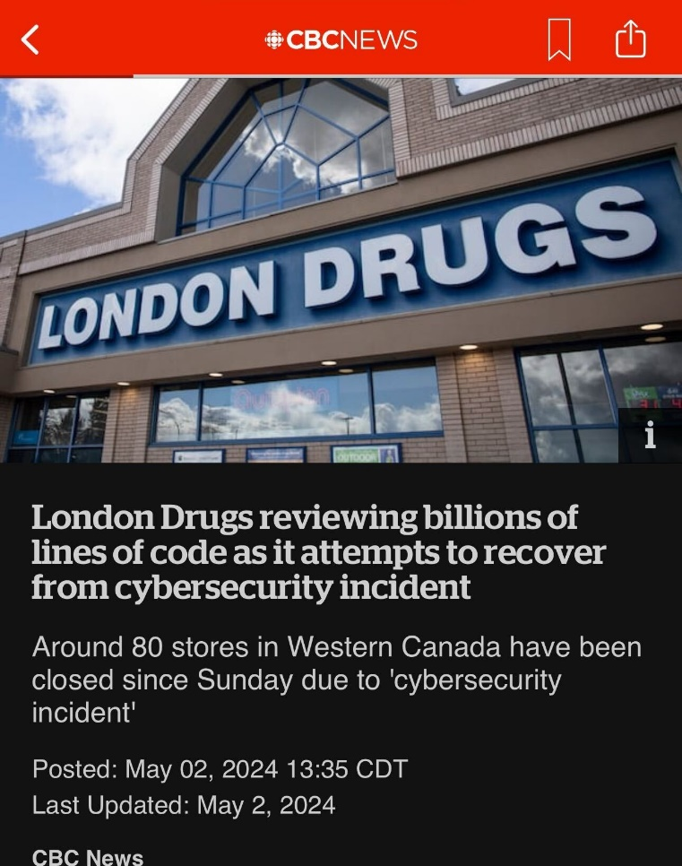
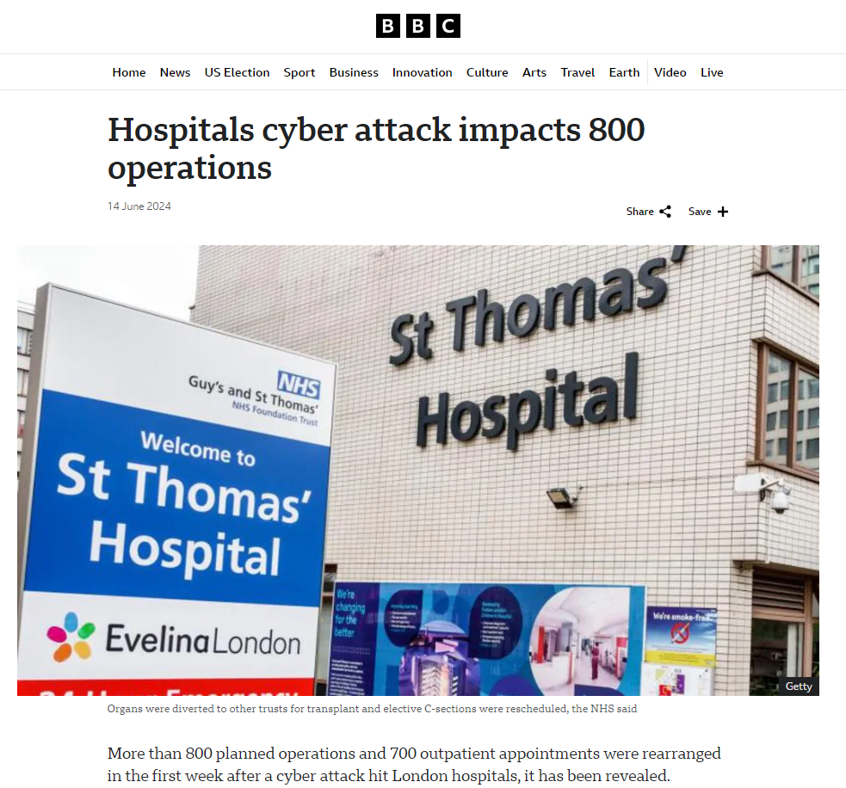
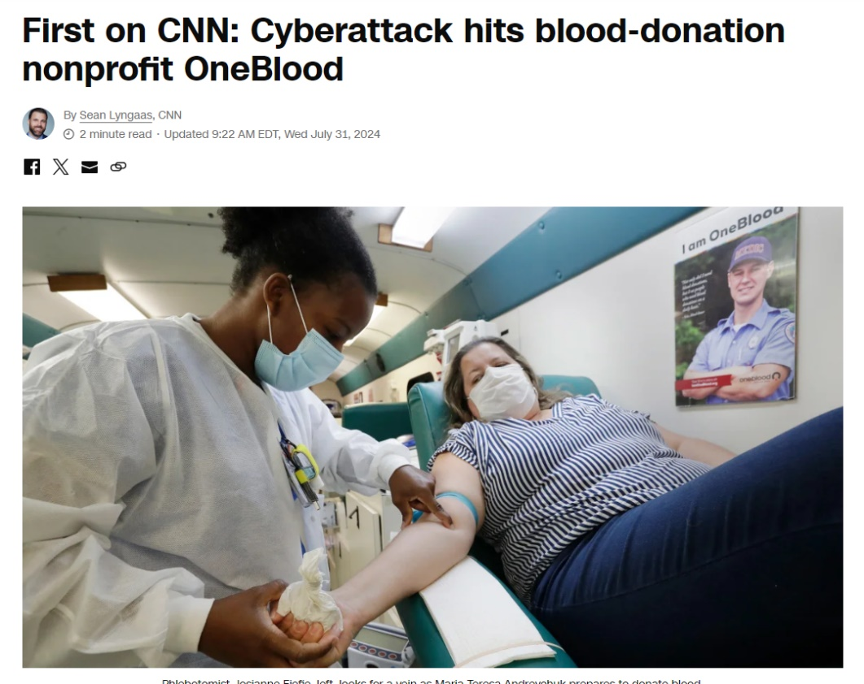
Uncontaminated
Opening our silos to the world carries real risk
Notes:
May 8, 2023
Ransomware Attack Associated With Disruptions at Adjacent Emergency Departments in the US
Christian Dameff, MD, MS^{1,2,3}; Jeffrey Tully, MD⁴; Theodore C. Chan, MD¹; et alEdward M. Castillo, PhD, MPH¹; Stefan Savage, PhD³; Patricia Maysent, MHA, MBA⁵; Thomas M. Hemmen, MD, PhD⁶; Brian J. Clay, MD^{2,5}; Christopher A. Longhurst, MD, MS^{2,5}
Author Affiliations Article Information
JAMA Netw Open. 2023;6(5):e2312270. doi:10.1001/jamanetworkopen.2023.12270
During the attack and postattack phases, significant increases in patient census, ambulance arrivals, waiting room times, patients left without being seen, total patient length of stay, county-wide emergency medical services diversion, and acute stroke care metrics were seen in the unaffected ED.
significant increase in the number of confirmed strokes diagnosed when comparing the preattack phase
So we have two competing public health challenges… but there are opportunities to leverage standards to address them.

Slide 6
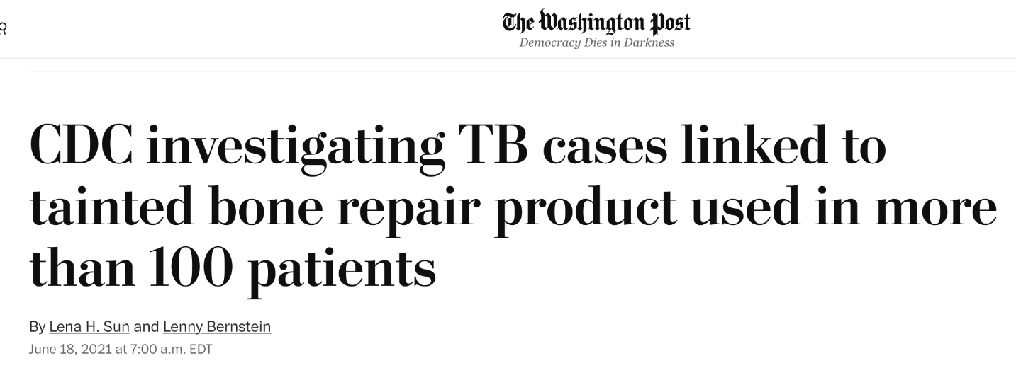
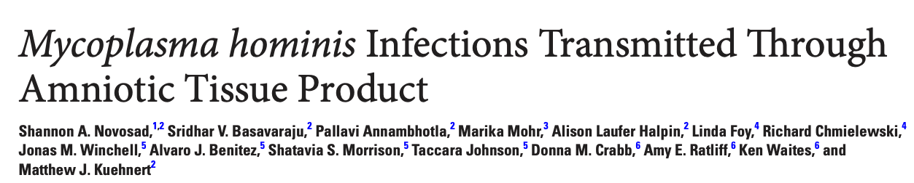
Accessible
Biovigilance ∴ Traceable MPHO ∴ Accessible Data
Notes:
Biovigilance – rapid traceability -
Twenty-seven tissue product vials from a donor were distributed to facilities in 7 states; at least 20 vials from this donor were used in 14 patients. Of these, 4 of 14 (29%) developed surgical site infections, including 2 M. hominis infections. Mycoplasma hominis was detected by culture and qPCR in 2 unused vials from the donor. Sequencing indicated >99% similarity between patient and unopened vial isolates. For 5 of 27 (19%) vials, the final disposition could not be confirmed.
In a 2014 brief in Cell and Tissue Banking, reported that “When a tissue bank issued a recall of the donated tissue…
Mean time to locate and notify the physicians who had transplanted the tissue was 13 days,
Mean time to notify, inform, and test the patients was 29 days.
Lack of common coding and nomenclature was one of the key challenges in tracking tissue to the recipient.”

Slide 7
Accessible Data
Cell Processing Facility
Transplant Program
Apheresis
Hospitals can be fragmented
Notes:
All using separate, fit-for-purposes software. They may be on separate networks. Have separate directories of users… we work with a cell processing facility in the UK where each of these is in a separate NHS trust within the shared walls of hospital. The BC Cancer Agency processes cells for Vancouver general hospital, and they are separate entities at our provincial level…
Keep in mind that this may not be a bad thing… in a cyberattack at the University of Vermont Medical Center earlier this year, the only department that didn’t go offline was a Laboratory Medicine, ironically because their systems had been walled off from everyone else because they were too old to update. That segmentation saved them.

Slide 8
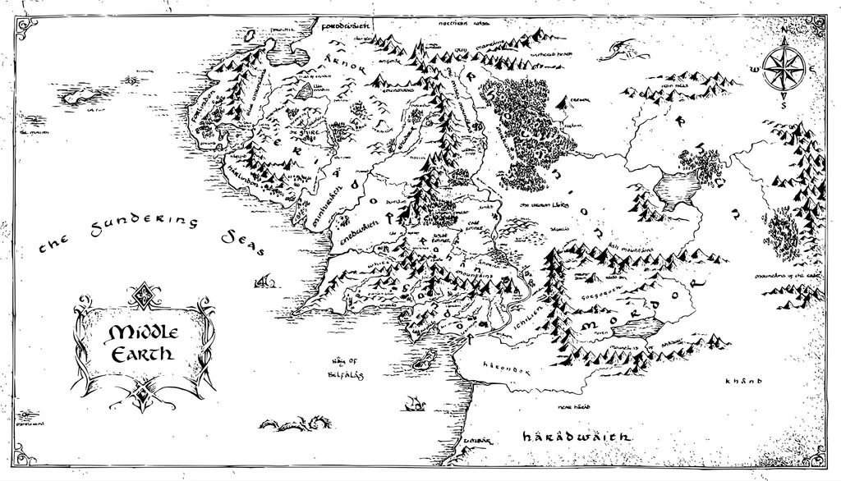



Accessible Data
MPHO are highly distributed
© 9Voltaire / Thingverse / CC-BY-4.0
Notes:
…and consider what happens when your partners are in another country… on another continent.
Vanuni 86 clinical trials
COHOPE 1000 Tx per year
by 9Voltaire is licensed under the Creative Commons - Attribution license.

Slide 9
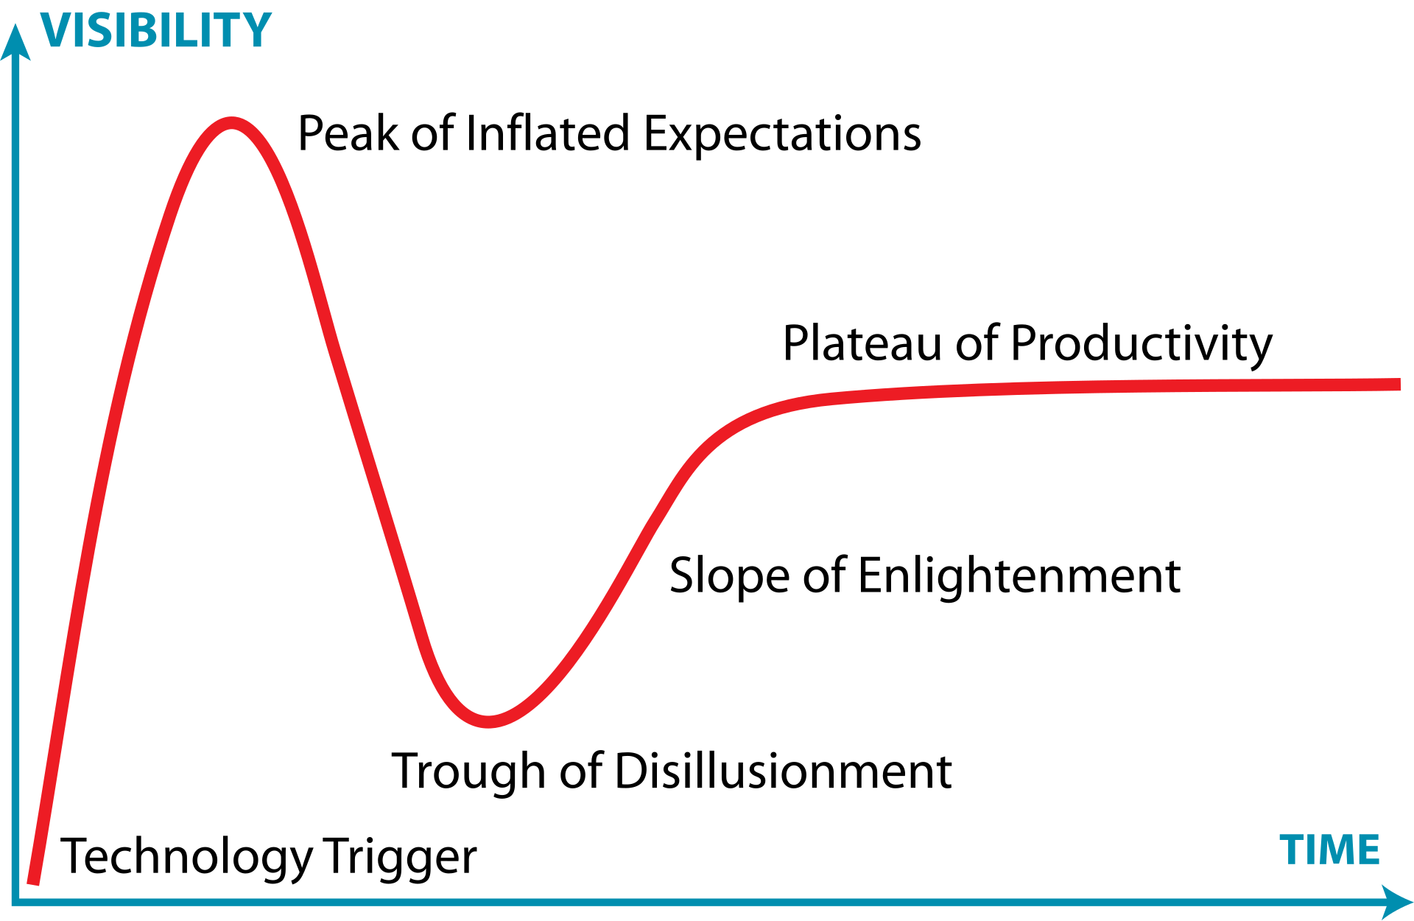
Interoperability
Safe, Viable, and Affordable?
© Jeremy Kemp / Wikimedia Commons / CC-SA-3.0 Underlying concept conceived by Gartner, Inc.
Notes:
So that’s our problem… what options are there for interoperability that will allow distinct software systems, in distinct locations, operated by unrelated groups to communicate?
Which options actually work?
Which of those options is actually affordable?
I’ve put up the Gartner Hype Cycle here because a lot of talks like mine are going to focus on technologies at the Peak of Inflated Expectations. A few years ago every technology startup, every talk at a conference, even many of my clients were talking about The Blockchain… it has been a few years since I’ve heard that the blockchain will solve our problems. Today, that’s AI. AI will solve all our problems. AI is certainly going to be something… but I’m not convinced it is the answer to how we ensure safe, secure, and consistent communication of healthcare data. For that reason, I want to focus on technologies that are either in the slope of enlightenment, or already at the plateau of productivity.
https://commons.wikimedia.org/wiki/File:Gartner_Hype_Cycle.svg

Slide 10
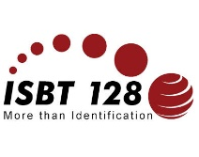


Identifiers
Labels
2D Barcodes
MPHO Unique Identifier
Chain of Identity Identifier
specialists don’t need to understand domain
IT specialists have one key to link
EHR vendors don’t need a special search
Consistent, Reliable
Flexible for various container sizes
Lower cost through commodification
Common and affordable technologies
Relatively data dense
Relatively secure
Notes:
ICCBBA and the ISBT 128 standards are definitely on that plateau. These are proven elements that are critical to any practical MPHO project.
Identifiers are the unsung hero here and we are just starting to see their impact. The MPHO Unique Identifier and Chain of Identity Identifier solve a number of problems for unique, global identification of a medical product of human origin, and they have the further virtue that a software developer doesn’t need to know anything about our field to be able to use them. We have one unique value that lets us store a record, relate it to other records, without having to understand compound ID or even really what that ID means. When used in electronic health records then a standard search function will work just fine… lots of things become cheaper and easier.
Similarly, standardized labels are a very real form of interoperability. When the elements and barcodes on that label are well defined and consistent then the cost of supporting those labels plummets. We don’t tend to think of it this way, but a label is very much a tool of interoperability.
I also want to call out 2D barcodes here. ICCBBA supports data matrix barcodes with a rich, well defined set of attributes that allows common, affordable technologies to be used to communicate a meaningful volume or product or patient data in a small space, and do so in a way that you can print and transport along with the cell product or with a person. I actually think we haven’t done enough to exploit this capability.

Slide 11

Open
Modern
Implementer Focused
REST
HTTP Actions
XML, JSON, Oauth
W3C data types
Designed in the era of Cloud, Mobile, and IoT
Extensible and Atomic
Architecture Agnostic
Common web technologies
Support from AWS,
MS Azure, SFDC, SAP, etc
Multiple open-source toolkits
Notes:
Many of you may be familiar with HL7, the de facto global standard for healthcare interoperability. You may also already be familiar with Fast Healthcare Interoperability Resources… or HL7 FHIR. Known for a lot of incendiary puns, HL7 FHIR was designed to be open, modern, and implementer focused, while also being flexible enough to address a significant number of healthcare interoperability challenges.
Specifically, it is open, using technologies that are well proven and in use every day. The ones listed here effectively address authentication, connectivity, privacy, and data transfer in ways that are not at all healthcare specific… they use technologies that we all use on the internet every day.
These are modern, designed for a world with billions of devices talking to each other and not presupposing a hospital network that is tightly controlled. Our challenge of dealing with a distributed and changeable network of organizations is no different than the challenges of having networks of software run by different providers all communicating every day.
And, most importantly in my view, they are implementer focused – the tools and skills required are cheap or free, readily available, and most developers in the world work with them already. That means a small organization like mine can afford to do this effectively and you don’t need to be a in a wealthy country or area, you don’t need to have a robust technology base, to start share data about MPHO. It is notable in my list that FHIR, a healthcare standard, already has support from Amazon web services, Microsoft’s Azure platform, Salesforce.com, and even SAP the giant in manufacturing systems… this is something that is available now, with tools that are widely available, and you can hire someone straight out of university to work with it.

Slide 12
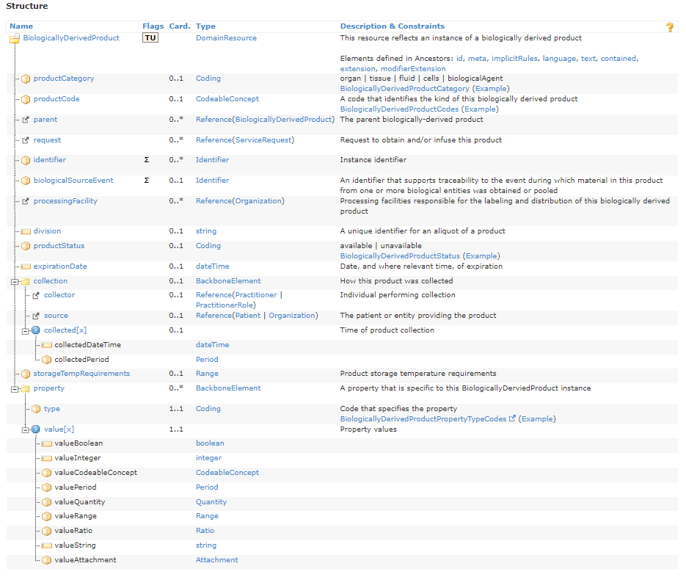
Supports MPHO
Biologically Derived Product
First standard to describe a cell based product
Extensible to support future innovation
Works with existing building blocks:
  Patient
  Service Request
  Observation
Supports MPHO Unique Identifier and
CoI Identifier today!
Notes:
It also supports medical products of human origin. In fact it is, to the best of my knowledge, the first interoperability standard that supports MPHO. Prior to this we had to treat an MPHO like it was a drug or device, which never worked very well, required negotiation every time, and therefore was expensive and time consuming. Biologically Derived Product is in FHIR R4 and later and my team are have been using it in production for years to communicate cell product data between the cell processing facility and transplant program in hospitals around the world.

Slide 13
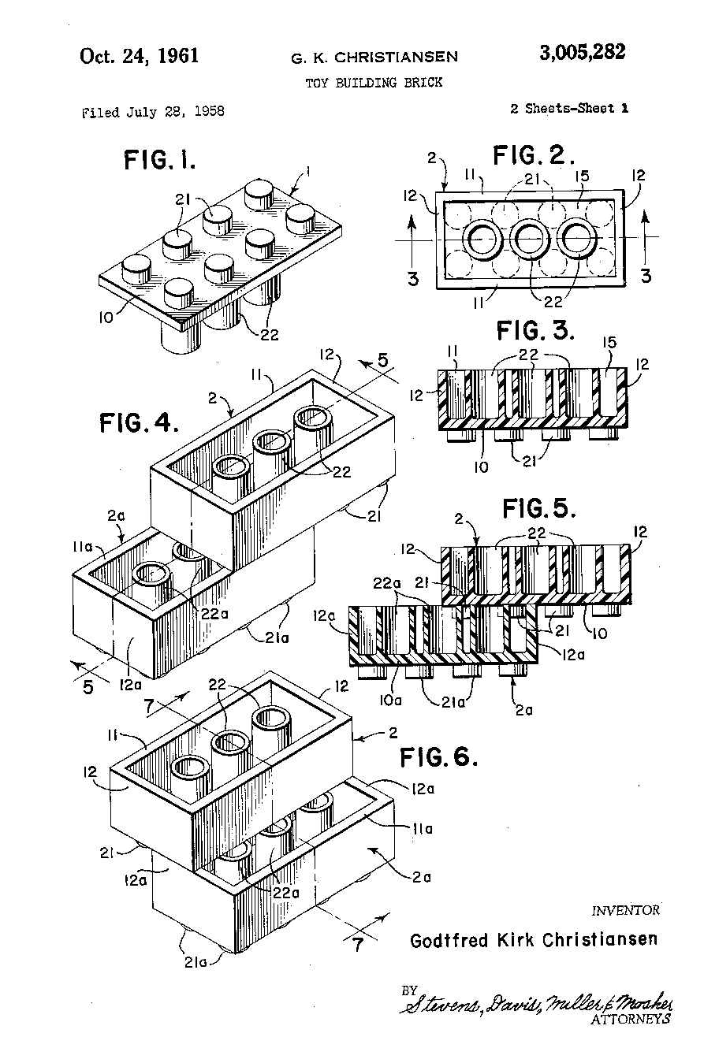
FHIR Profiles
A set of constraints on a FHIR resource represented by a structure definition.
Rules about which resource elements are used
Extensions on resource elements
Rules that create specific bindings of terminology to a resource element
Computable: Validate and check that a submitted resource conforms
Can be published to registry.fhir.org and can be discovered
Notes:
FHIR was designed such that any given element should address about 80% of the use cases with everything else handled by extension in a controlled way.
FHIR profiles allow us to take the lego block that is the Biologically Derived Product concept, and extend it with observations for things like volume, CD34 count, viability results, and more
If the Biologically Derived Product is a lego block, then the Profile is a set of instructions for creating a specific kit. I’m of the view that organizations like the Standards Coordinating Body for Gene, Cell, and Regenerative Medicines and Cell-Based Drug Discovery (SCB) can and should define profiles to support a consistent conversation between commercial cell therapy manufactuerers and their clients. Similarly, biovigilance efforts can create a profile, or even leverage the same one to support a distributed reporting model.
Ref https://www.standardscoordinatingbody.org/
Image https://patents.google.com/patent/US3005282A/en
A set of constraints on a FHIR resource represented by a structure definition.
Rules about which resource elements are used
Extensions on resource elements
Rules that create specific bindings of terminology to a resource element

Slide 14
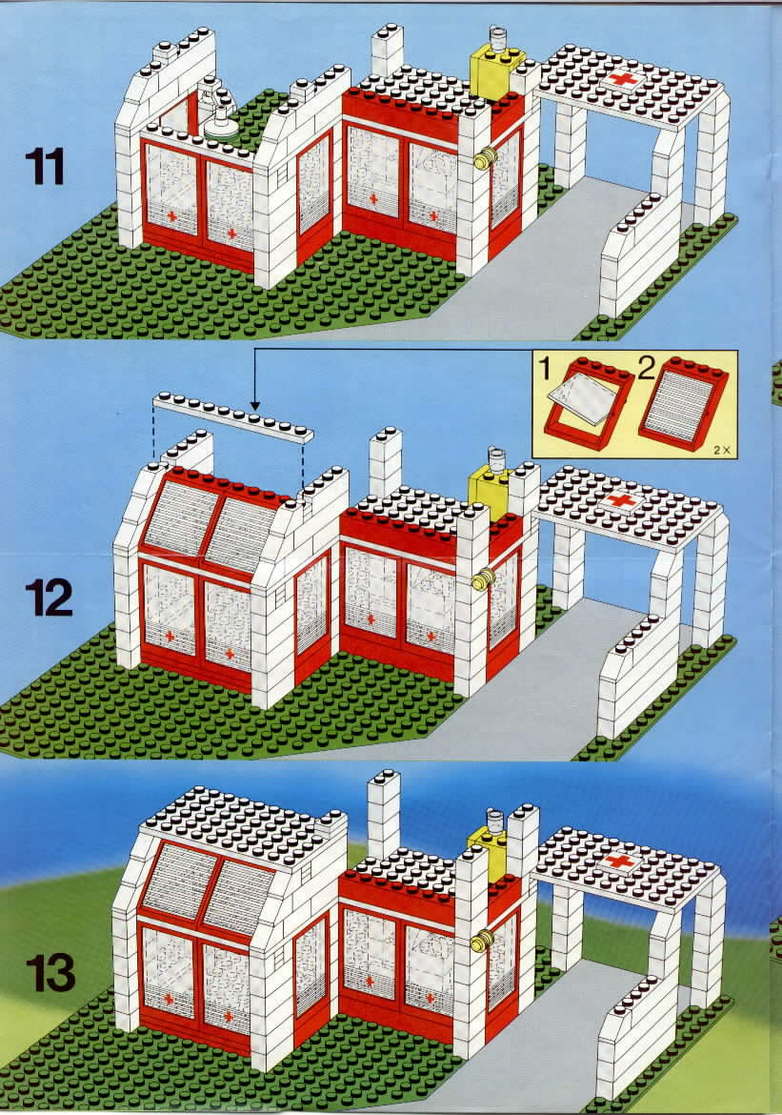
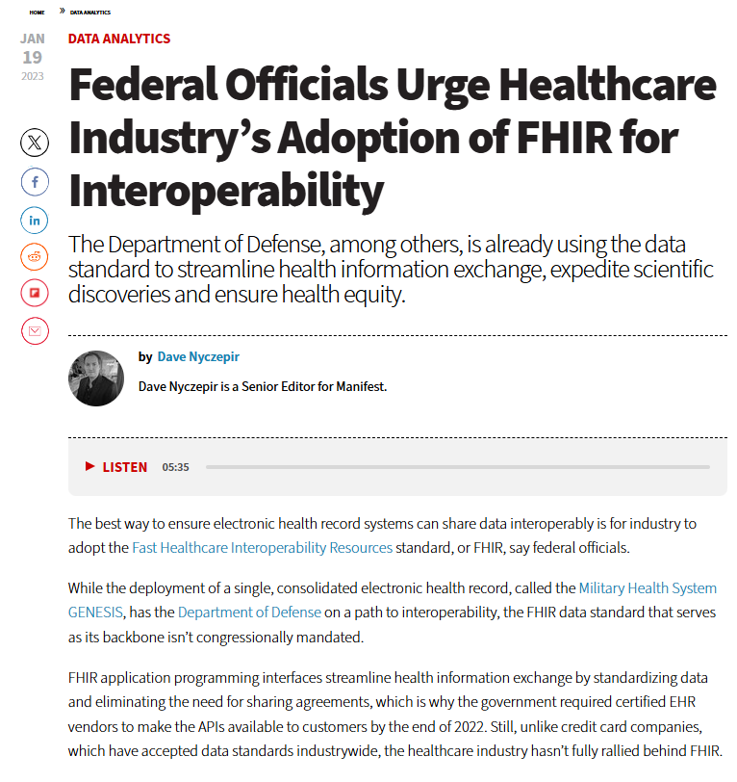
Profiles for MPHO?
Or Reuse?
Can we consider collaborating to create common profiles?
Commercial Portals
Standards Coordinating Body for Gene, Cell, and Regenerative Medicines and Cell-Based Drug Discovery (SCB)
Outcome Registries:
(CIBMTR, EBMT)
Biovigilance: US CDC, Health Canada, AABB… and many more in this room
Existing FHIR profiles can be used by anybody!
US DOD

Slide 15

We Need You!
Thank you!
Seek opportunities to influence data standards such as HL7 FHIR and the USCDI (Even if you aren’t American)
Ask developers of electronic health records to incorporate MPHO Unique Identifier and FHIR Biologically Derived Product
Notify ICCBBA of EHR/Electronic Data Standards development in your country
Contact me on LinkedIn if you’d like to discuss this further!
Notes:
Add a note on what HL7 FHIR is….
The United States Core Data for Interoperability (USCDI) is a standardized set of health data classes and constituent data elements for nationwide, interoperable health information exchange
USCDI: a standardized set of health data classes and constituent data elements for nationwide, interoperable health information exchange • USCDI Data Class: an aggregation of various data elements by a common theme or use case • USCDI Data Element: the most granular level at which a piece of data is represented in the USCDI for exchange
This page describes the 5 level FHIR maturity model for FHIR artifacts. It's based on the CMM (Capability Maturity Model) framework, and the intention is to give implementers a sense of how mature an artifact is based on the level and types of review it has been subject to. These criteria may evolve over time.
Draft
FMM0 = the artifact has been published on the current build. This level is synonymous with Draft.
STU
FMM1 = FMM0 + the artifact produces no warnings during the build process and the responsible WG has indicated that they consider the artifact substantially complete and ready for implementation. For resources, profiles and implementation guides, the FHIR Management Group has approved the underlying resource/profile/IG proposal.
FMM2 = FMM1 + the artifact has been tested and successfully supports interoperability among at least three independently developed systems leveraging most of the scope (e.g. at least 80% of the core data elements) using semi-realistic data and scenarios based on at least one of the declared scopes of the artifact (e.g. at a connectathon). These interoperability results must have been reported to and accepted by the FMG
FMM3 = FMM2 + the artifact has been verified by the work group as meeting the Conformance Resource Quality Guidelines; has been subject to a round of formal balloting; has at least 10 distinct implementer comments recorded in the tracker drawn from at least 3 organizations resulting in at least one substantive change
FMM4 = FMM3 + the artifact has been tested across its scope (see below), published in a formal publication (e.g. STU), and implemented in multiple prototype projects. As well, the responsible work group agrees the artifact is sufficiently stable to require implementer consultation for subsequent non-backward compatible changes.
FMM5 = FMM4 + the artifact has been published in two formal publication release cycles at FMM1+ (i.e. STU level) and has been implemented in at least 5 independent production systems in more than one country
Normative

