Slide 1
Tissue supply, patients and donors
How do we achieve the balance between these factors?
Session 02: Need, Safety, Risk and Availability
14. November 2024
Martin Börgel
Secretary general of WUTBA
President of EATCB
CEO of DGFG

Slide 2

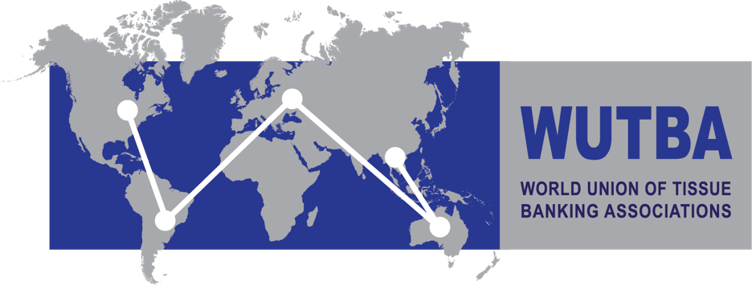

Tissue Donation – the “little sister“ of Organ Donation?
The future and emancipation of tissue donation and supply.

Slide 3
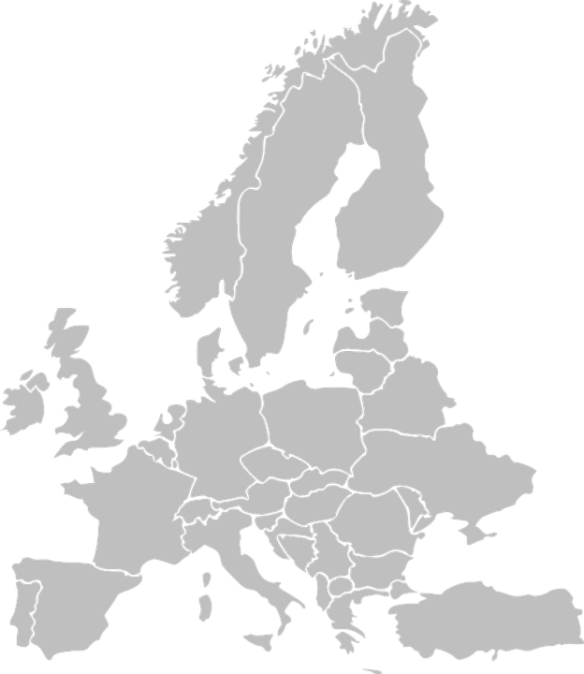
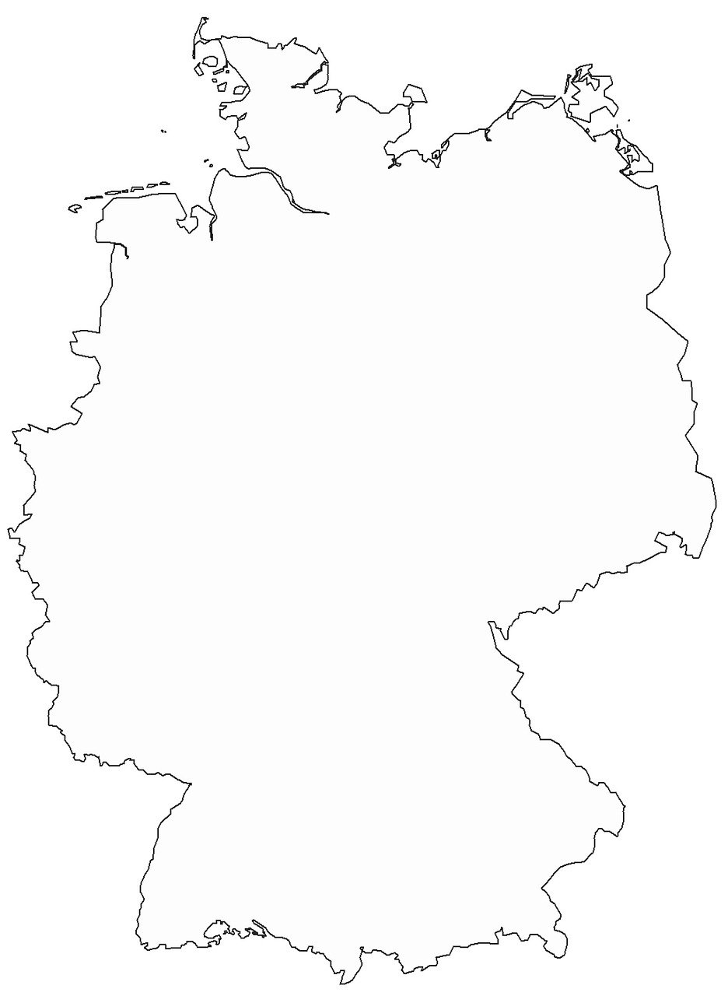

There is a lack of organ donors in Europe
European Union
Country | Organ donors per million inhabitants (2022)
Spain | 40.8
Portugal | 29.6
Belgium | 26.9
Czechia | 25
France | 24.7
Slovenia | 19.5
Italy | 24.1
Germany
83,8 million inhabitants (2022)
869 organ donors (2022)
= 10,3 organ donors per 1 million inhabitants
Notes:
Quelle: https://www.statista.com/statistics/537908/deceased-organ-donor-rate-in-europe/
Quelle: https://www.organspende-info.de/zahlen-und-fakten/statistiken/
Einwohnerzahlen aus Wikipedia: Deutschland 84.669.326, Stand 32.12.2023,
EU: 448,4 Mio. ( Stand 1.1.2023),
Sterbefälle in Deutschland 2023: 1 028 206, https://de.statista.com/statistik/daten/studie/156902/umfrage/sterbefaelle-in-deutschland/
Aus DSO-Jahresbericht 2023: 965 Menschen haben in 2023 nach ihrem Tod ein oder mehrere Organe gespendet. Das sind 11 Prozent mehr als noch im Jahr zuvor.
Mit diesem Plus konnten wir gerade einmal den unerwarteten Rückgang in 2022 kompensieren. Wir sind damit so gesehen wieder auf dem Niveau, auf dem wir in den Jahren seit 2018 verweilen.
Angesichts von rund 8.400 schwer kranken Patientinnen und Patienten auf den Wartelisten für ein Spenderorgan sind diese Zahlen viel zu niedrig.
Deutschland: 11,6 Mio donors pro 1 Mio / Aus Organ donation and transplantation: Facts, figures and European Union action (2020)
https://www.europarl.europa.eu/RegData/etudes/BRIE/2020/649363/EPRS_BRI(2020)649363_EN.pdf
Actual deceased organ donors 2018 (annual rate per million population)
EU-Zahl 11.324 Organspender in 2028: https://www.europarl.europa.eu/EPRS/Newsletter_Transplant_2019.pdf
Germany
84,67 million inhabitants (2023, source wikipedia)
1,03 million deaths (2023, source de.statistica.com)
965 organ donors in 2023 (source DSO annual report)
Ca. 11 organ donors per 1 million inhabitants in 2018 (including brain death and cardiac death, source europarl.europa.eu)
European Union
448 million inhabitants (2023, source wikipedia)
4,8 million deaths (2023 , source de.statistica.com)
11,325 actual deceased organ donors in 2018 (including brain death and cardiac deat, europarl.europa.eu/EPRS/Newsletter_Transplant)

Slide 4


Tissue donation as “little sister”: an additional field in the difficult terrain of Organ donation
Identification of donors
Infrastructure
Limited resources at hospital + extra work
Insecurity: Brain death
poor press
Training
Limited Donor numbers
Data Protection
Time pressure
Logistics
Political Overload

Slide 5
There is no lack of possible Tissue donors in Europe
Germany
84,6 million inhabitants (2023)
1,03 million deaths (2023)
Ca. 12.100 death per 1 million inhabitants
(Data from 2023)
European Union
448 million inhabitants (2023)
4,8 million deaths (2023)
Ca. 10.800 death per 1 million inhabitants
(Data from 2023)
Notes:
Einwohnerzahlen aus Wikipedia: Deutschland 84.669.326, Stand 32.12.2023,
EU: 448,4 Mio. ( Stand 1.1.2023),
Sterbefälle in Deutschland 2023: 1 028 206, https://de.statista.com/statistik/daten/studie/156902/umfrage/sterbefaelle-in-deutschland/
Aus DSO-Jahresbericht 2023: 965 Menschen haben in 2023 nach ihrem Tod ein oder mehrere Organe gespendet. Das sind 11 Prozent mehr als noch im Jahr zuvor.
Mit diesem Plus konnten wir gerade einmal den unerwarteten Rückgang in 2022 kompensieren. Wir sind damit so gesehen wieder auf dem Niveau, auf dem wir in den Jahren seit 2018 verweilen.
Angesichts von rund 8.400 schwer kranken Patientinnen und Patienten auf den Wartelisten für ein Spenderorgan sind diese Zahlen viel zu niedrig.
Deutschland: 11,6 Mio donors pro 1 Mio / Aus Organ donation and transplantation: Facts, figures and European Union action (2020)
https://www.europarl.europa.eu/RegData/etudes/BRIE/2020/649363/EPRS_BRI(2020)649363_EN.pdf
Actual deceased organ donors 2018 (annual rate per million population)
EU-Zahl 11.324 Organspender in 2028: https://www.europarl.europa.eu/EPRS/Newsletter_Transplant_2019.pdf
Germany
84,67 million inhabitants (2023, source wikipedia)
1,03 million deaths (2023, source de.statistica.com)
965 organ donors in 2023 (source DSO annual report)
Ca. 11 organ donors per 1 million inhabitants in 2018 (including brain death and cardiac death, source europarl.europa.eu)
European Union
448 million inhabitants (2023, source wikipedia)
4,8 million deaths (2023, source de.statistica.com)
11,325 actual deceased organ donors in 2018 (including brain death and cardiac deat, europarl.europa.eu/EPRS/Newsletter_Transplant)

Slide 6
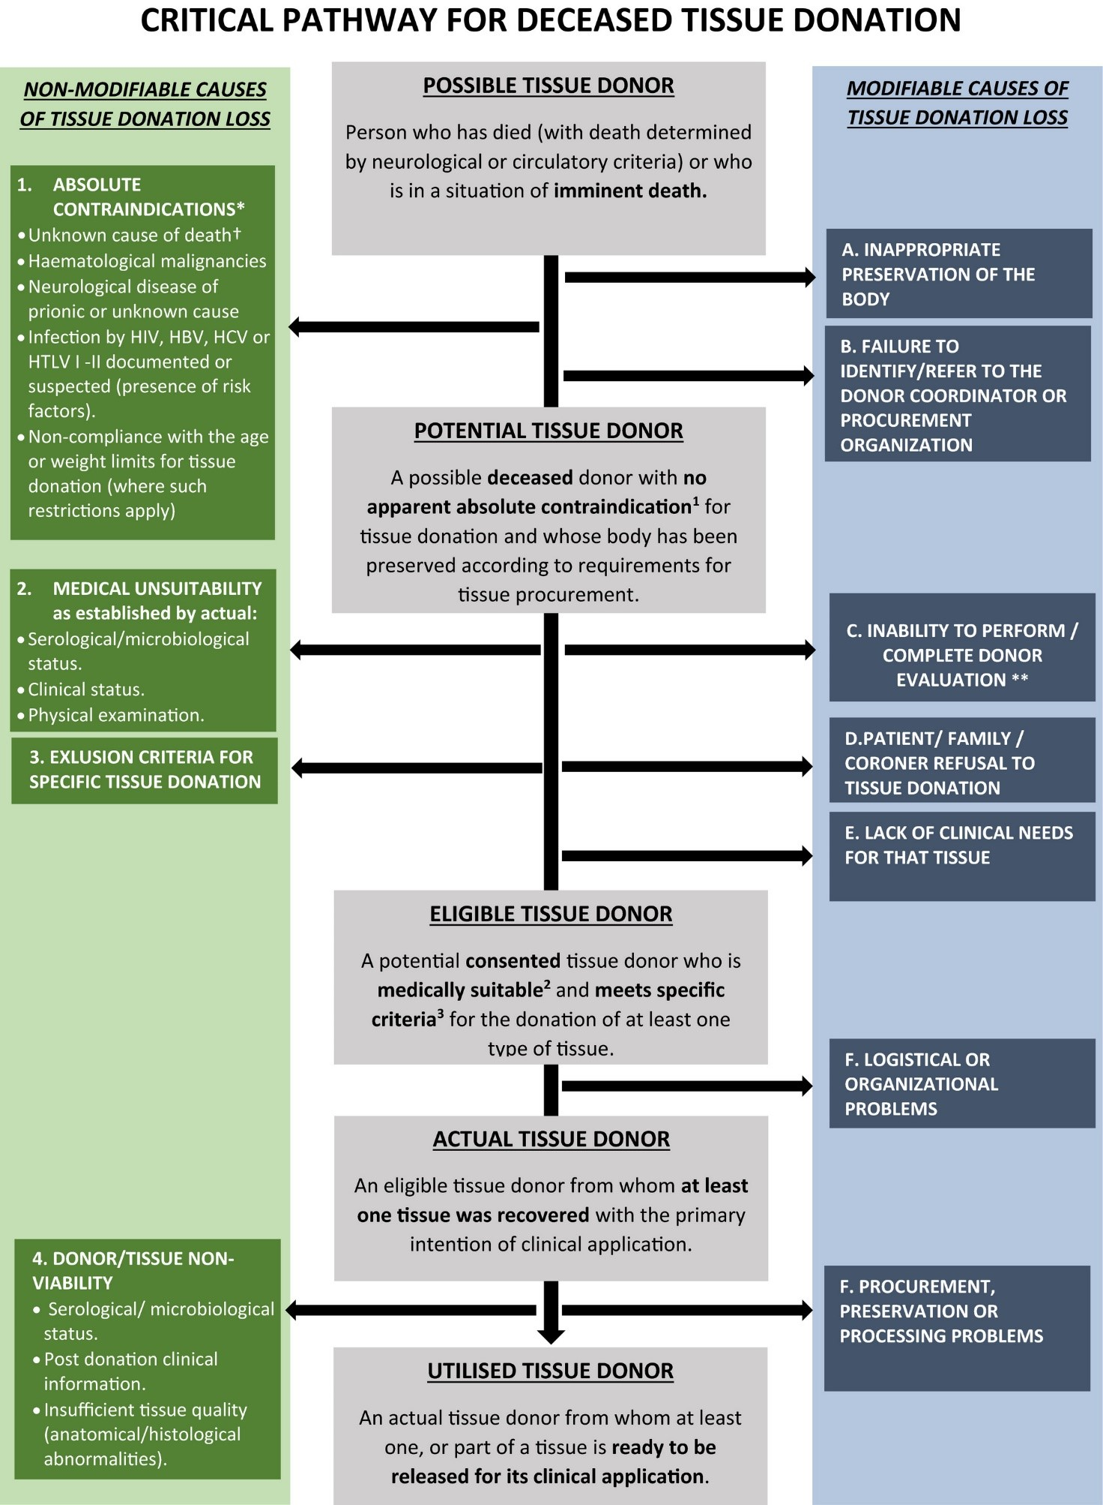
Example EU: deaths in 2021
NON-MODIFIABLE
causes of tissue donation loss
MODIFIABLE
causes of tissue donation loss
5.3000.000 deaths
50% exclusion due to:
Absolute contra indications
Medical unsuitability
Non-Viability of donor or tissue
2.650.000
Consent rate in Opt-in /
feasibility in Opt-out
40% from
2.650.000
2.650.000
1.060.000
Eligible Donors per year
Sandiumenge et al., Transpl Int., 2021 May, doi: 10.1111/tri.13841.
Notes:
'Critical pathway for deceased tissue donation', developed by the European Committee on Organ Transplantation of the Council of Europe (CD-P-TO).
Sandiumenge A, Domínguez-Gil B, Pont T, Sánchez Ibáñez J, Chandrasekar A, Bokhorst A, Filipe Severino P, Oliveira J, Boergel M, Ponzin D, Trias E; European Committee on Organ Transplantation of the Council of Europe (CD-P-TO). Critical pathway for deceased tissue donation: a novel adaptative European systematic approach. Transpl Int. 2021 May;34(5):865-871. doi: 10.1111/tri.13841. Epub 2021 Mar 13. PMID: 33559299; PMCID: PMC8251811]

Slide 7
Tissue Donation – an easier terrain
More time
In all processes
Less extra work for physicians
Enough possible donors
Independent from hosptial resources
Not promoted for commercial purposes
No unsecurity of death
Transparent legal basis
Notes:
SoHO Regulation 17.07.204. whereas (54) „… Use of SoHO in humans is not promoted for commercial purposes…“

Slide 8




There is a lack of organization of tissue donation in Europe
Over time requirements changed, but not the structure
No reimbursement of efforts and investments
till 2024
…
ECDC
EDQM Guide 1st to 5th edition
2004
Historic structure
1-3 persons – in-house supply
New EU SoHO Regulation, 2024
National Laws

Slide 9
Time for emancipation and independence of tissue donation
Highlight, enforce and shape the processes of tissue donation independently instead of overloading its processes with too complex concepts from organ donation.
…
Future structure, networking, exchance
Towards independence
Lobbying,
system adaption
2024
Professional modern management of HR, Training, create sustainable structures
Customize the Regulation framework for tissues, understand the differences and separate from Organs
Process optimization, responsibility for economics and effectivness

Slide 10
Most tissues are donated and transplanted in the same country!
Before we organize European exchange, we must organize self-sufficiency in every country and in Europe in total.
The Tissue Bank sector is mainly driven by small and medium TEs
Donation
Processing
Distribution/Allocation
Identification of donors,
Data protection,
Training
Logistic,
Infrastructure,
Resources
Exchance of tissues,
Innovation

Slide 11



Utilize the national and regional landscape (EATCB, EEBA, …)
Support local / regional / national engagement
Create a program supporting small and medium entities
Distribution
Donation
Exchange of tissues, Innovation
Processing
Logistic, Infrastructure, Resources
Identification of donors, Data protection, Training

Slide 12

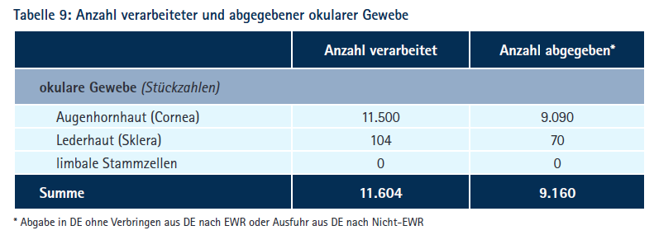

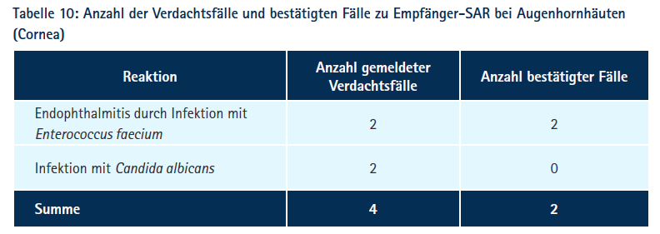
More regulation = better safety of tissue transplants?
Tissue Vigilance Report 2021
„In the 2021 reporting year, there were no deaths with a confirmed causal relationship to tissue donation or tissue transplantation.“
9.160 cornea and sclera distributed for transplantation
Only 4 reported suspected cases
Only 2 confirmed SAR (serious adverse reaction) on the recipient side
Notes:
Gewebevigilanzbericht PEI 2021: The Tissue Vigilance Report covers all spontaneous reports received in the past year of severe adverse reactions occurring in recipients in connection with the transplantation of human tissue preparations. All severe adverse reactions in tissue donors and all serious incidents involving the processing of human tissues are listed as well.
https://www.pei.de/EN/newsroom/mandatory-reports/tissue-vigilance-reports/tissue-vigilance-reports-node.html

Slide 13
One source, two ethics.
Organ
donation and transplantation
altruistic donation
focus on the target, to do the
most possible help for a recipient
SoHO
donation and use
altruistic donation
focus on maximal safety
Promoting accessibility by accepting
insecurities
borderline organs
risk of rejection
Accept no accessibility in favour of maximum safety.
Ethics by duty: following the single principle that it must be save, even if no access means more harm to health
Utilitarianism: following what is best and most responsible for the majority

Slide 14
Is it a market?
Regulated “market” organ Tx
limited resources organ donation
altruistic donation
no upscaling possible
no substitute
Open “market” SoHO
unlimited resources
altruistic donation
upscaling possible
substitutes partially available
Nationally regulated by Transplant Act! Including costs and accessibility!
Nationally regulated by several ordinances!
Based on Med. Product, ATMP, … act!
Not included cost and accessibility!
Lack of donors defines
lack of access.
Unattainable targets define lack of access.

Slide 15
More regulation = tissues are super safe, but not available
Tissue Vigilance Report 2021
It is the responsibility of the Regulatory bodies if patients have access to transplants.
Everything you do is a decision, even if you don't decide anything.
What is an adequate balance between safety and access?
New risk-based approach in SoHO-Regulation
Notes:
Gewebevigilanzbericht PEI 2021: The Tissue Vigilance Report covers all spontaneous reports received in the past year of severe adverse reactions occurring in recipients in connection with the transplantation of human tissue preparations. All severe adverse reactions in tissue donors and all serious incidents involving the processing of human tissues are listed as well.
https://www.pei.de/EN/newsroom/mandatory-reports/tissue-vigilance-reports/tissue-vigilance-reports-node.html

Slide 16
Making innovation
… affordable for health care systems
… accessible for patients
revise definitions and regulatory framework
guarantee transparency in costs, pricing and profit from SoHO-derived innovative therapies
think about “Service providers”
regulations other than market authorization should also be supported (e.g. the exemption of hospitals in the EU)
Donation and receipt belong together!
The community in which the donation is made should also be one of the preferred recipients, regardless of the price.
Ownership and power of disposal are also important for SoHO.
SoHO is not lacking in donors, but in innovative regulations and financing to ensure a sustainable development and to make SoHO affordable for the health care systems and accessible for patients!

Slide 17



Welcome to the valley of lifeless ideas
Innovation in Financing and Regulation
We need a Sherpa Modell!
Privately
invested
money
Spending tax money
basic research
industry
Sustainable, university-affiliated companies that work independently but also with industry and go beyond pure basic research into applications
Research Lab
Working Groups
Scientific exchange
Clinical study
Exemption for hospitals
Tax-financed
public & university driven
research
Patents, upscaling
industrial standards
Investment
Private interest financing
finalization

Slide 18


We can do better…
Initiative to support donation
Innovative models to collaborate
Avoid dependency for easy available transplants
Create resilience by networking
Import of needed high end transplants/products
No undermining of local and national initiatives and infrastructure by „price“
Donation
Distribution/Allocation
Processing
Innovative models of collaboration public/private/non-profit/profit

Slide 19



Recommandations of WP 3
The complementary capabilities, experience and infrastructure of public and private entities, as well as cooperation between non-profit and for-profit organizatons, are crucial for the development of SoHO-derived commercial products.
We can do better…
Competent authorities worldwide should take all necessary steps to guarantee transparency in costs, pricing and profit from SoHO-derived innovative therapies by companies as well as regulate fees and profitability to make them affordable and accessible to patients while maintaining public trust in altruistic SoHO donation.
Socially responsible public-private partnerships that ensure citizens‘ access to SoHO-based
therapies should be promoted.
transparency in costs, pricing and profit from SoHO-derived innovative therapies by companies to make them affordable and accessible to patients
Donation
Distribution/Allocation
Processing
innovative models of collaboration public/private/non-profit/profit
/hospital exemption

Slide 20

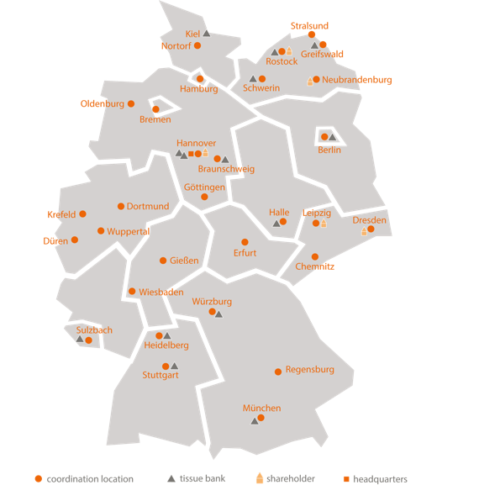







Thank you for your
attention!

